Slide 1
Rendering a picture in 3ds Max using the Arnold renderer:
The LEGO man visits the photo studio
Tomas Benzon, DTU/MEK, March 2018

Slide 2
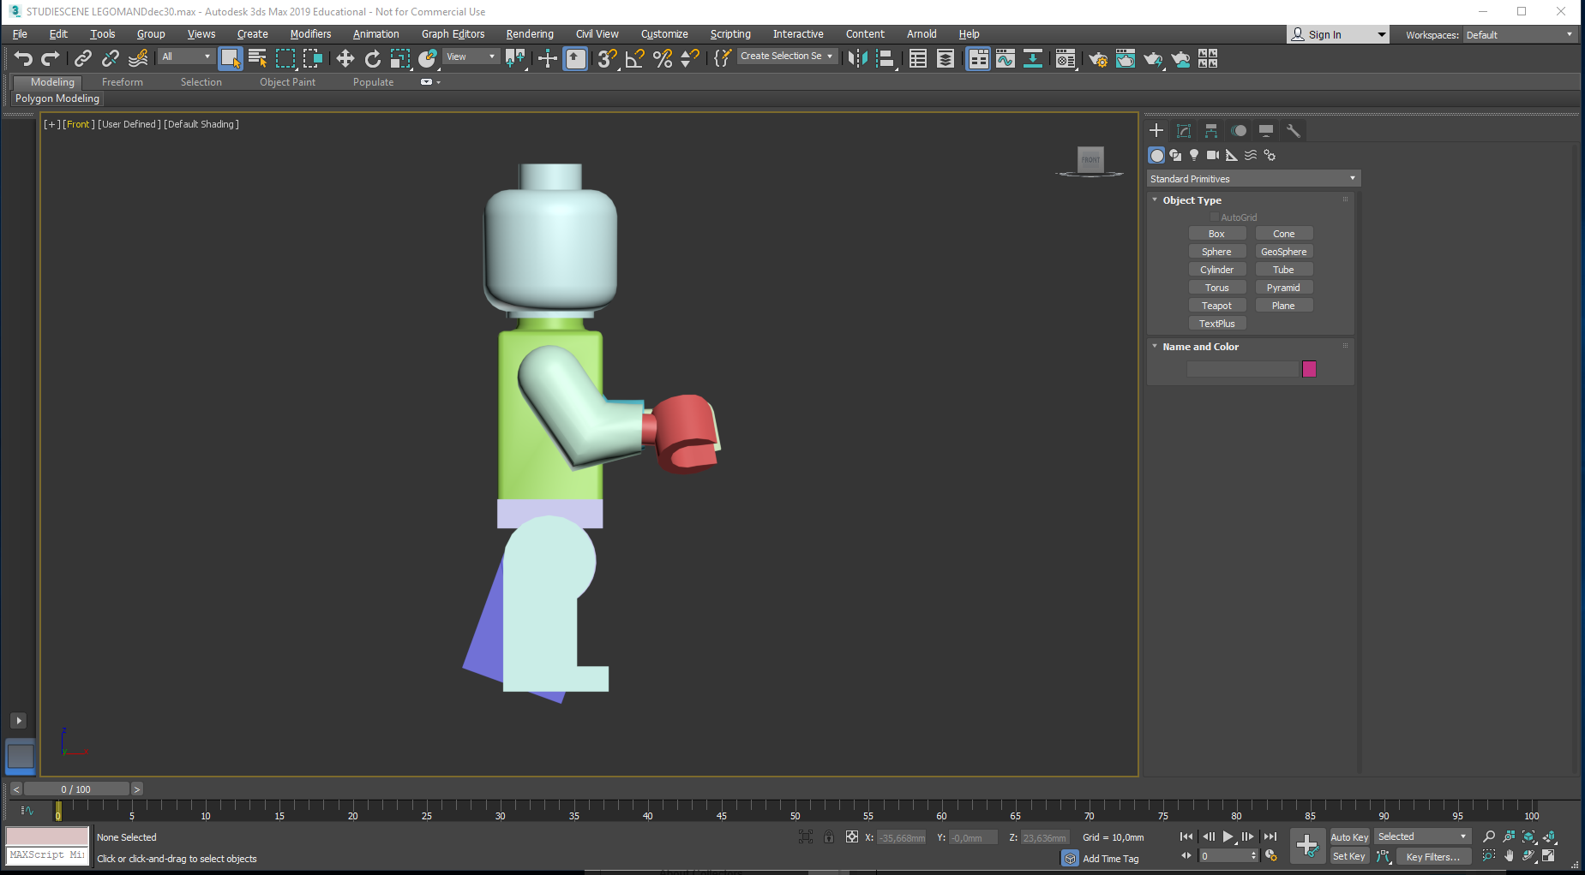
This tutorial is a continuation of Translation of the LEGO man, (describing how to import him to 3ds Max as a group of individual parts, allowing you to animate him).
Here I will demonstrate how to arrange lights and create images with realistic looking shadows.

Slide 3
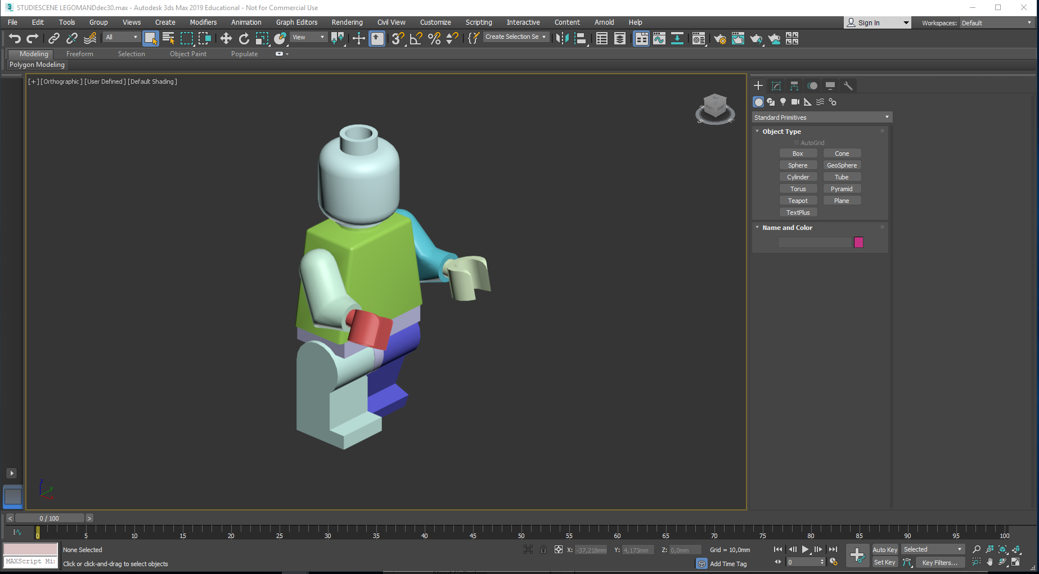
Before starting I will do a checkup on a few settings in 3ds Max…

Slide 4
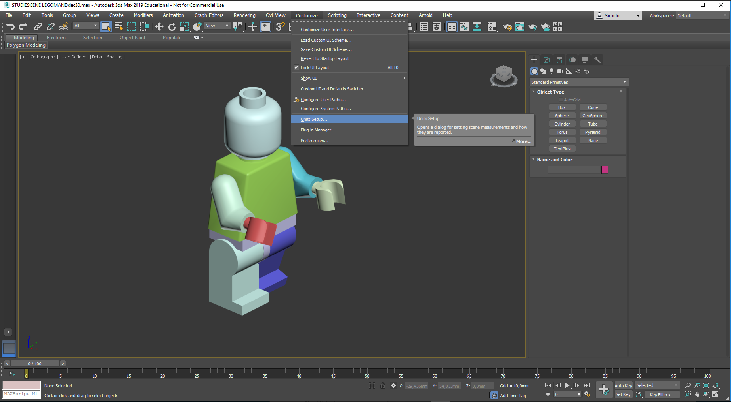
Before starting I will do a checkup on a few settings in 3ds Max… Are we working in millimeters? This is checked by entering Customize / Units Setup…

Slide 5
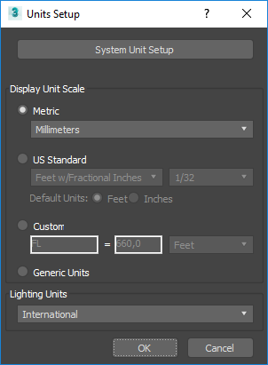
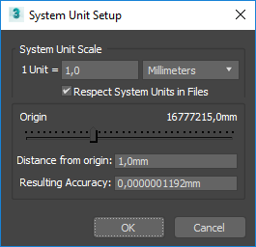
Click here…
Before starting I will do a checkup on a few settings in Max… Are we working in millimeters? This is checked by entering Customize / Units Setup…
System Unit Setup opens…
Millimeters here,
No checkmark here…
(Assuming that Mr.
LEGO was initially
created in mm…)
In the Units Setup dialogue choose:
Metric/Millimeters
Close both boxes
with an OK. (No scaling errors today…)
Enter System Units Setup.

Slide 6
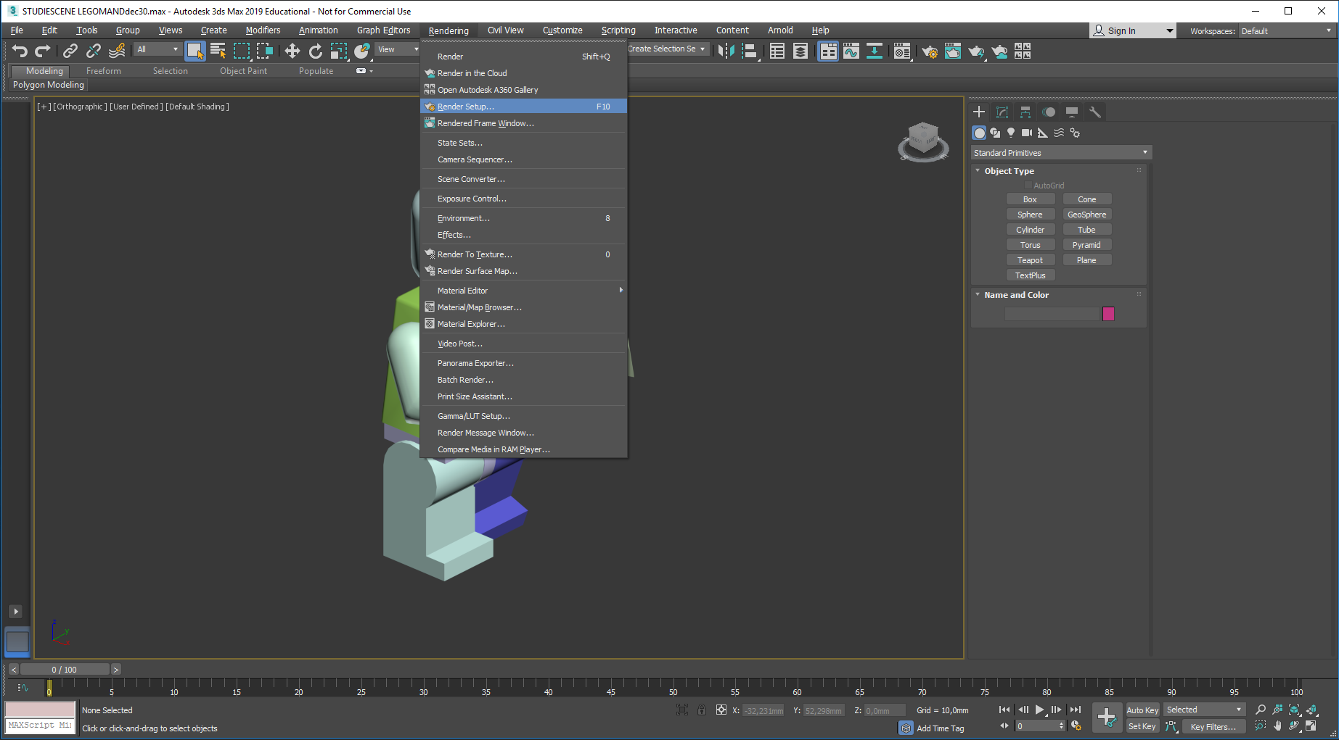
We will now prepare the scene, which will eventually allow us to create an image (a rendering) of mr. Lego.
Click Rendering and Render Setup…

Slide 7
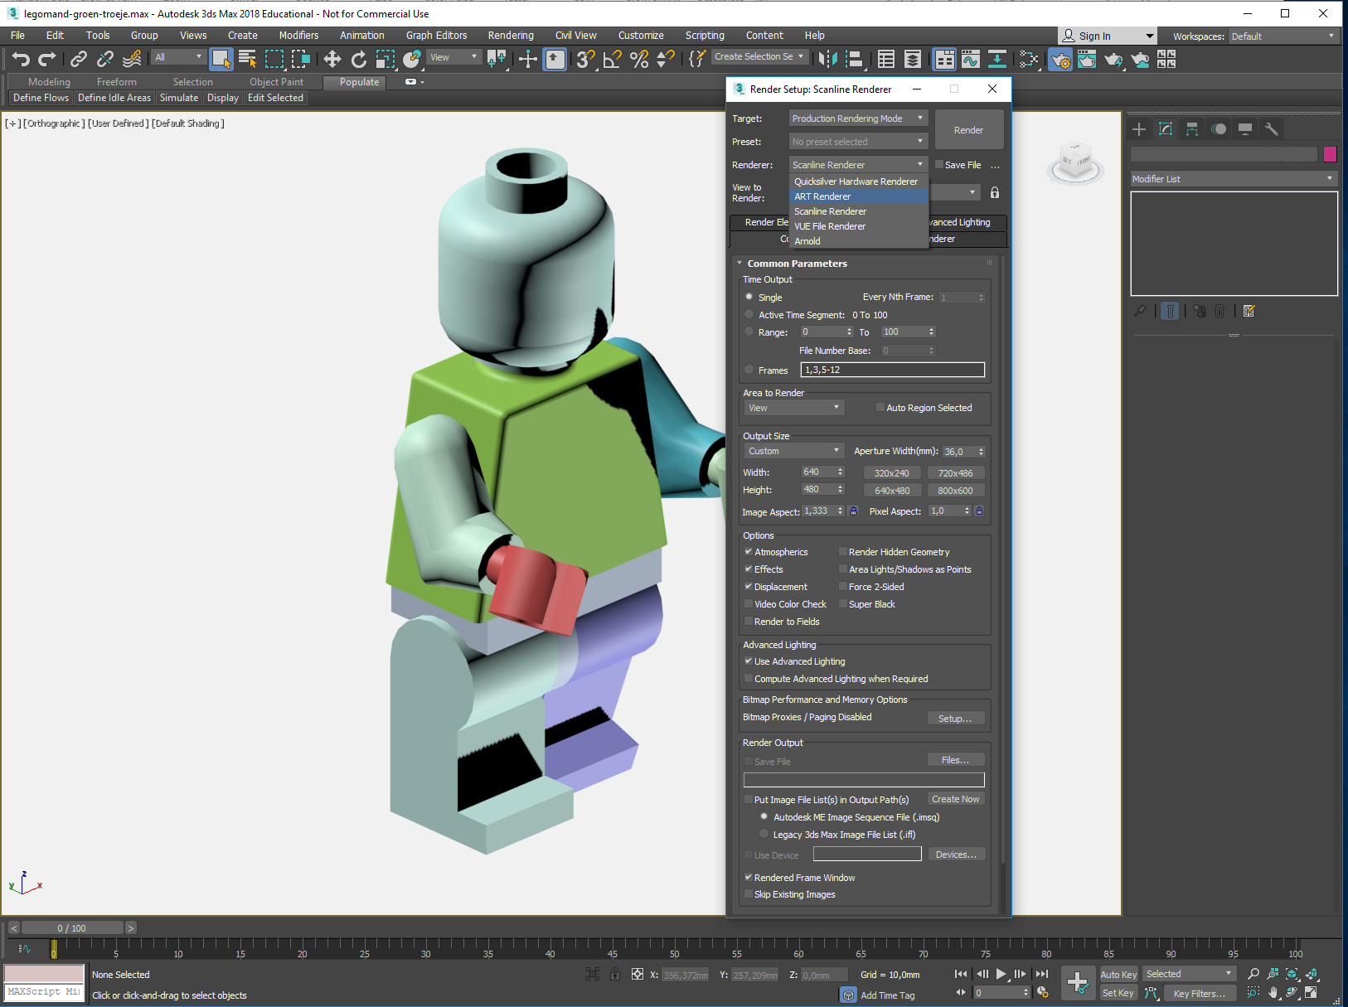
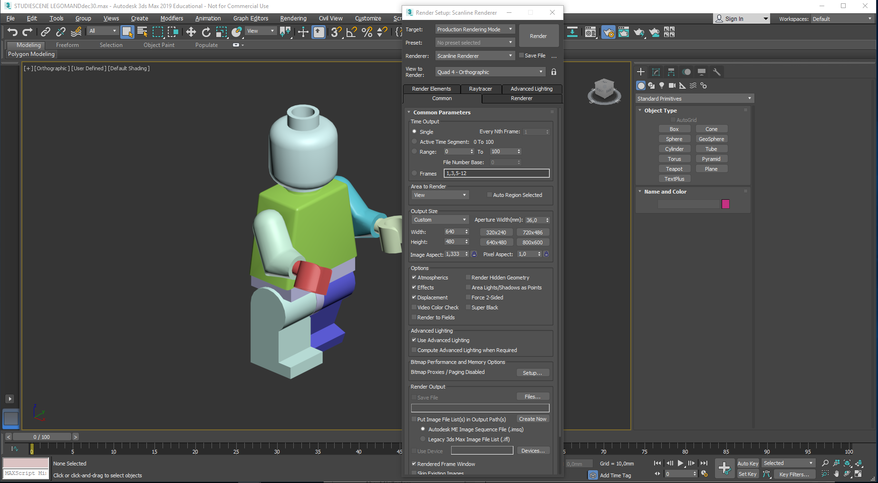
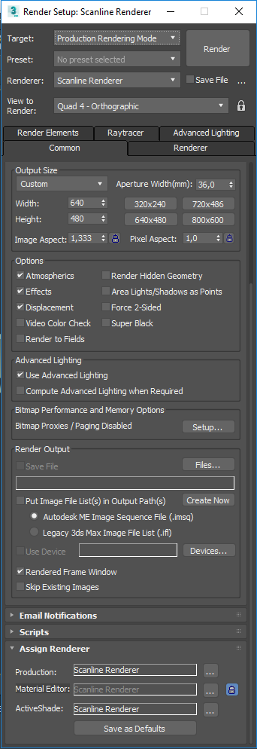
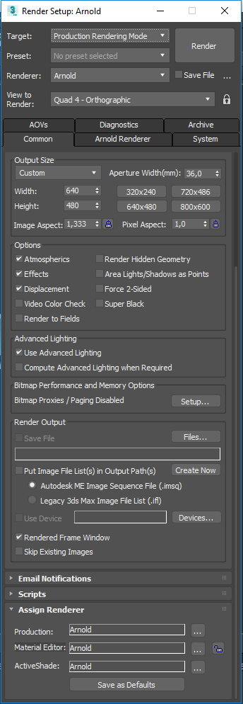
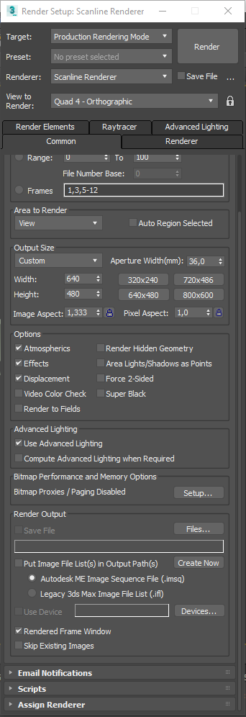
Render Setup opens. In Max you can choose between multible Render Engines. In this Demo I will use the ARNOLD renderer
ARNOLD is now active. Close the Render Setup box here
The ARNOLD renderer is selected this way:
1) Check that the Common pane is the active one…
2) Scroll to the bottom of the Render Setup dialogue…
3) Click the Assign Renderer entry…
4) Unlock the small padlock…
5) Click on the three small dots and change Scanline to Arnold…Repeat for the other two, ending up with 3 x Arnold…lock the padlock once again

Slide 8
-
All modern renderers work this way: a light source (with a defined size and shape) radiates simulated photons out into the Scene (The scene consists of any collection of objects you see on the screen in Max).
The photons hit the nearby objects and are mirrored – they ”bounce”, (now as reflected light) and this is repeated on and on.
The number of bounces determines the image quality – and has a big impact on the time spent when generating (Rendering) the image.
It is important for the succes of the rendering that all the photons hit scene objects and are unable to ”escape into abyss ”…
It is therefore a good idea to build a room – a photo studio – to contain the photons and delimit the scene, which in this case will consist of:
The motif (the LEGO man),
Surroundings (The inner walls of the studio),
A light source,
A camera…
We will start by building the studio…

Slide 9
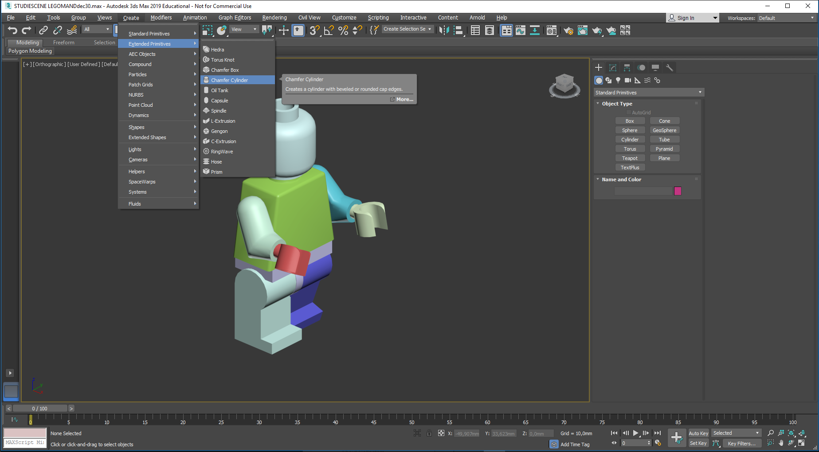
The studio is a chamfered cylinder (with rounded edges, avoiding harsh shadows) in a appropriate size…

Slide 10
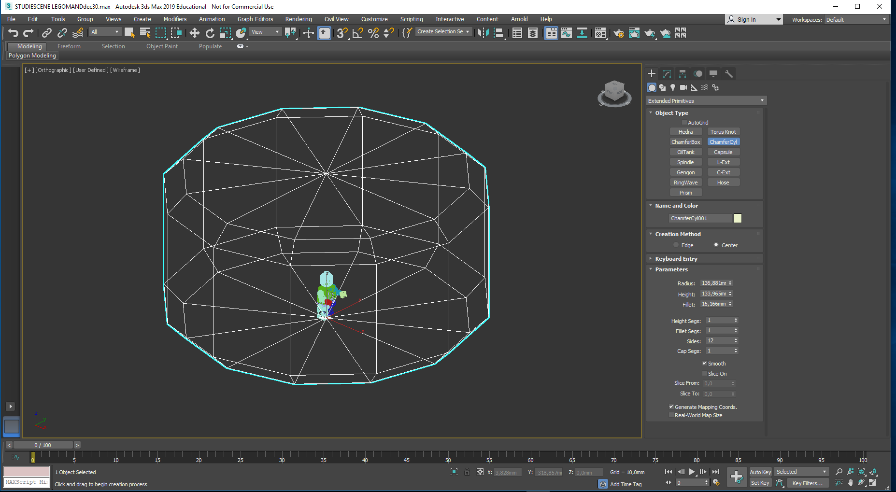
Shown here is the first attempt:
Default settings produces a ”cylinder” with only 12 sides and a sharp chamfer
Size of the cylinder is right, but these Parameters need adjustment:
Fillet segments: 1…to be increased to 4
Sides: 12…to be increased to 48
The fillet itself could be increased a bit

Slide 11
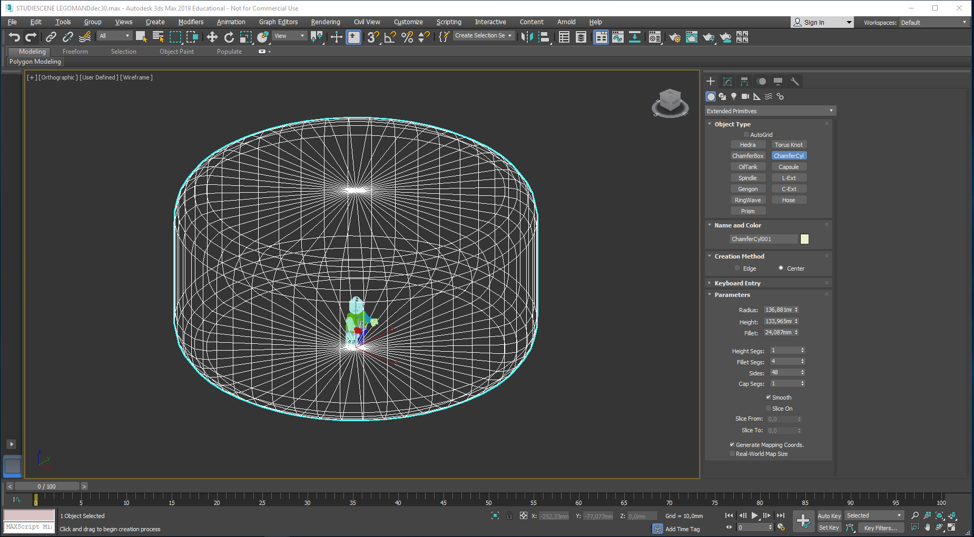
The studio would end up looking like this:

Slide 12
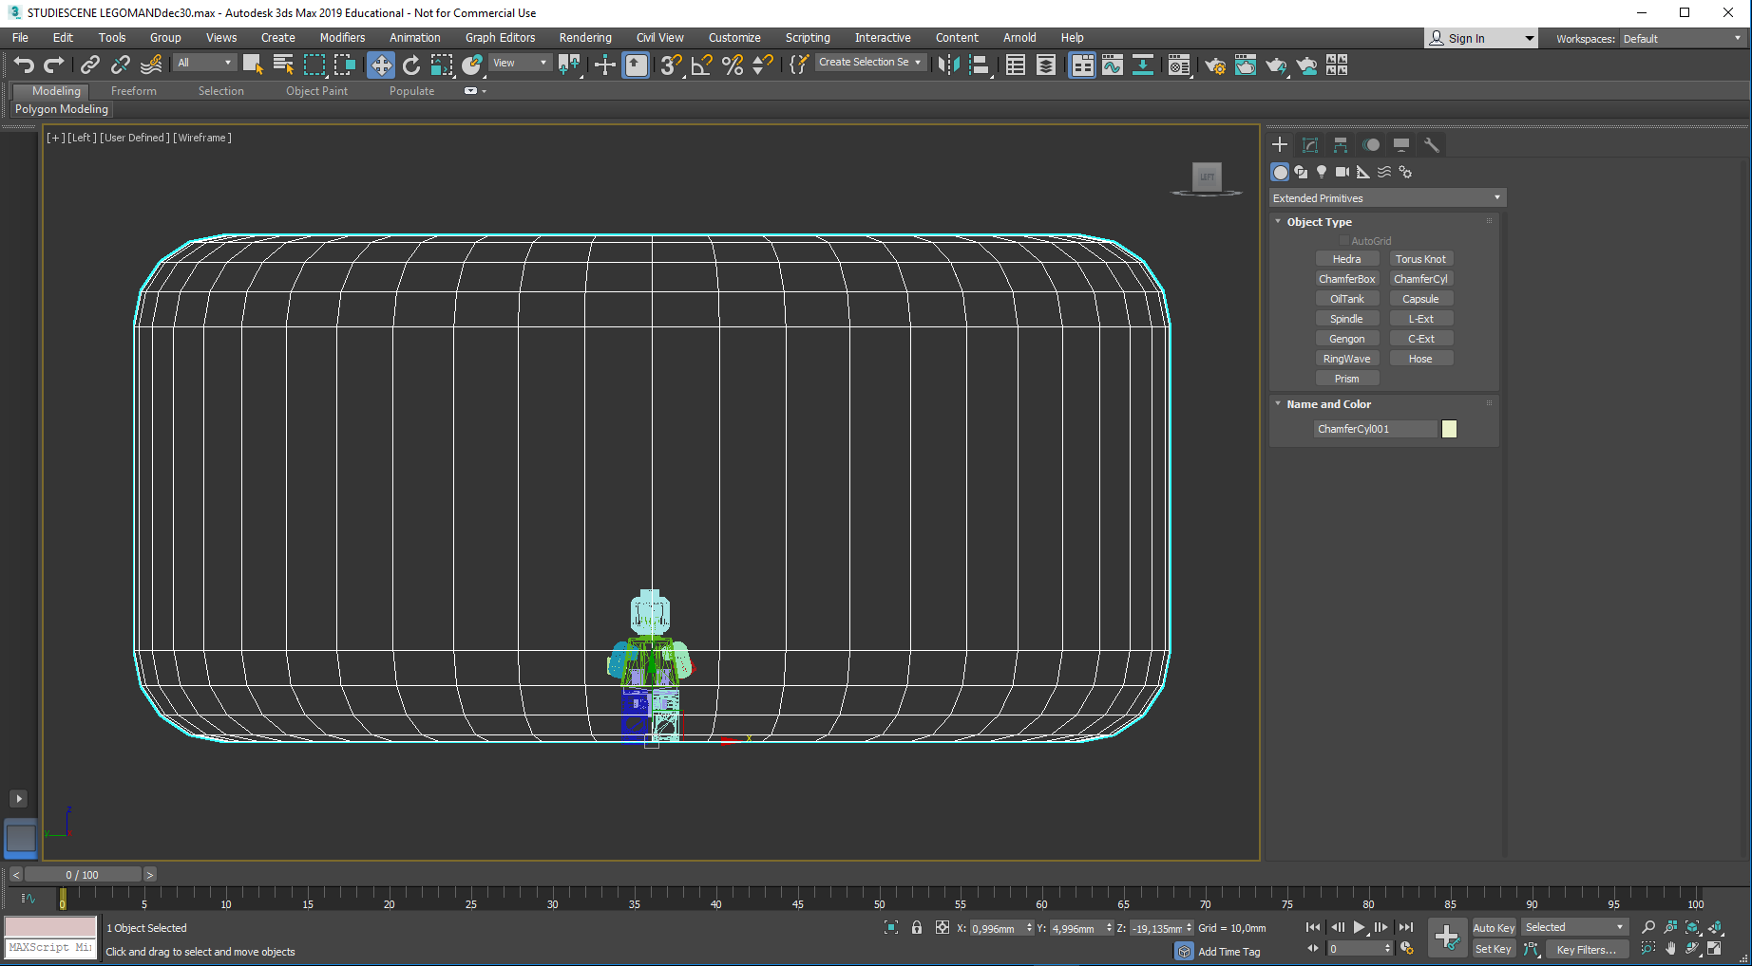
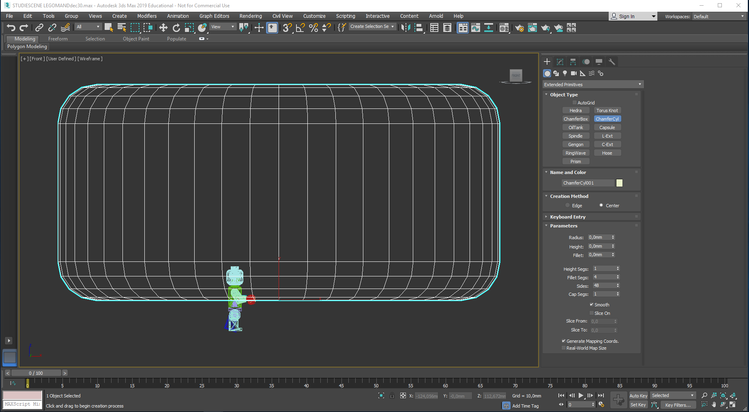
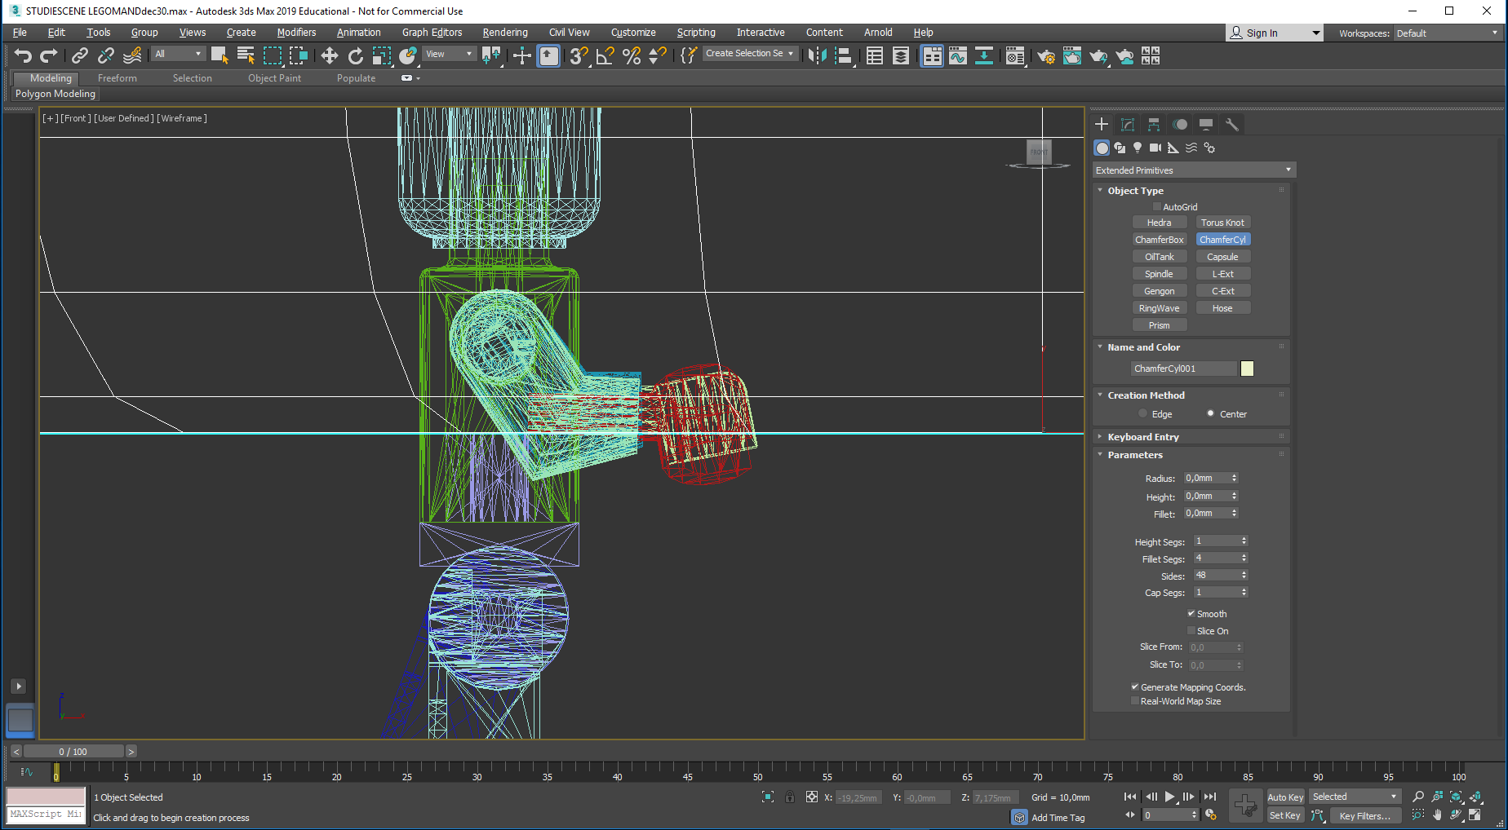
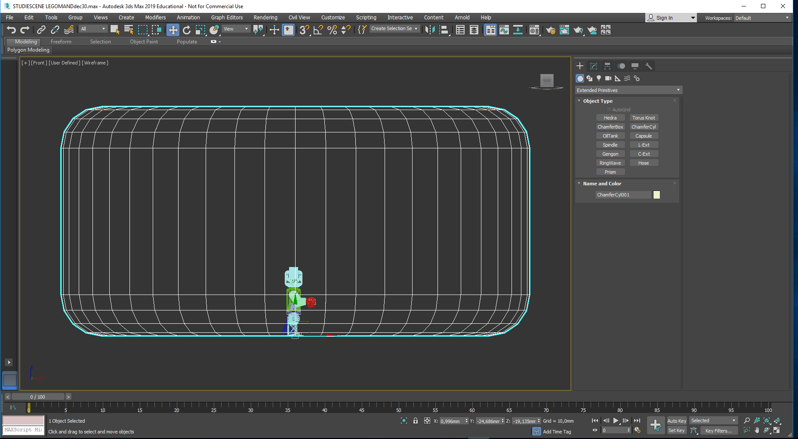
Now the studio has to be placed at the right spot: Press F to get a front view…
Press the combination
CTRL ALT Z to view the whole scene…
Press W (select & move), and move the studio,(not Mr. Lego) so he appears to be standing on the middle of the floor. You may use the wheel on your mouse to zoom in on his feet in order to check that they rest on the floor…
Press L to get a left view…if the view is in shaded mode, press F3 to get wireframe back again
Move the studio right or left to center Mr. Lego…

Slide 13
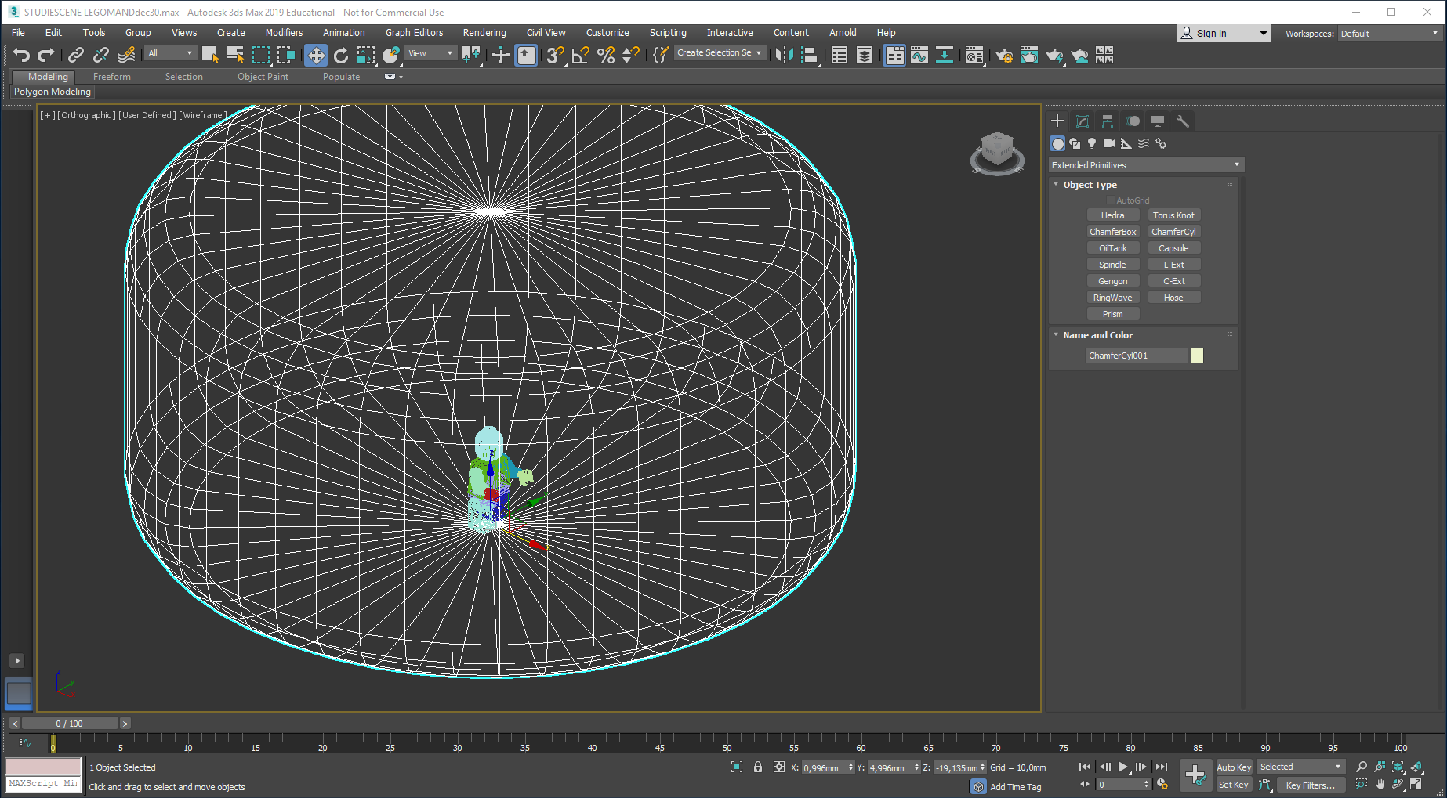
Mr. LEGO now stands on the floor , placed in the center of the studio…
Select the studio, rightclick it and convert it to a Editable Poly…

Slide 14
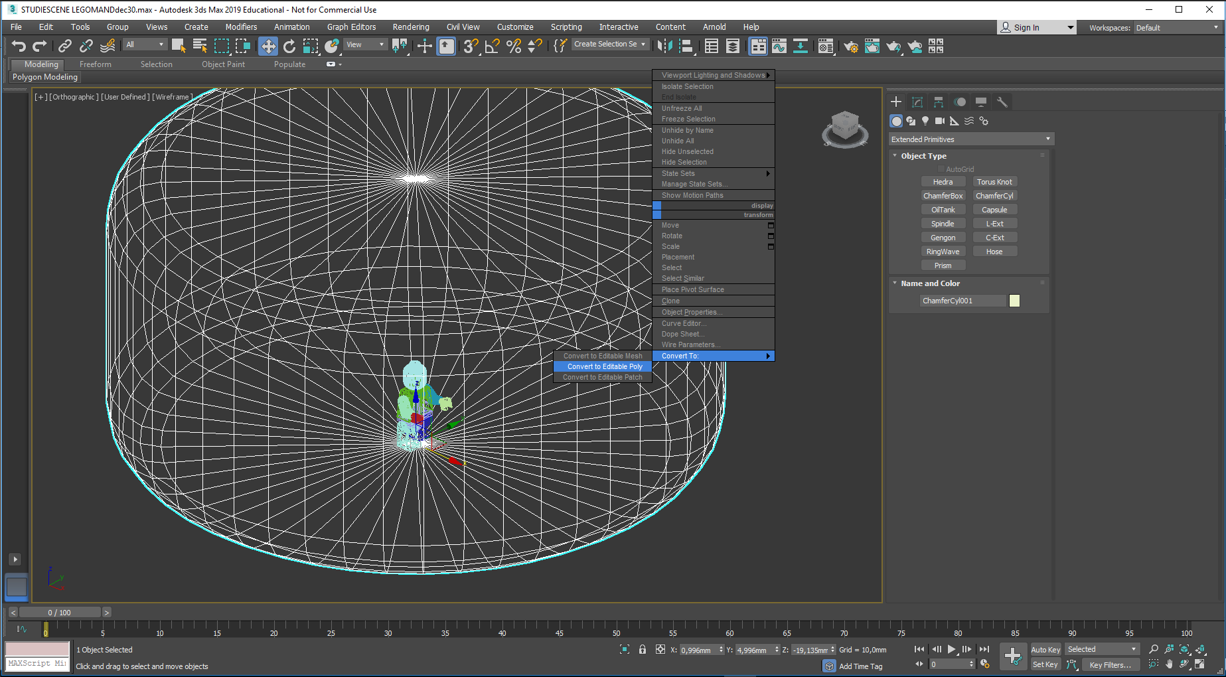
Select the studio, rightclick it and convert it to a Editable Poly…

Slide 15
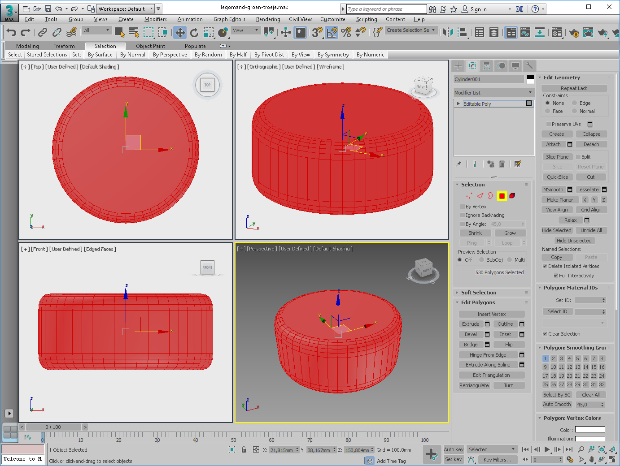
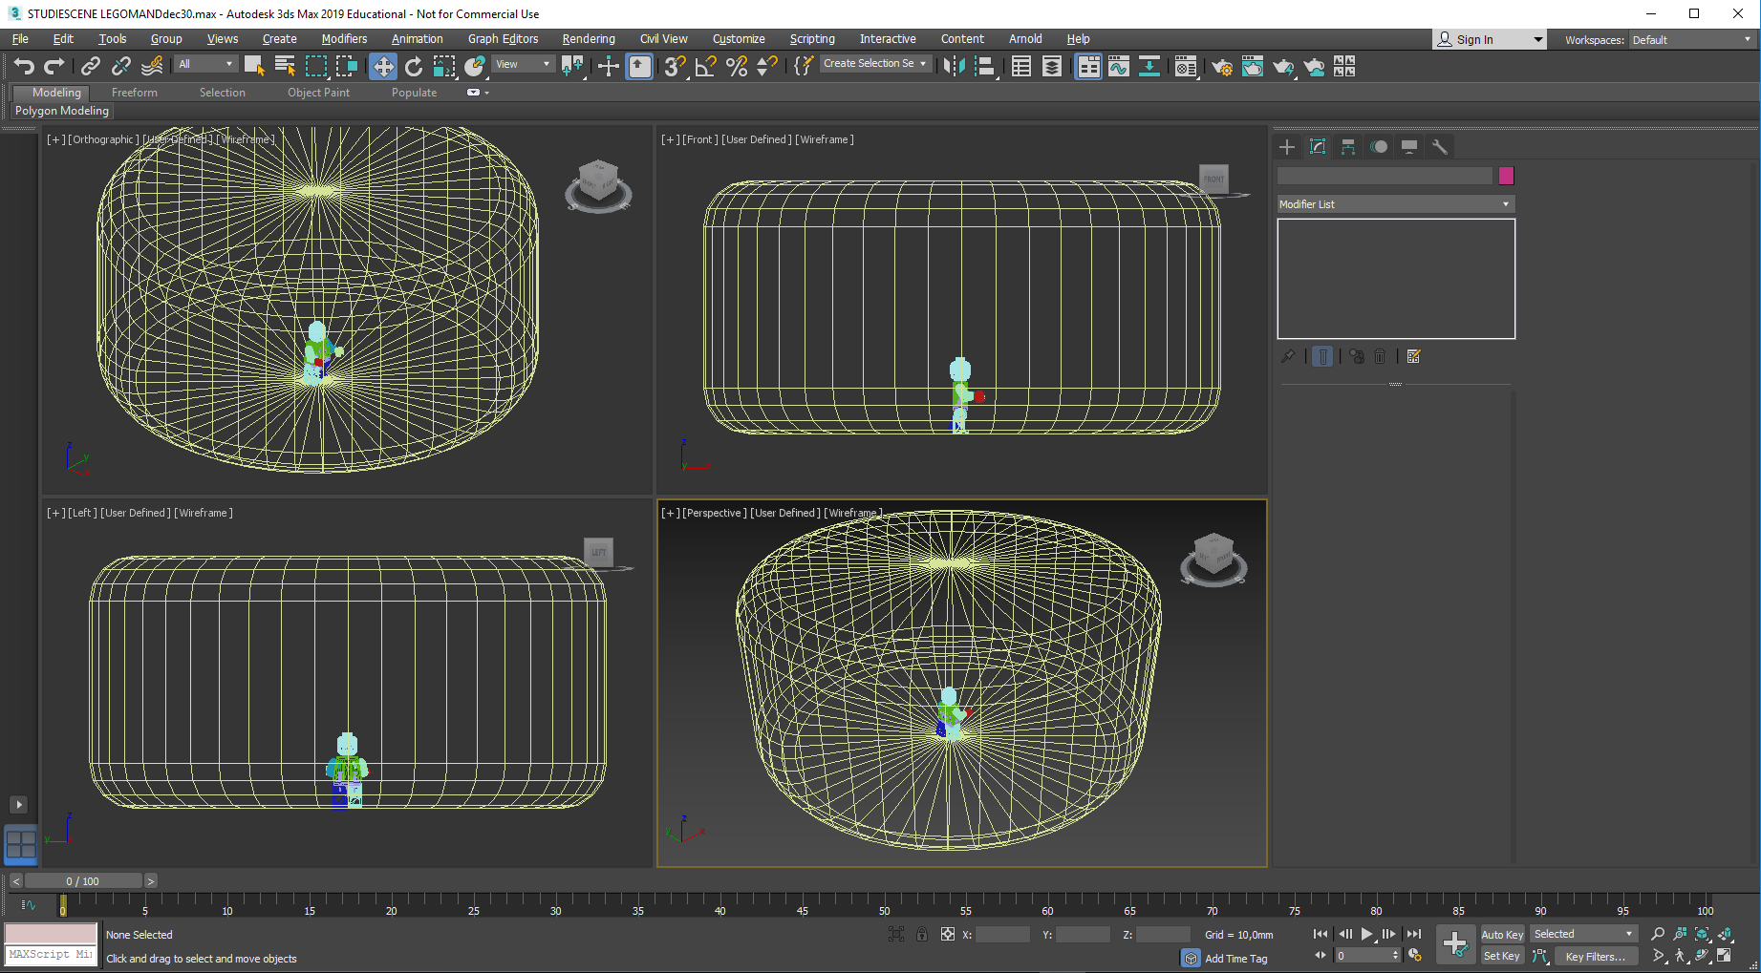
If you press Alt + W all four viewports will display. The viewports shown here happen to in wireframe mode
Click in a viewport to activate it, and press F3 to enter shaded mode. Repeat in the other 3 viewports

Slide 16
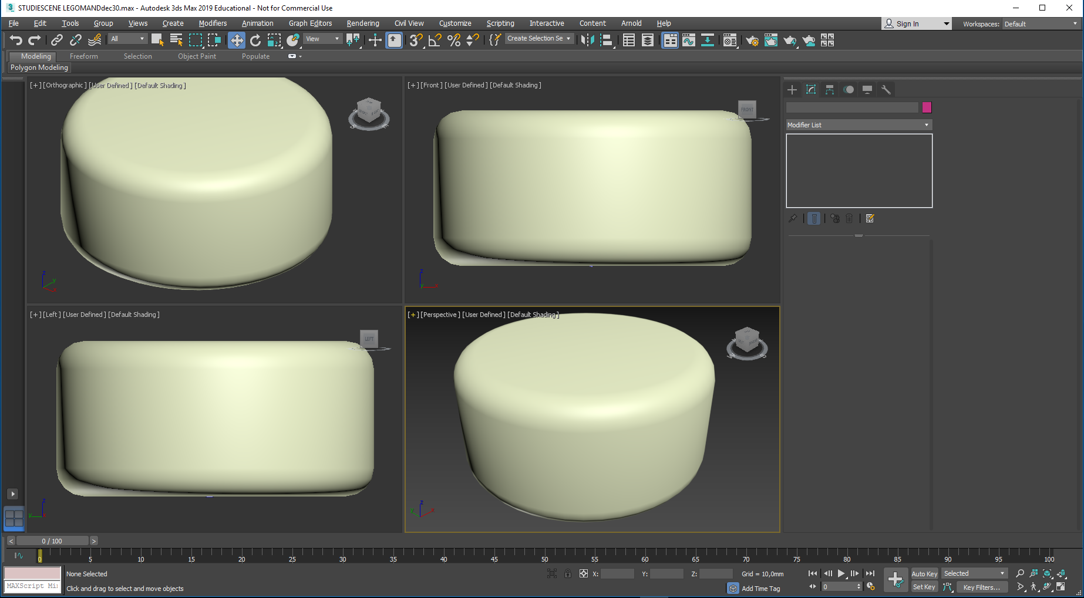
If you press Alt + W all four viewports will display. The viewports shown here happen to be in wireframe mode
Click in a viewport to activate it(the edge changes color), and press F3 to enter shaded mode. Repeat in the other 3 viewports
Viewports are now shaded. The Perspective viewport is made the active one.

Slide 17
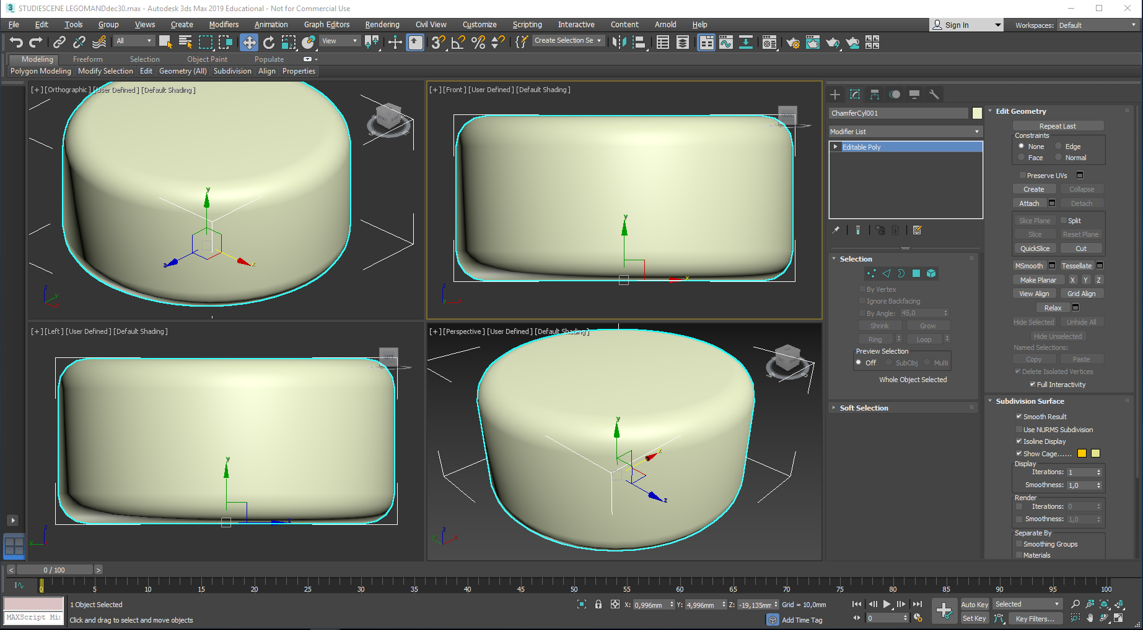
If you press Alt + W all four viewports will display. The viewports shown here happens to be in wireframe mode
Click in a viewport to activate it(the edge changes color), and press F3 to enter shaded mode. Repeat in the other 3 viewports
Viewports are now shaded. The Perspective viewport is made the active one.
Now, select the studio…
Select the Polygon level…

Slide 18
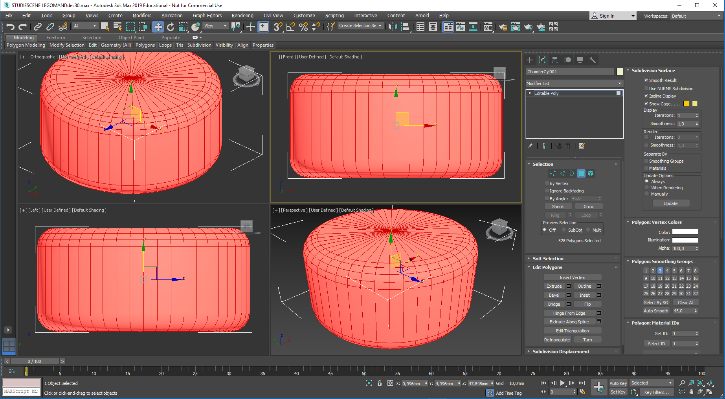
If you press Alt + W all four viewports will display. The viewports shown here happens to be in wireframe mode
Click in a viewport to activate it(the edge changes color), and press F3 to enter shaded mode. Repeat in the other 3 viewports
Viewports are now shaded. The Perspective viewport is made the active one.
Now, select the studio…
Select the Polygon level…
Select all the faces on the cylinder (Ctrl + A)…
Select the Auto Smooth…
This will smoothen out the studio walls.

Slide 19
Right-click in the Perspective Viewport to activate it…

Slide 20
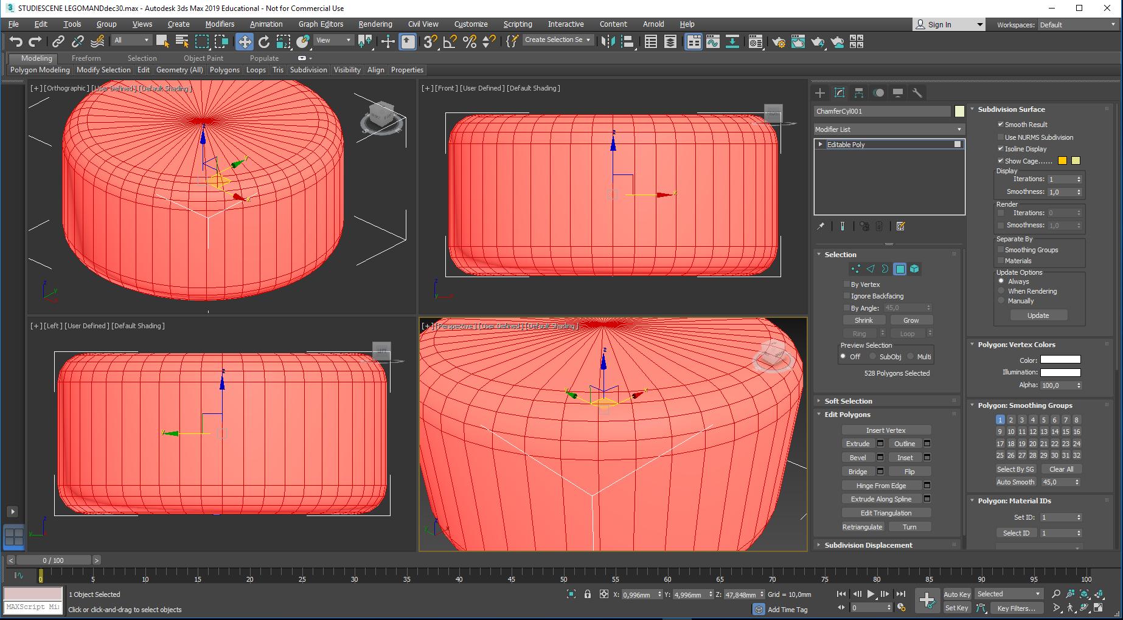
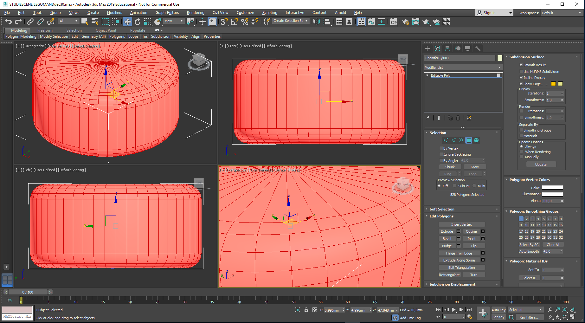
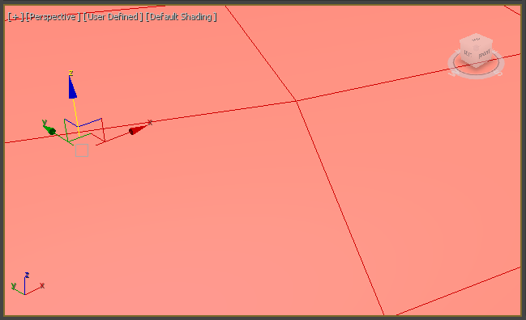
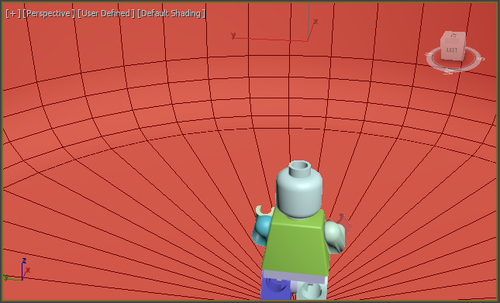
Try to gradually zoom closer and closer to the cylinder, rolling the mouse wheel for zooming and pressing it for panning…
Until you break through the wall and see the LEGO man…
You have now entered the inside of the studio.

Slide 21
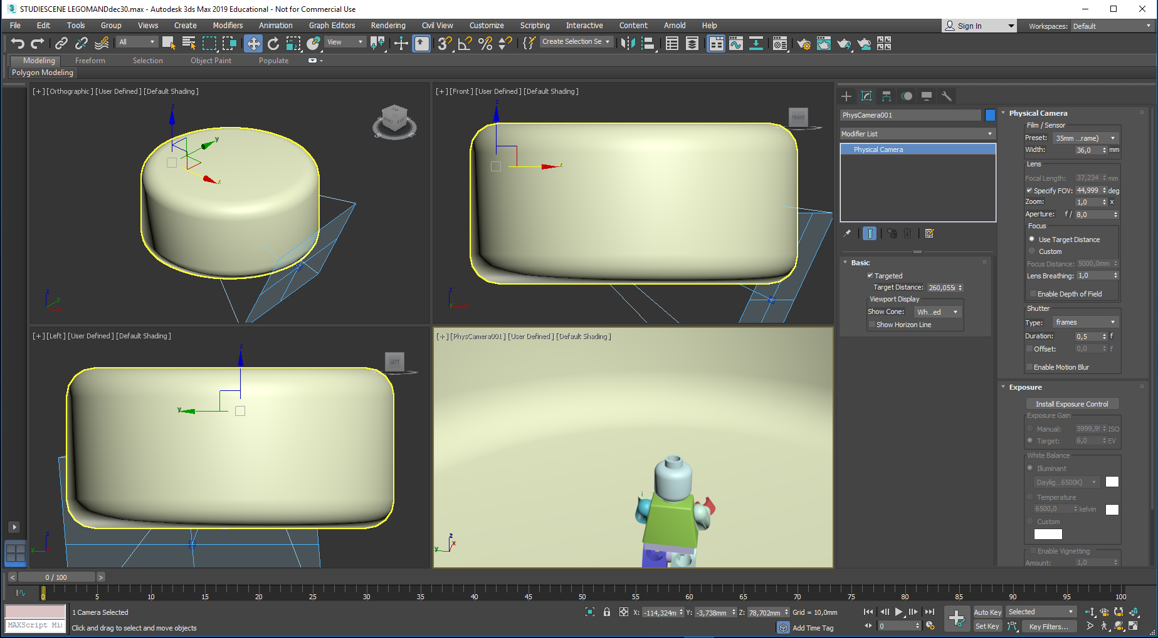
Press CTRL + C to convert the Perspective view to a Physical Camera view
Click the small padlock to keep the Camera selected
This helps a lot when you move things around in a cluttered scene
Disable the Targeted option

Slide 22
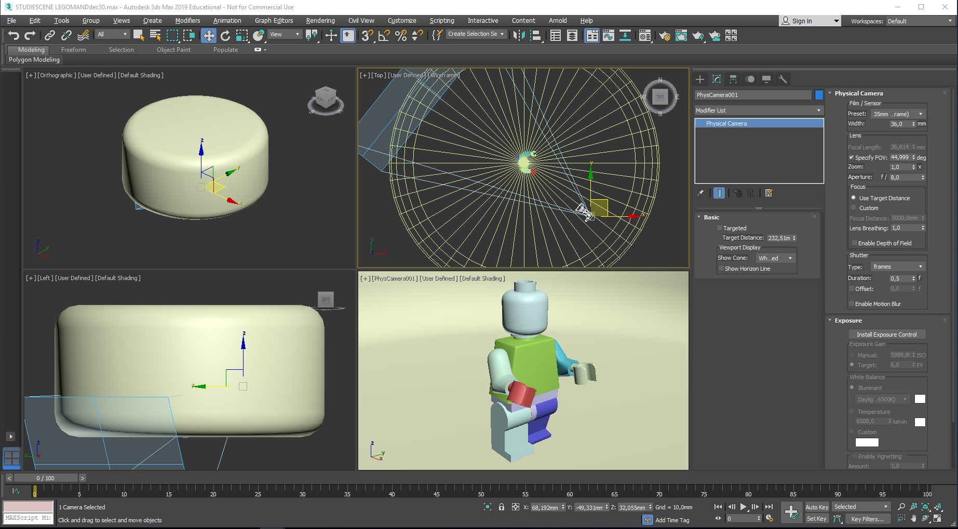
Try to get a camera view similar to this one by moving (W) and rotating (E) the camera in the non-perspective viewports. This can be a bit tricky. Using a top view (T) may help…

Slide 23
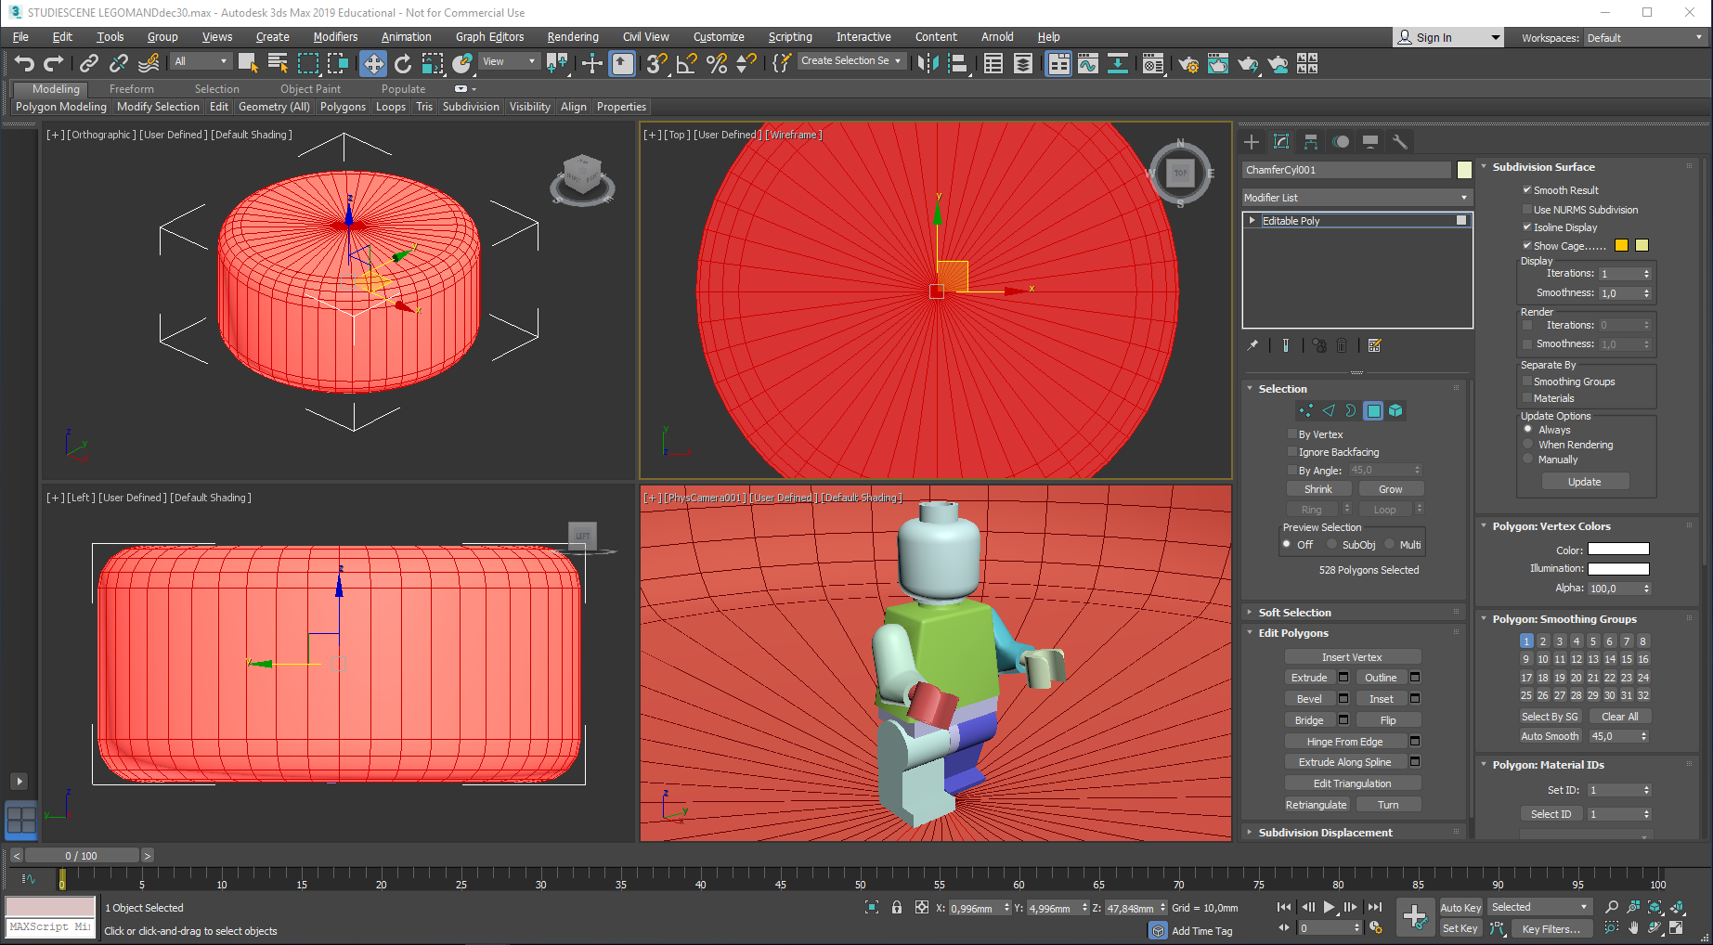
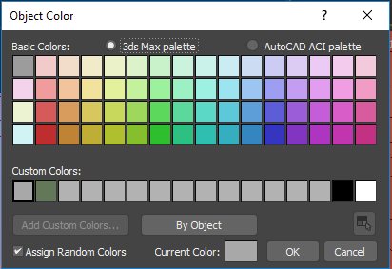
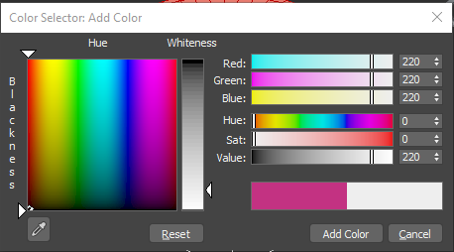
Release the Camera padlock.
Select the studio once again and enter Polygon mode. It may still reside in this mode, if you previously left it with the polygons selected . Anyway, select all the polygons again.
Rename the studio: Studio, instead of ChamferCyl001
Press the Color button and change the color of the studio:
Press a Custom Color button, then Add Custom Colors button
Inside the Color Selector Add Color dialogue a suitable pale grey color is chosen for wall paint inside the studio.
Here I have made a custom grey (RGB 220,220,220).
Accept by pressing Add Color.
Close by clicking in the top right corner
Close the Object Color Dialogue by pressing OK. The studio is now pale grey when deselected.

Slide 24
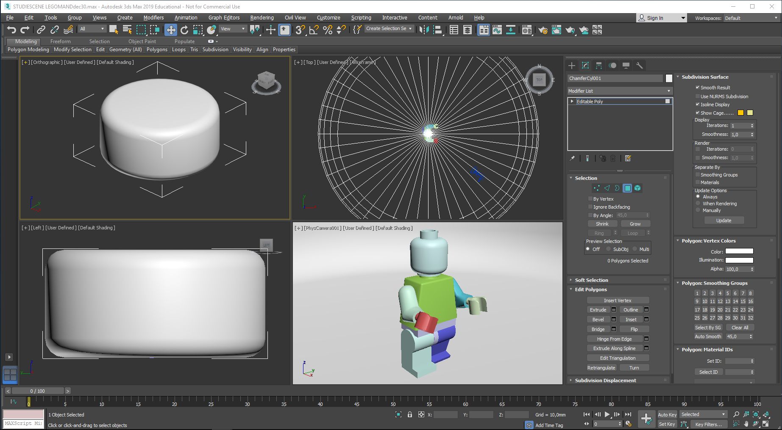
You leave the Modify commands by pressing (deactivating…) the active polygon button…
-And then click on an empty area somewhere in a viewport.

Slide 25
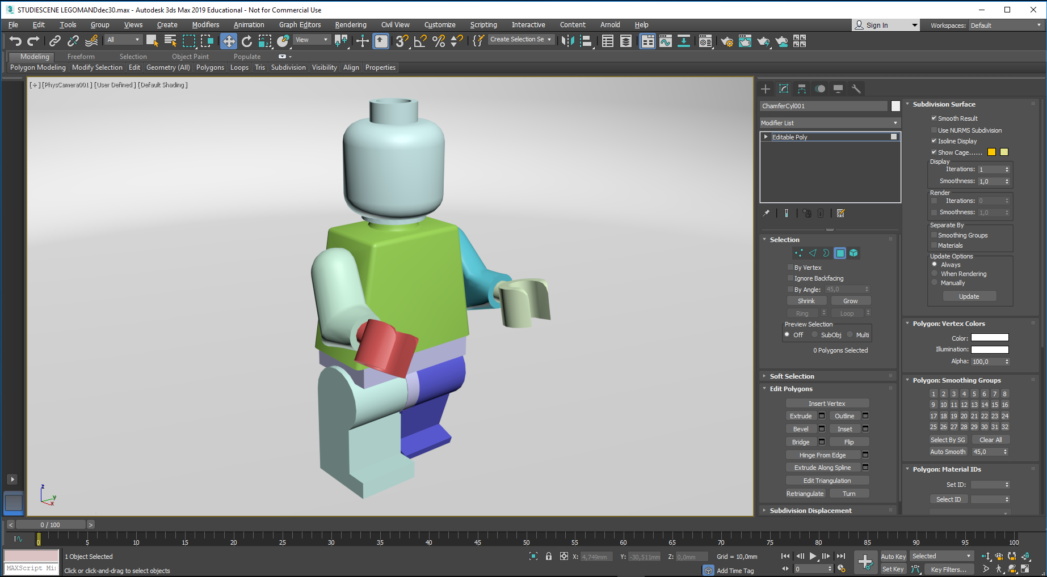
The Camera viewport is maximized…
You can move around in the studio by using the navigation buttons in the lower left corner, or play around with the mouse wheel…

Slide 26
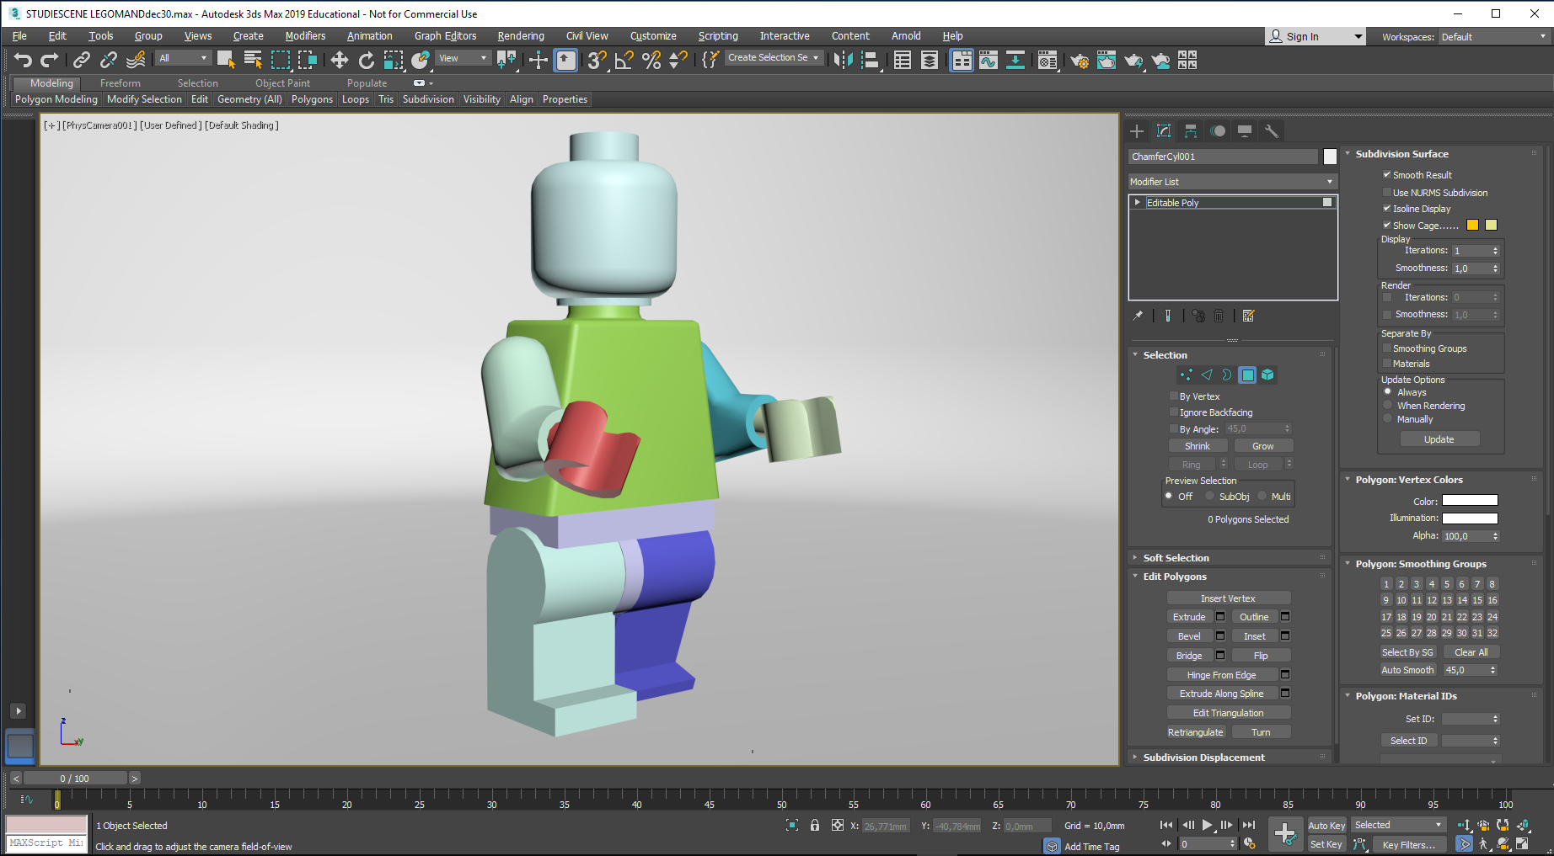
The Camera viewport is maximized…
You can move around in the studio by using the navigation buttons in the lower left corner, or play around with the mouse wheel…
Now, you may adjust your camera perspective for your first image.

Slide 27
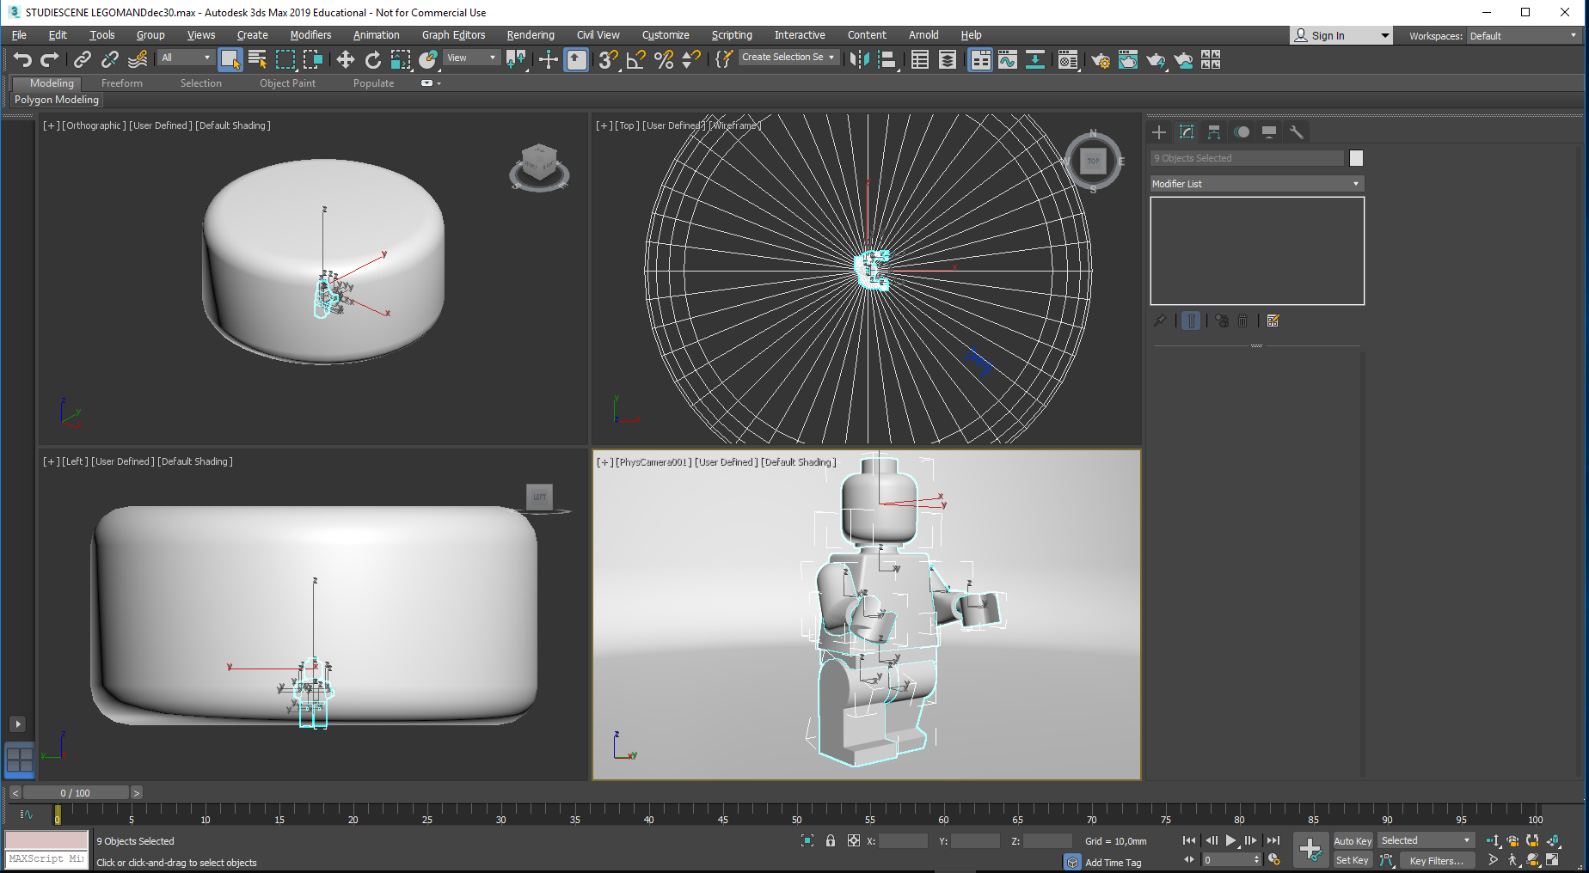
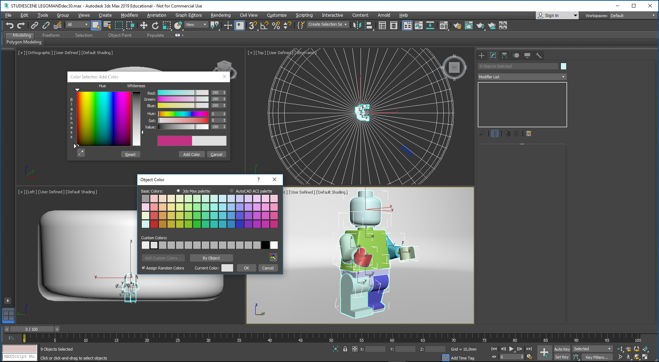
In order to make a proper evaluation of the light setting it is a good idea to dress Mr. LEGO in a uniform color – by selecting all his parts and color them. Here I pick one part after another, using CTRL
I choose a slightly darker tone grey – RGB 190,190,190, which is added to the Color Palette as before

Slide 28
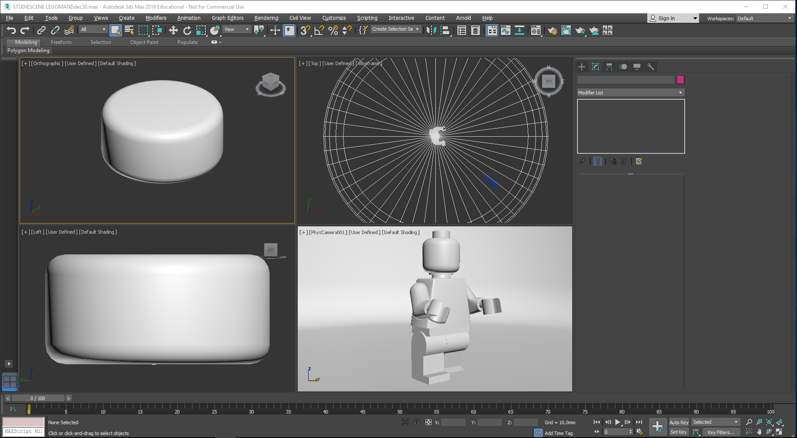
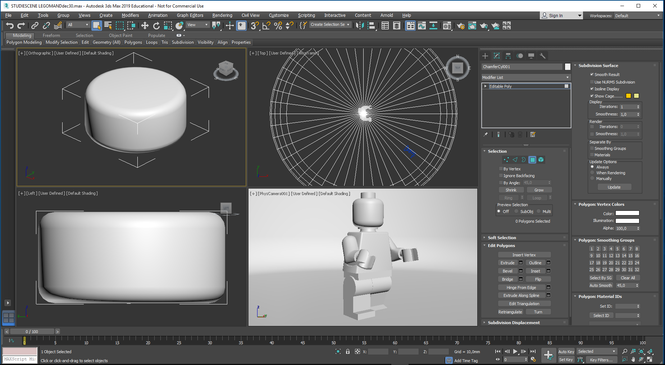
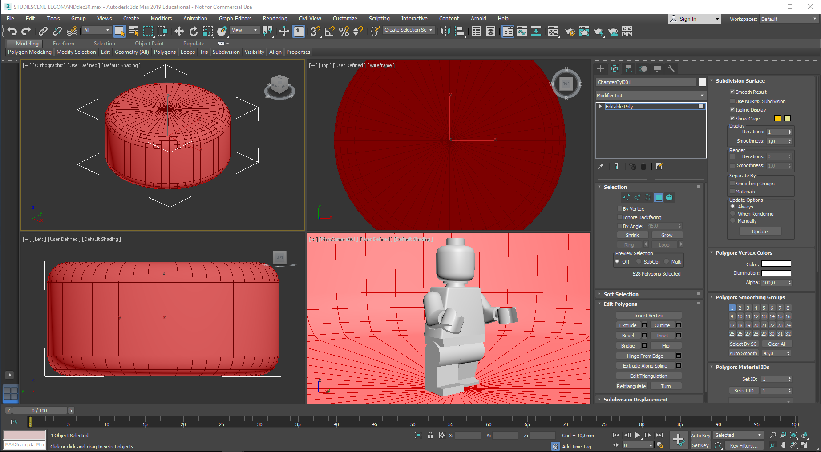
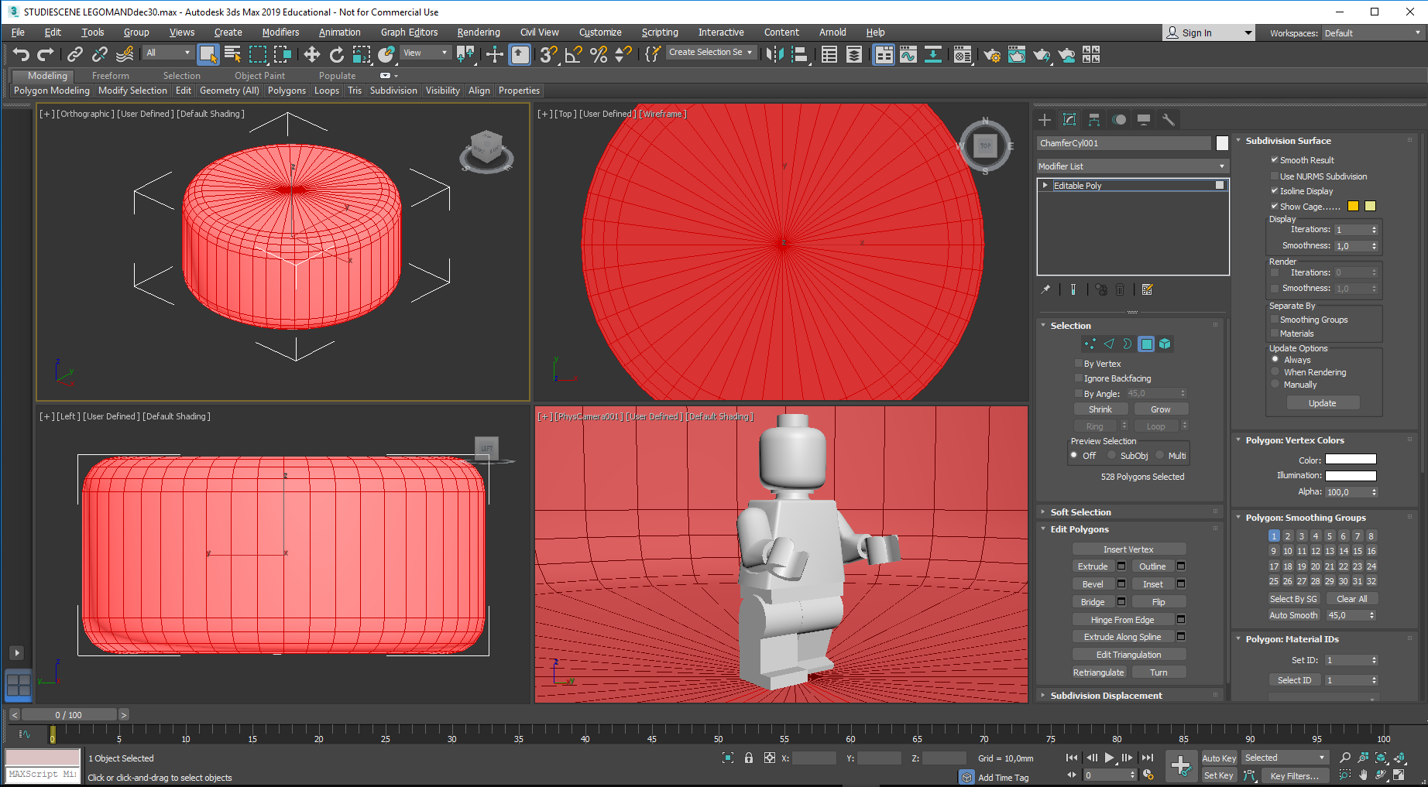
The purpose of the studio was to have its walls reflect the light emitted from a light source, helping nice soft shadows to form
In 3ds Max, things you create have an outside visible surface and an invisible inner surface. (the normals on faces point outwards)
Being inside the studio now, it is necessary to “turn the inside out” on the studio walls to enable them to reflect the light. It is done this way:
Select the studio, and select all its polygons…
Turn them all inside out, using the Flip command
You will notice that the outside of the studio gets darker, and its inner faces get lighter

Slide 29
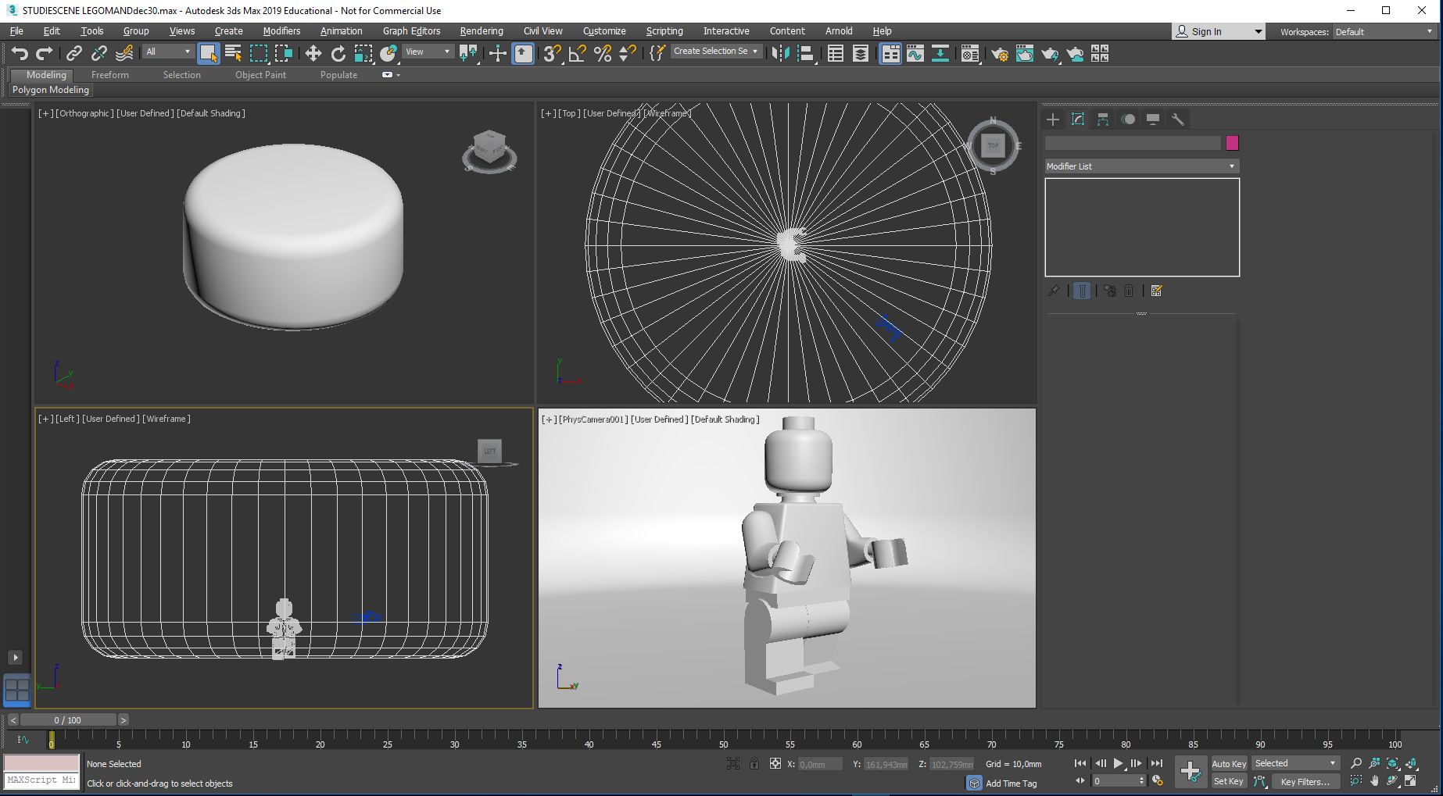
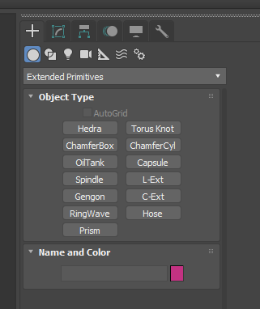
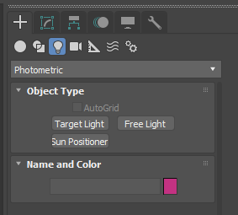
Time for creating a light:
Arrange that a top and a left view is in wireframe mode…
Click this Create button, followed by this lights button
Click the Photometric entry and change the light type to an Arnold light

Slide 30
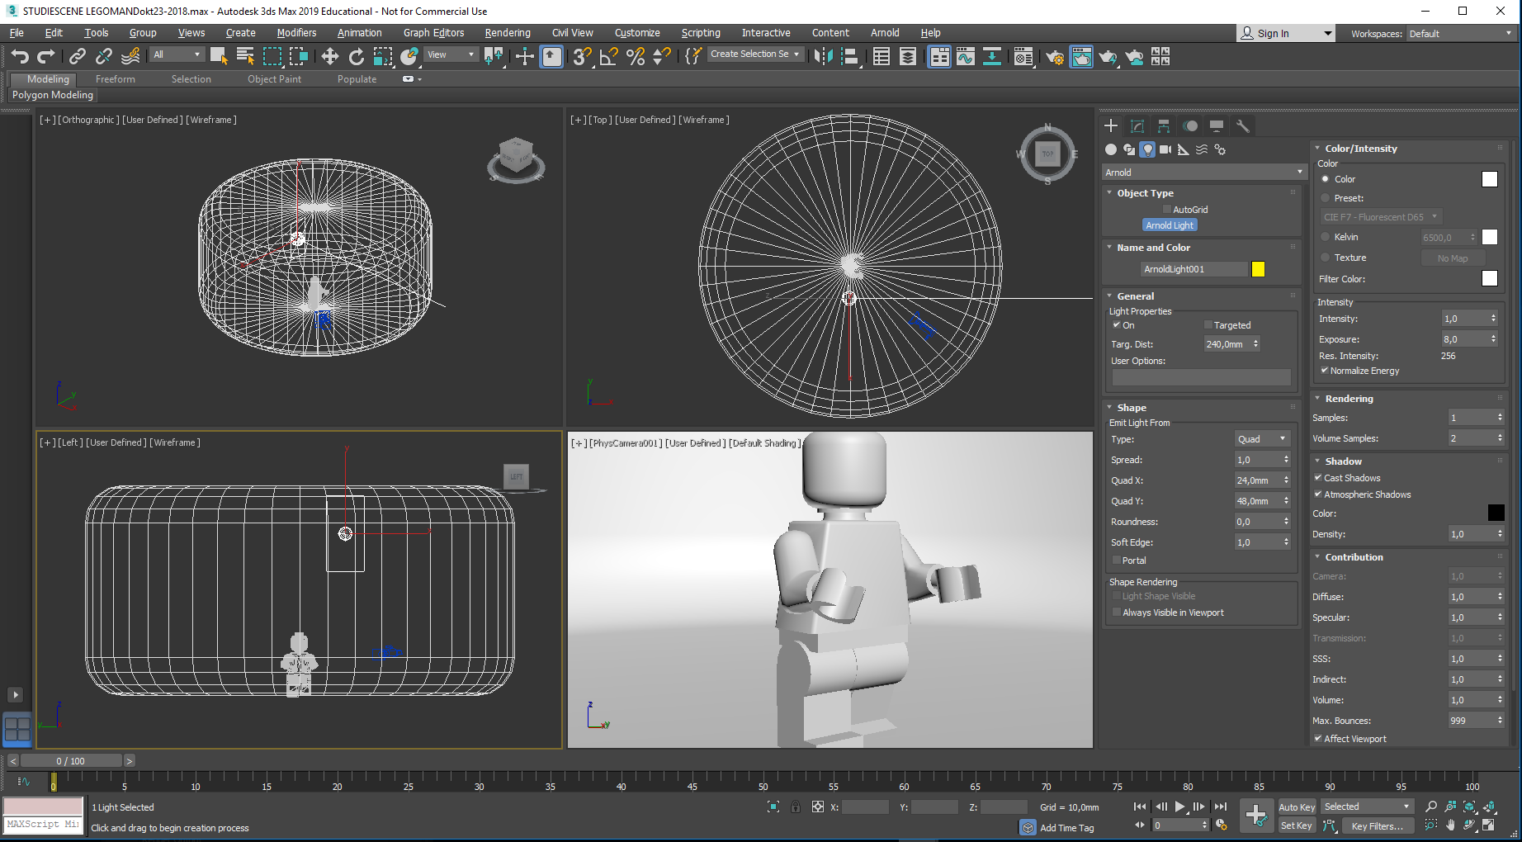
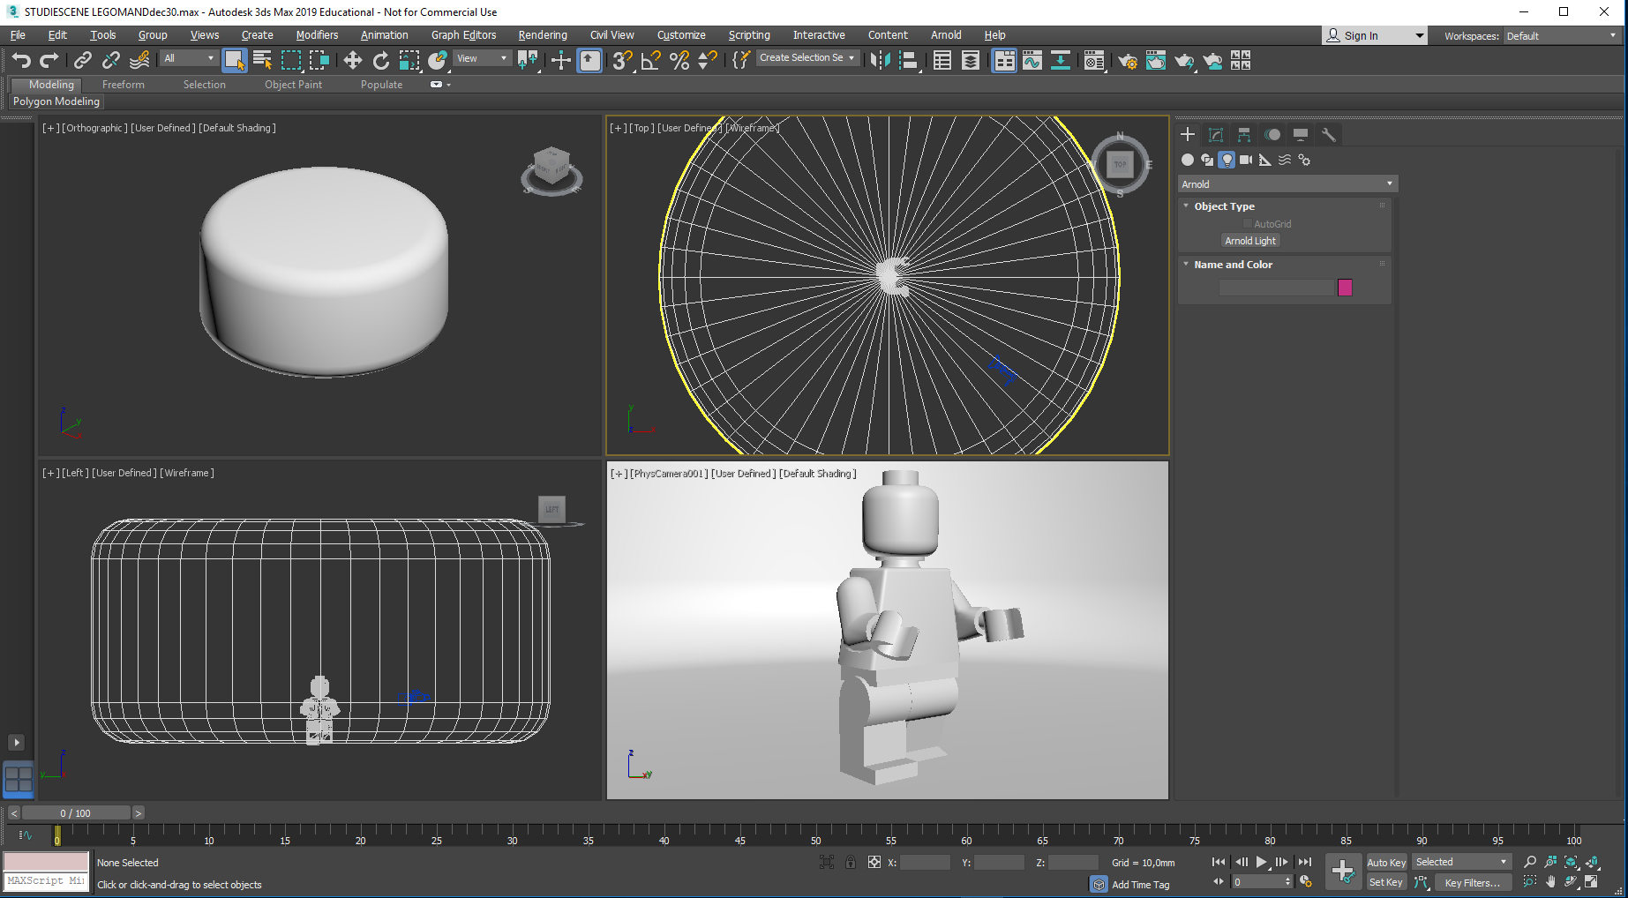
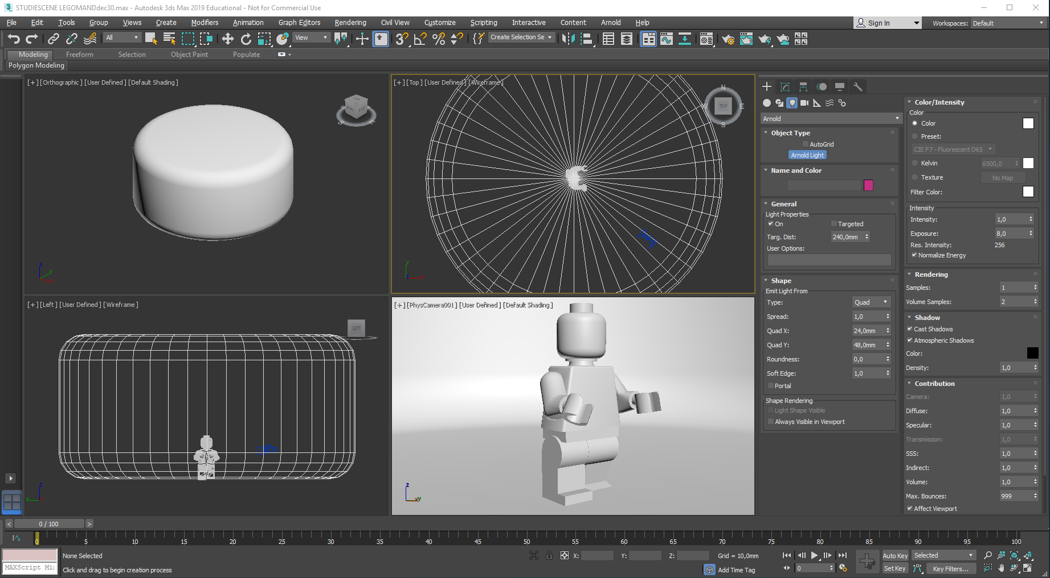
Click the Arnold Light entry to access its parameters…
- But leave them open. Click somewhere in the studio, either in the top view or in the left view

Slide 31
A default Quad Light was put here – a bit randomly…
Now change it to a Point Light …

Slide 32
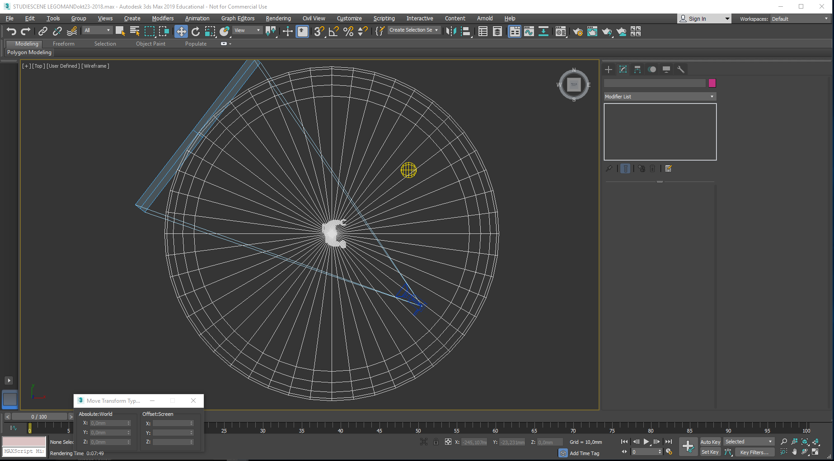
In the maximized top viewport (ALT + W) I have moved the new Point Light so it shines on his left front.
The Camera looks at his right front. I have not moved the Camera, but changed it so it now displays its Cone
This layout is quite similar to one you might have chosen when taking a photo in the real world with a digital camera…

Slide 33
Time for a snapshot…
Click and hold down on this teapot with the small lightning
Now, go back to 4-viewport configuration. Right-click in the Camera Viewport to make it the active one
Select the lower teapot with the small triangle – it will start the Active Shade preview – Is your Camera viewport still active?
The Active Shade creates an image immediately…
It is probably very dark

Slide 34
In the top viewport select the Point Light…
This can be a bit tricky…
Click on the Modify entry,
this will give access to the parameters of the light…
With the Point Light still selected, right-click in the Camera Viewport to make it active

Slide 35
In the Exposure entry (with the default value of 8), roll its small Scroll Bar upwards, to increase Exposure value. Yuo will notice that the Active Shade window will gradually lighten up.
Stop scrolling when things look nice:
In a well exposed photo one should not see any totally white – or black areas.

Slide 36
Here it looks like an Exposure value of 14,5 will do the job.
The Active Shade window is shown in the update phase

Slide 37
You might make a copy of the image by pressing Clone Rendered Frame Window.
In this way you can compare the image with future versions with changed settings.
Now, select the Teapot with the small lightning (Production Render)…
The Active Shade window closes, and a new rendering window (PhysCamera001) starts to develop an image. This might be rather grainy, as the default settings are rough, allowing an image to be generated quickly

Slide 38
Arnold has some sophisticated tools for improving the quality of the rendered image. Some of them can be accessed this way:
Open Render Setup, followed by the Arnold Renderer pane: the Sampling and Ray Depth entry has many variables for adjustment. Any higher setting will increase render time.
I have made some tests:

Slide 39
This image is similar to the one in the previous slide (= default settings)
- And this was made with the Diffuse value increased from 2 to 4

Slide 40
This has Diffuse value increased to 6 – not much graininess now
Diffuse value increased to 10

Slide 41
Here, the Camera value is increased from 2 to 12, resulting in a bit higher contrast – and no graininess.
The Camera value improves on all variables simoultaneusly, but at the cost of much more render time
It seems like increased Diffuse values generally results in better image quality without render times exploding.
Over and out…

