Slide 1
Translation of a CAD model from CREO to 3ds Max:
How will the LEGO man make the pass?
Tomas Benzon, DTU/MEK, October 2018

Slide 2
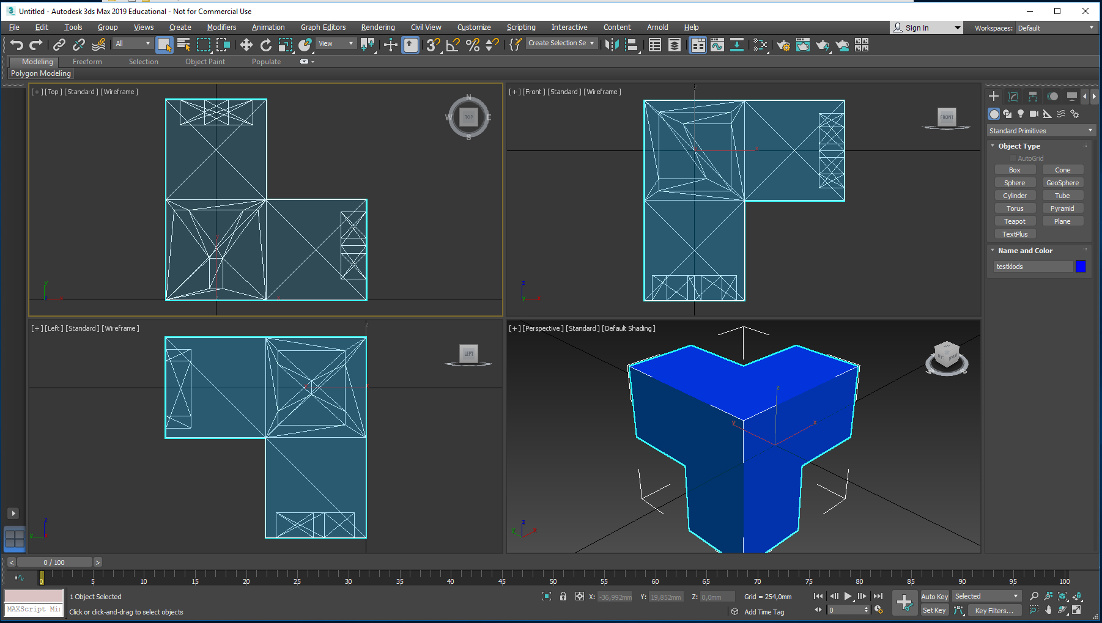
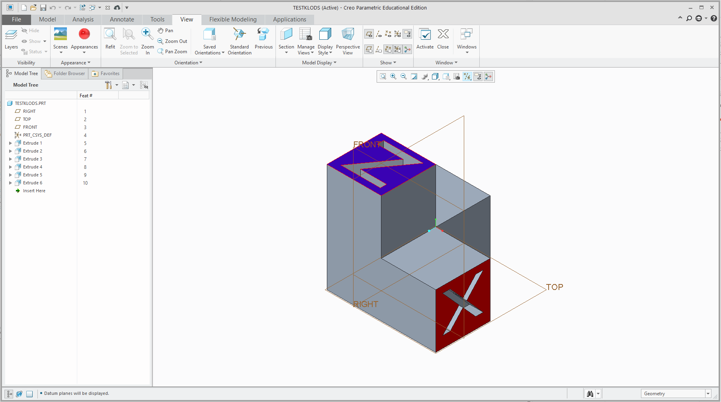
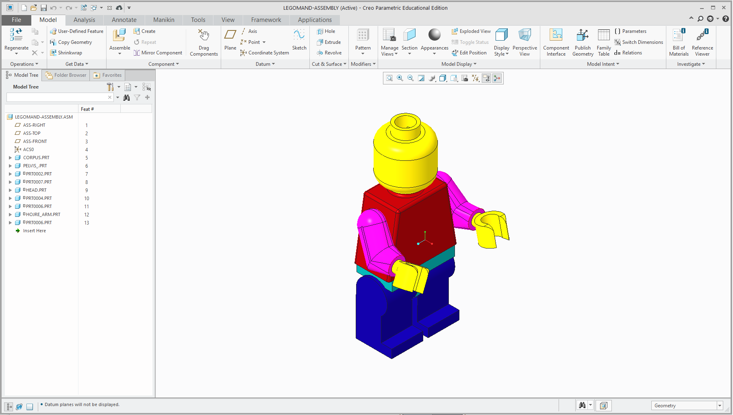
The assembly of the LEGO man has been opened in CREO…
This is for ensuring that his position looks right…
No exploded view, etc.
How does Creo interact with 3ds Max, export/importwise?
I created a test object…
This is now displayed in an isometric position with the TOP datum plane facing upwards – In Creo, this is actually the Y direction

Slide 3
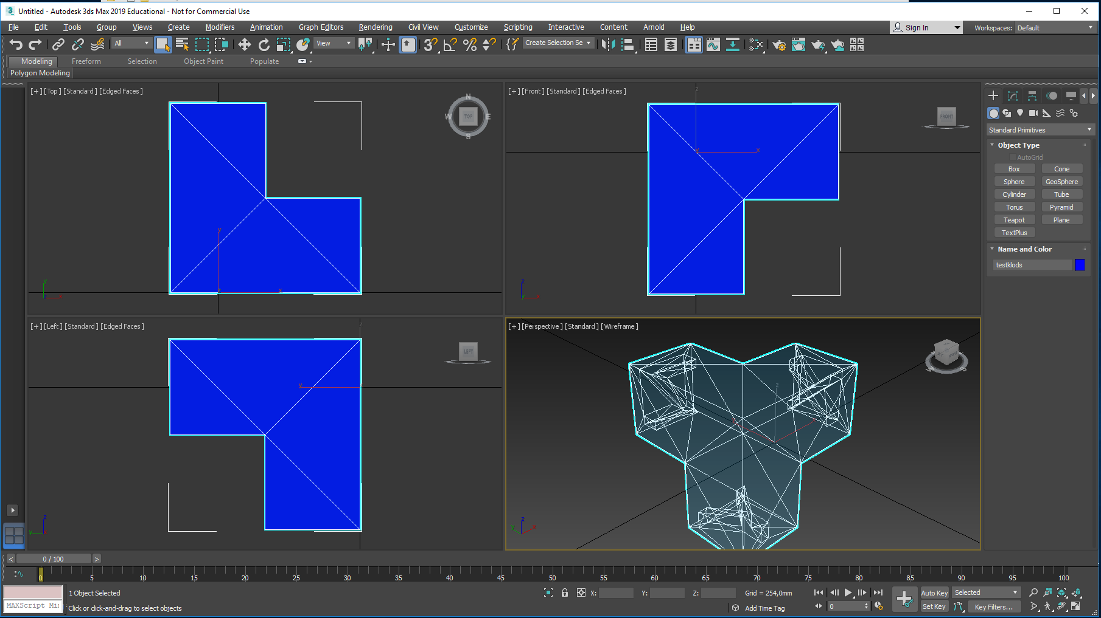
This is how the test object looked imported with default settings…(Up Axis = Z-Up)… X axis is ok, the other two are not.

Slide 4
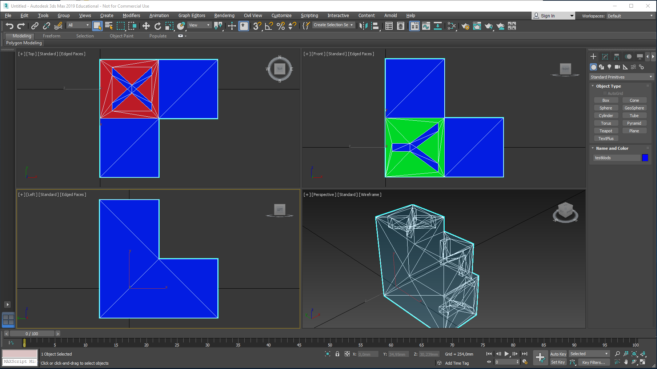
And this is how it looked imported with
(Up Axis = X-Up)…None of them OK

Slide 5
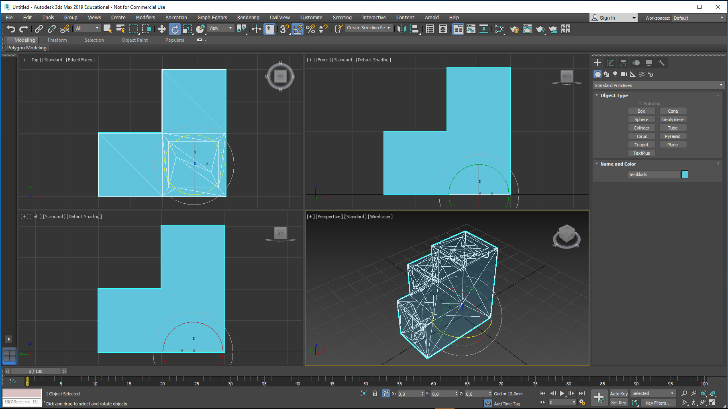
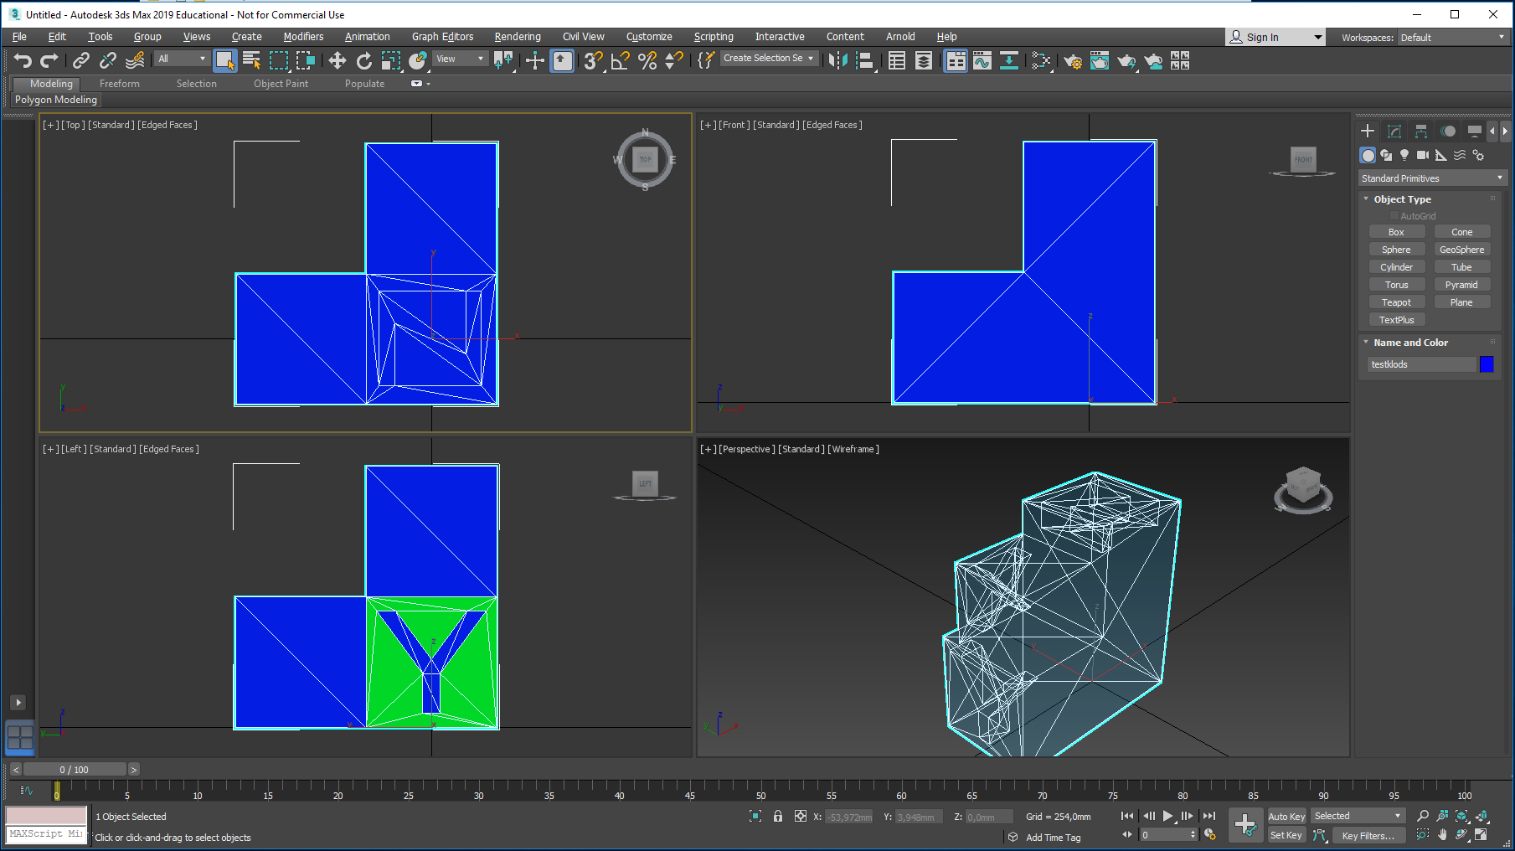
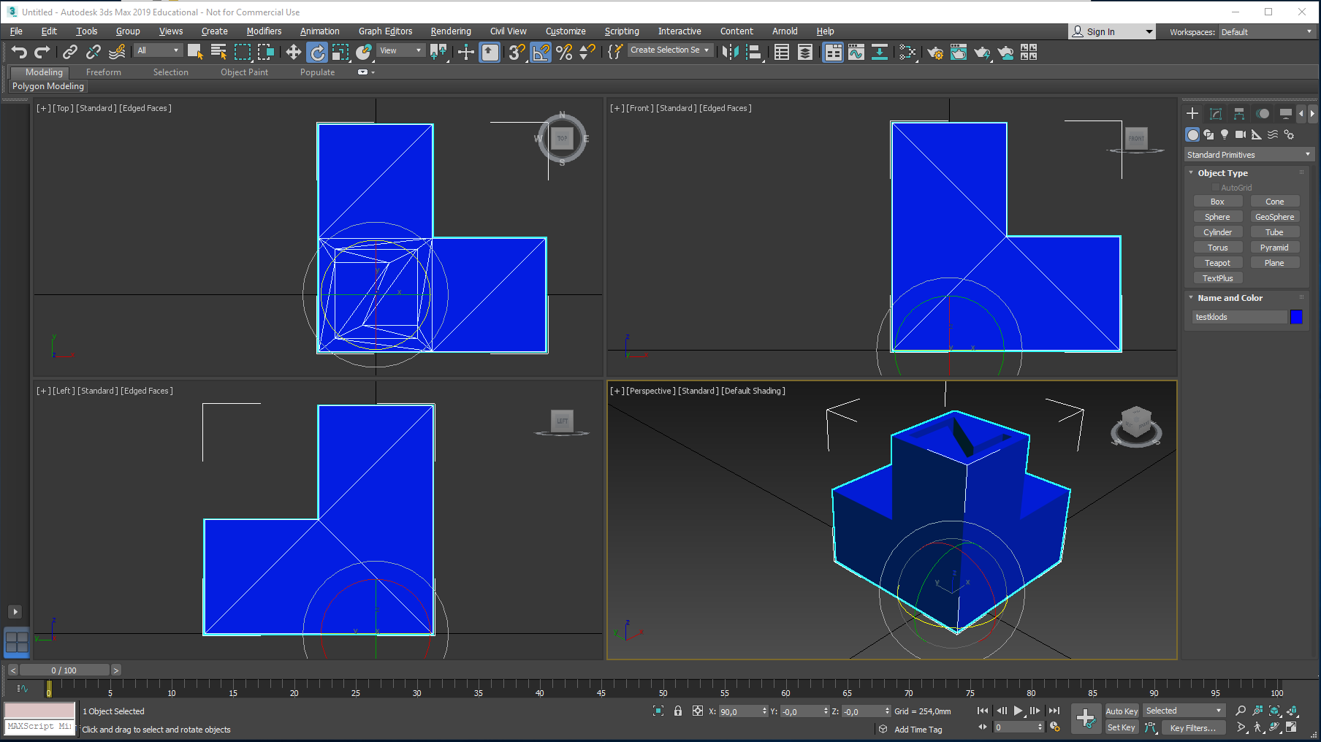
And…this is imported with
(Up Axis = Y-Up)…Seems to be the best compromize:
A clockwise 90 degree rotation along the Z Axis will replicate the Creo position

Slide 6
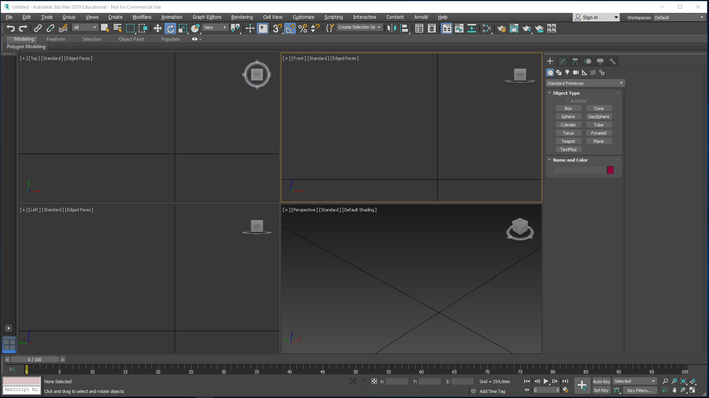
Before importing mr Lego I will do a checkup on a few settings in 3ds Max…

Slide 7
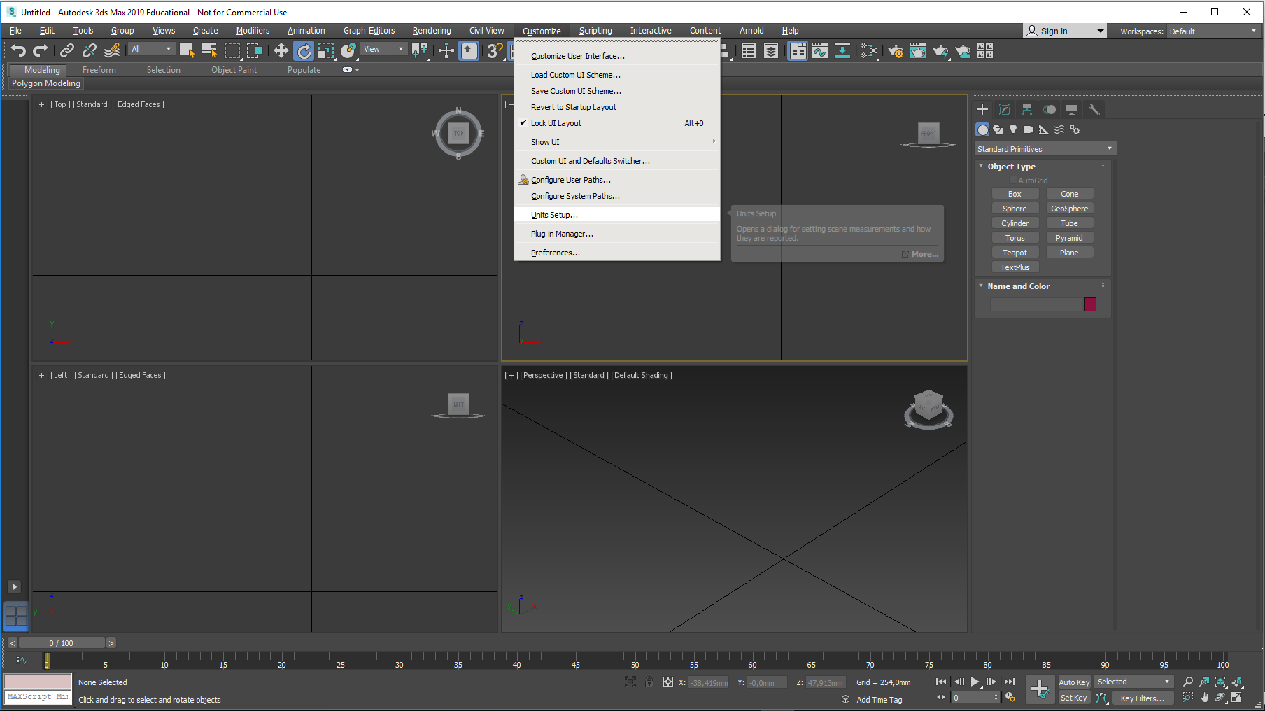
Are we working in millimeters? This is checked by entering Customize / Units Setup…
Before importing mr Lego I will do a checkup on a few settings in 3ds Max…

Slide 8
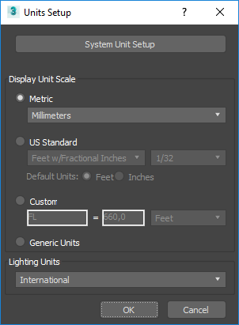
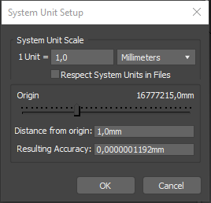
Are we working in millimeters? This is checked by entering Customize / Units Setup…
Before importing mr Lego I will do a checkup on a few settings in 3ds Max…
System Unit Setup opens…
Millimeters here,
In the Units Setup dialogue choose:
Metric/Millimeters
No checkmark here…
(Assuming that Mr.
LEGO was initially
created in mm…)
Enter System Units Setup.
Close both boxes
with an OK. (No scaling errors today…)

Slide 9
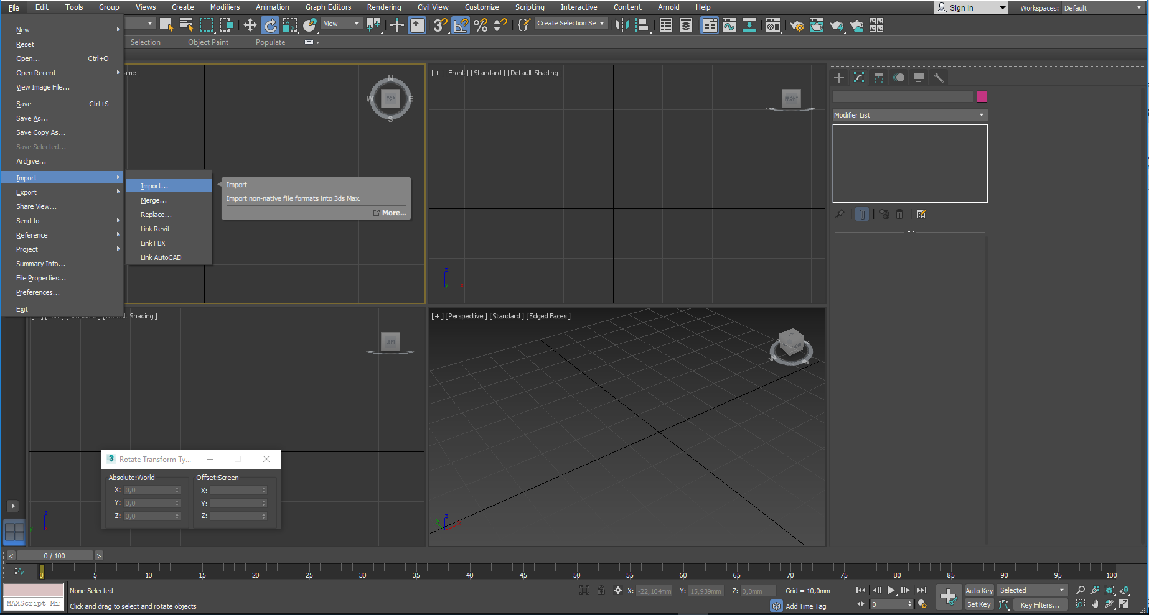
How will Mr Lego enter this program..?
Select:
File
Import
Import

Slide 10
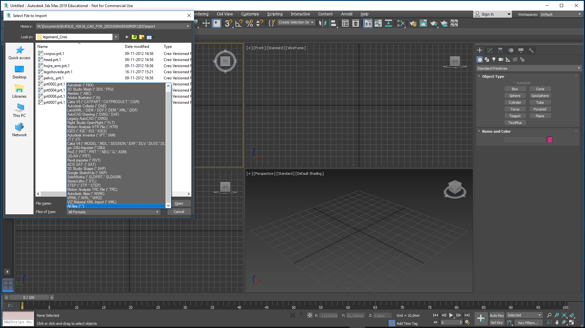
Now, where did you put the latest version of your Mr. Lego assembly?
Luckily, I found him here
It may be neccesary to select the All Files option to be able to see Creo assemblies

Slide 11
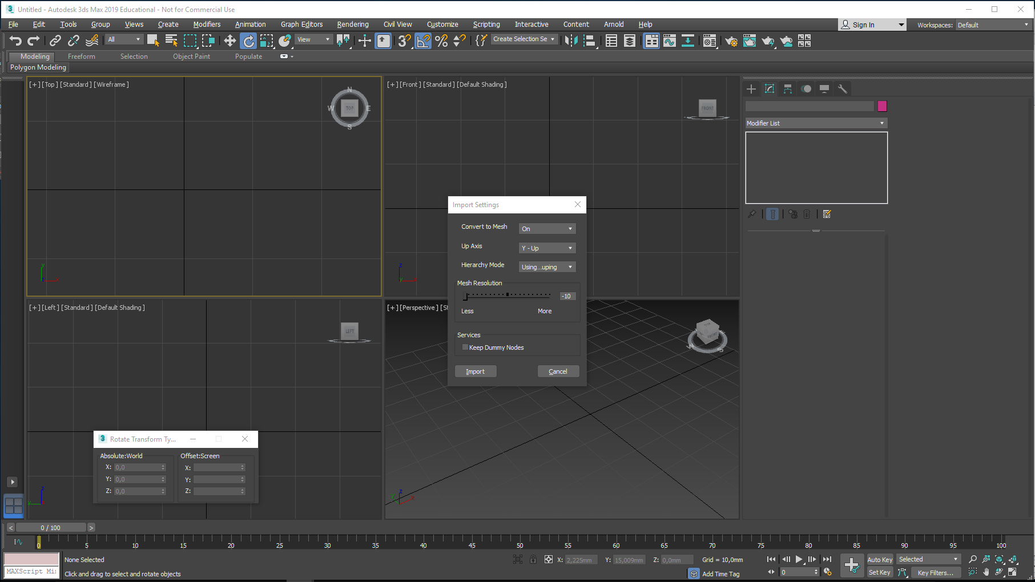
Now for the Import Settings dialogue…
Convert to Mesh = On
Up Axis: Y-Up
select Flattened
Mesh resolution: try the lowest option, even this one might produce a dense mesh – do not go overboard in the high values, files become huge
Import…

Slide 12
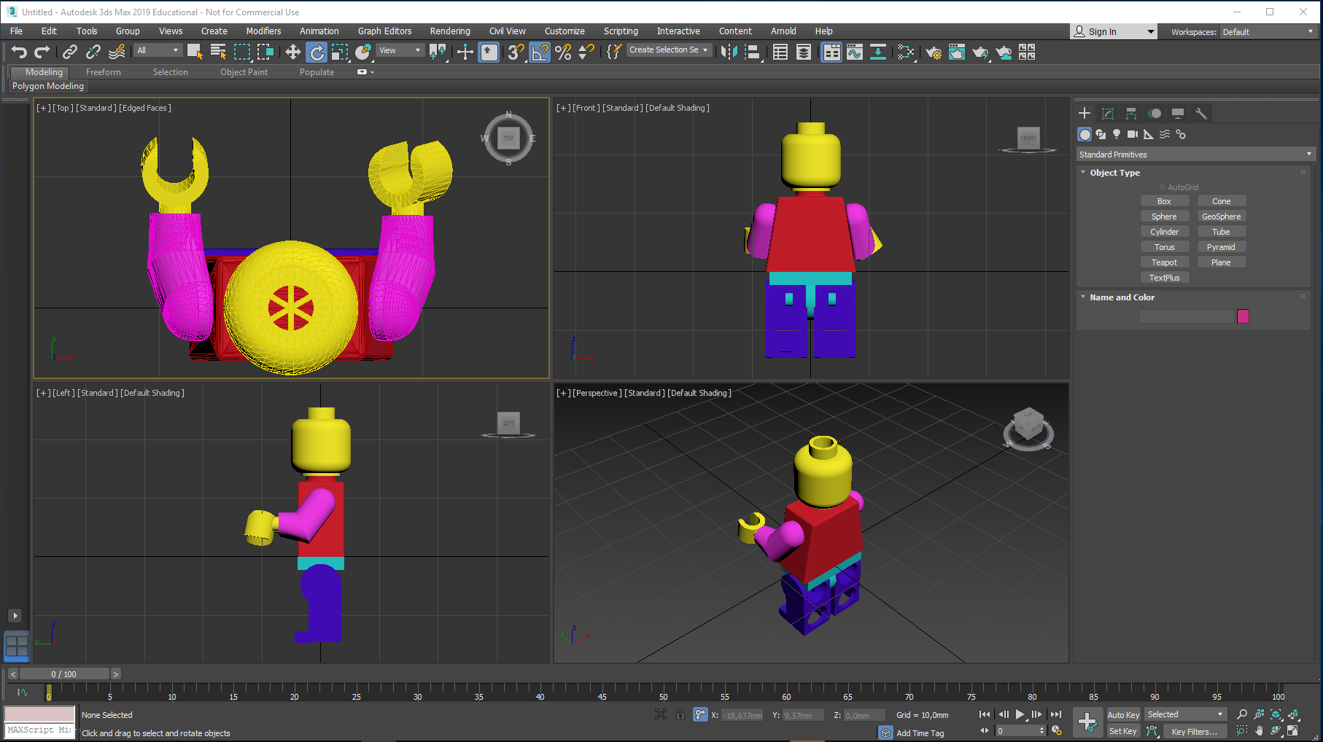
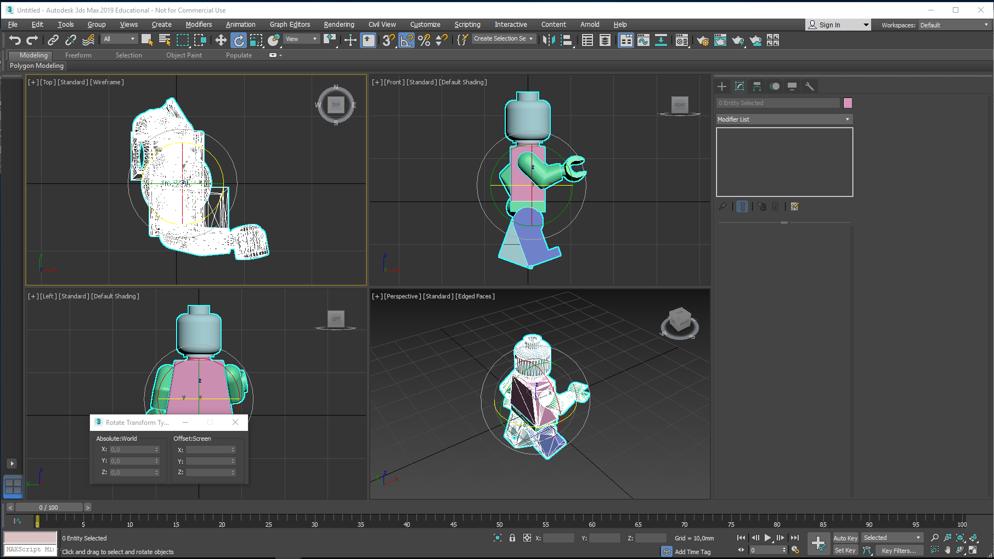
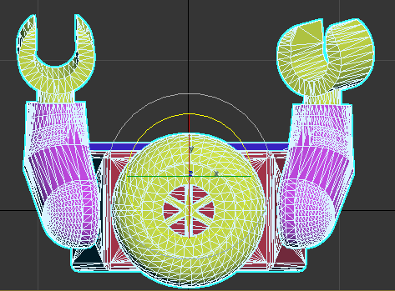
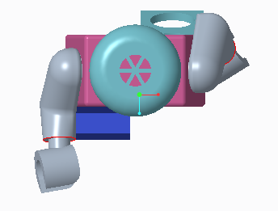
If you want him placed as he was in Creo – which is recommendable – he needs to be rotated 90 degree clockwise
The Mr Lego assembly has arrived…
As individual parts, once inside 3ds Max…
If he were a single part and you wanted him placed as he was in Creo – he should be rotated 90 degree clockwise in 3ds Max, if you used the recommended (Up Axis = Y-Up) setting in the previous slide
But as an assembly he is not that predictable…At least his head is opright…
I will suggest that you rotate him along Z, so he will look at you in a front view
Set Angle Snap Toggle = On: rotation will happen in 15 degree steps
Select the Select and Rotate tool, and rotate him by pulling the grey handle on the Rotate Gizmo

Slide 13
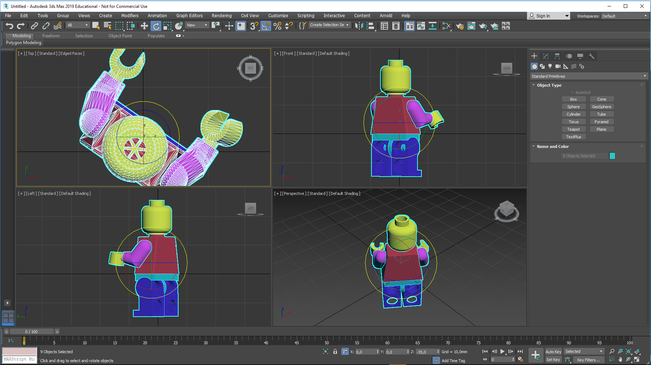
Rotation has begun…
And the Z value changes accordingly…

Slide 14
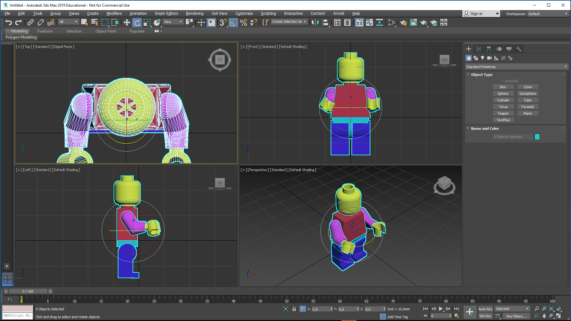
Rotation done…
Same result could be achieved by typing 180 here

Slide 15
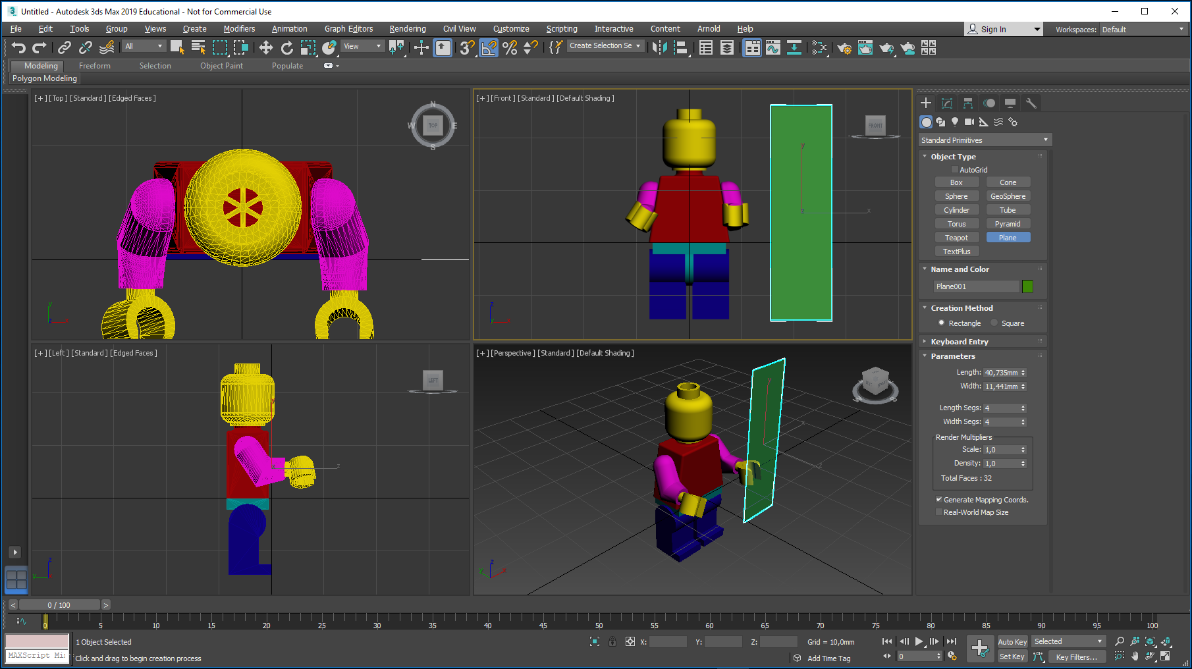
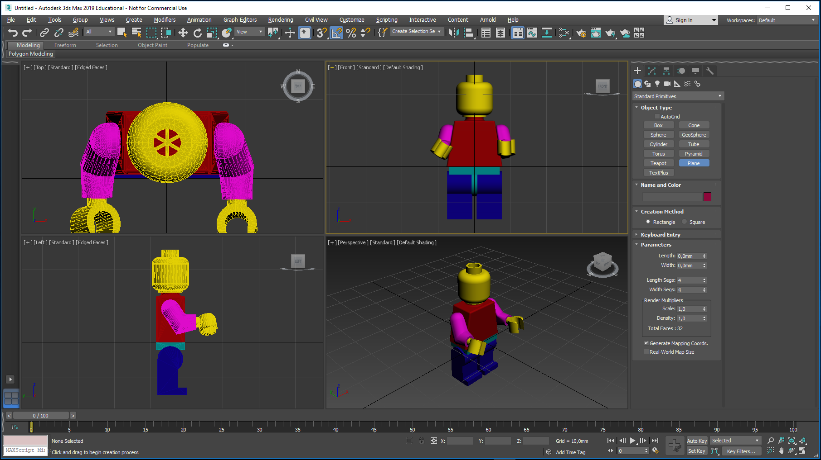
To be totally sure that we didn’t make any scaling errors, I have created a plane with a height similar to mr. Lego…
The height (length) should be about 40 mm…
(If the height is only about 2 mm, you have a mixup between inches and mm… in that case, correct the error!)
The following tutorials require correct scaling

Slide 16
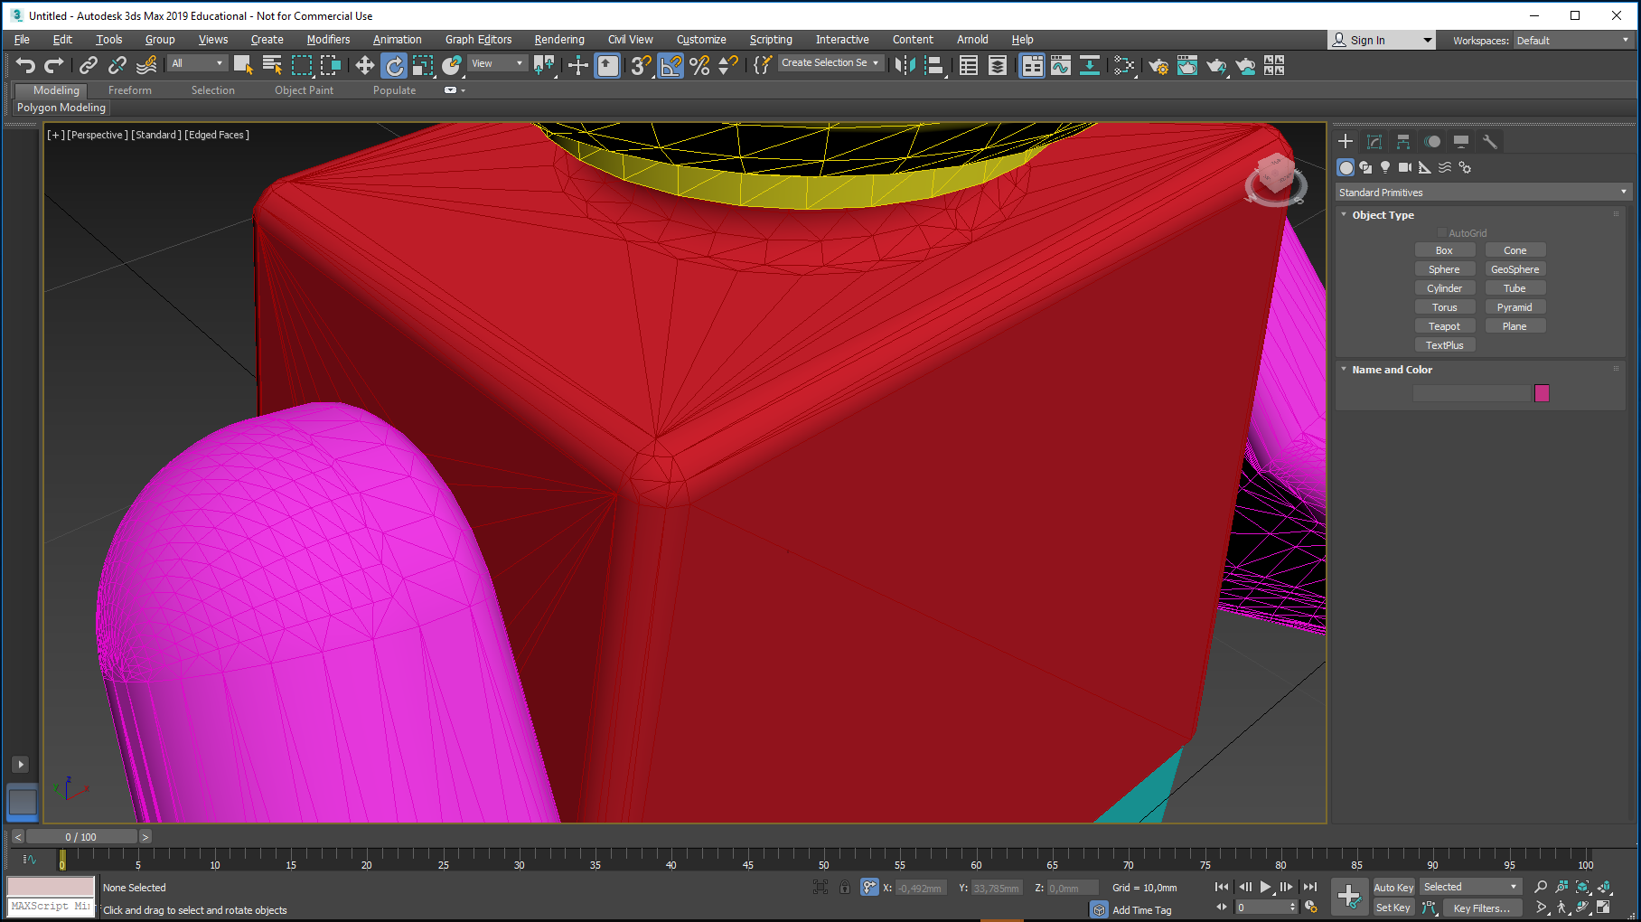
Notice how dense the surface mesh is - lowest value, remember?

Slide 17
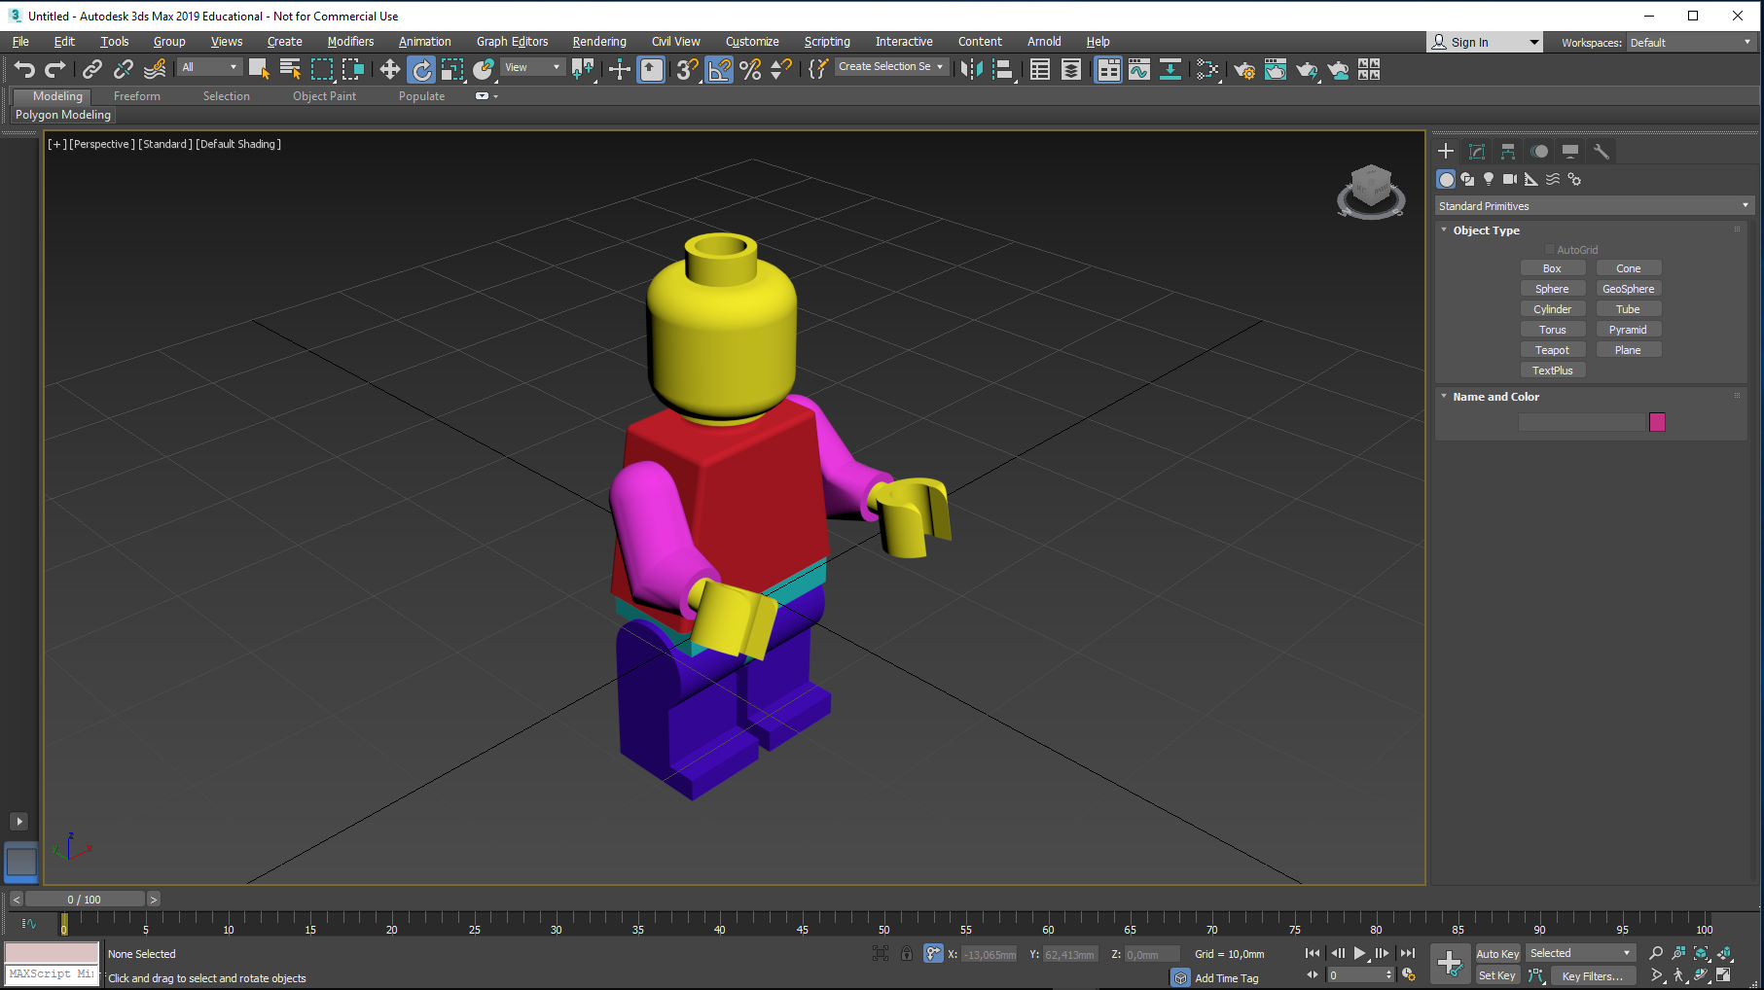
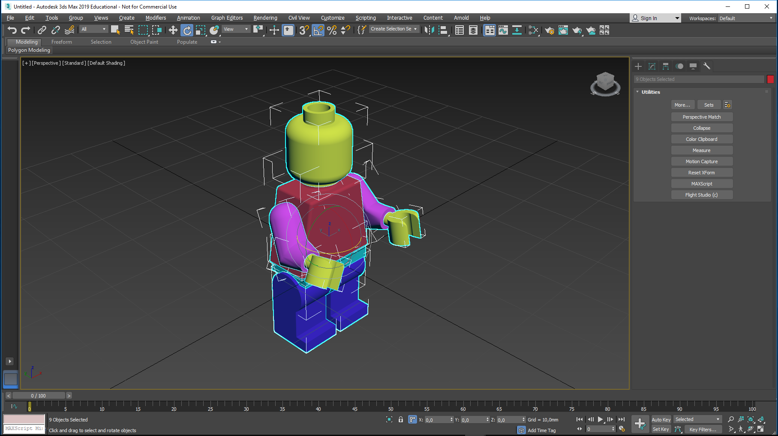
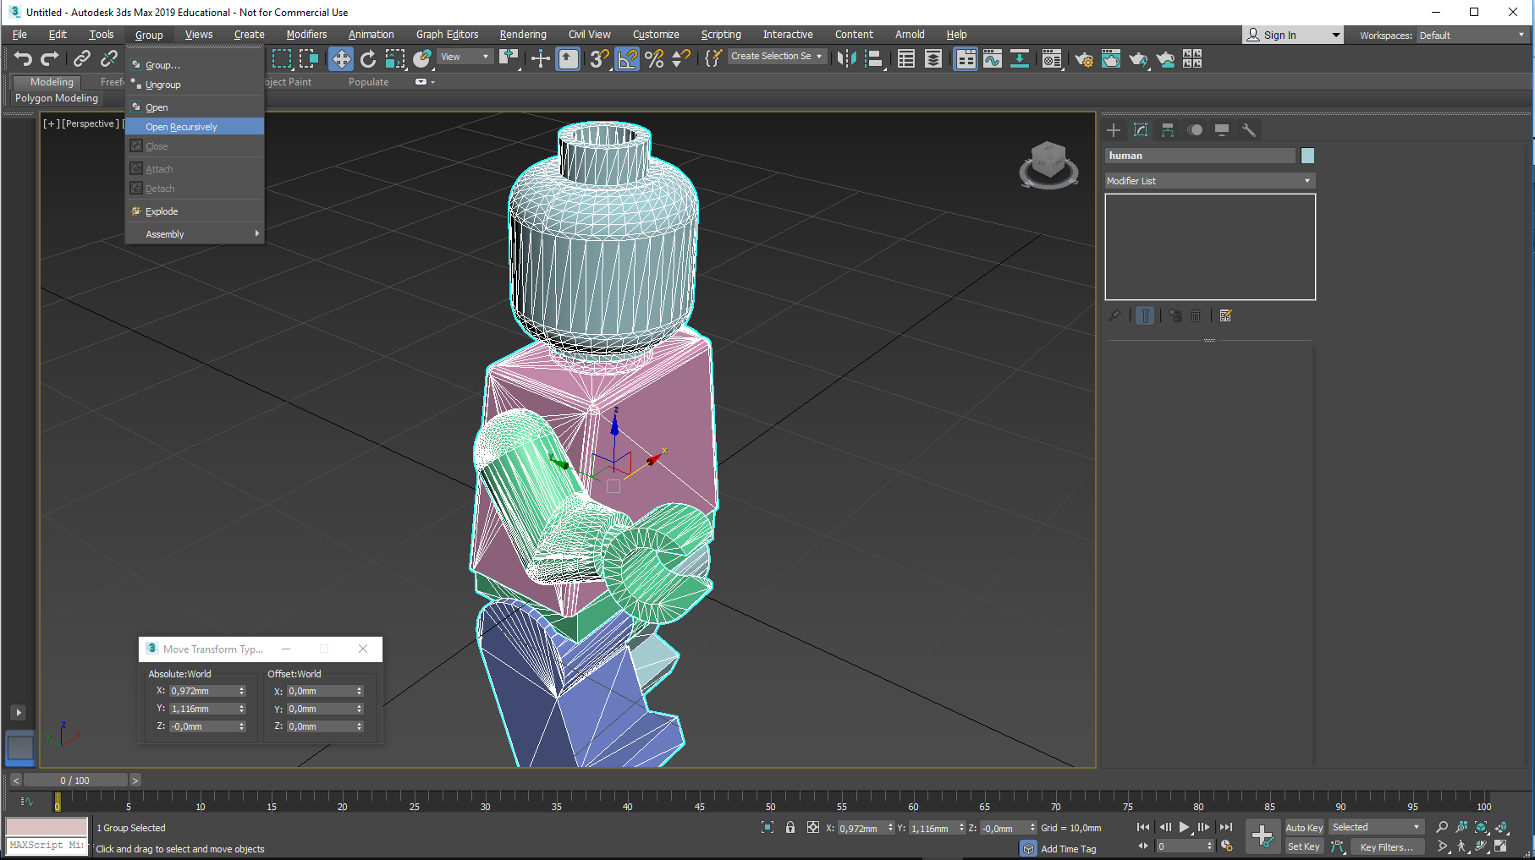
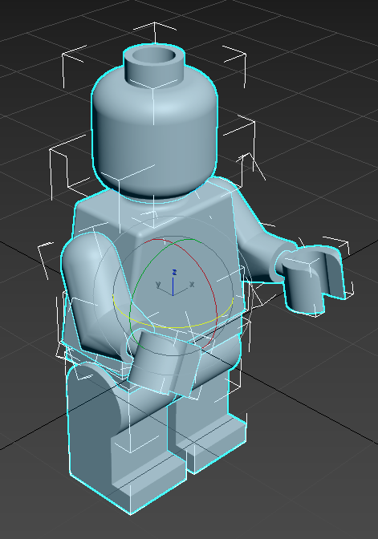
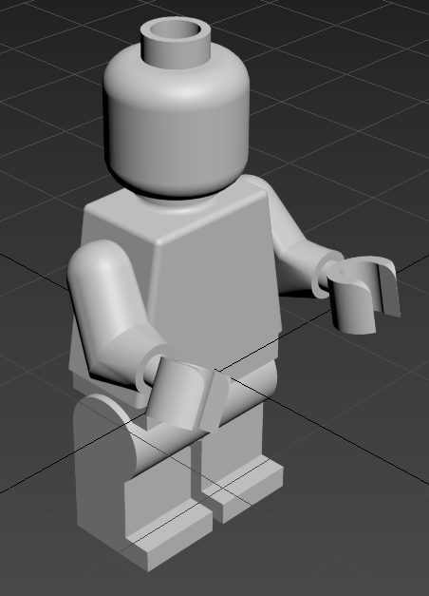
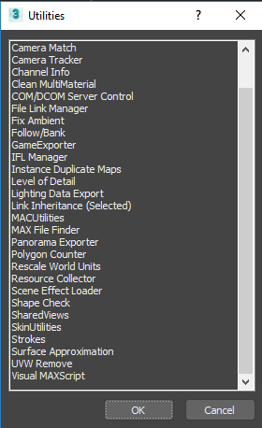
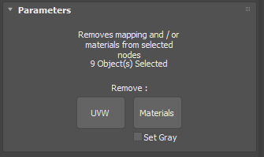
Select all of Mr. Lego…
Select the spanner icon (Utilities…), followed by
More…
After a successful rotation followed by a scaling test, mr. Lego has entered 3ds Max with his default Creo colors… Although they look nice, they create a problem:
They can not be changed…
A cleaning procedure is neccesary…
Scroll down in the Utilities scroll bar and double-click UVW Remove…
Select Materials and Set Gray.
This way the default noncompatible materials (they do not work with the Arnold renderer) are removed from the model

Slide 18
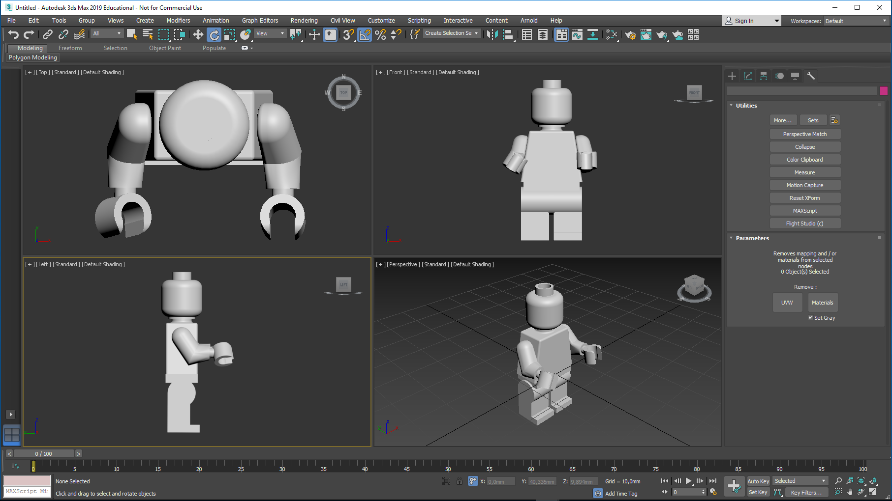
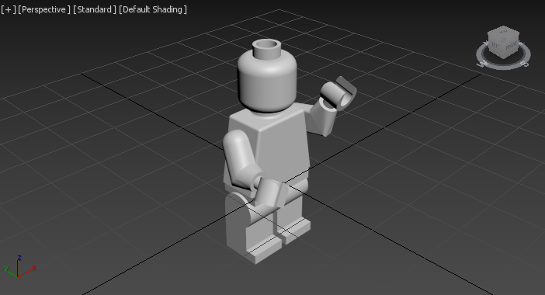
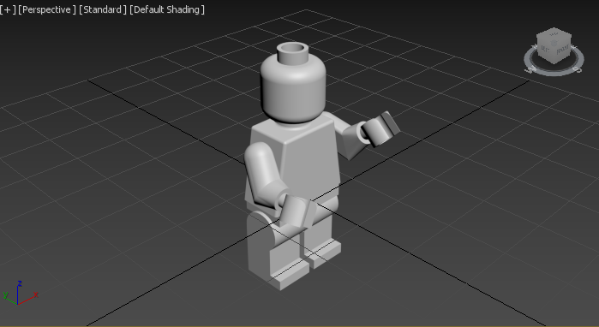
This way Mr. Lego entered 3ds Max. He consists of 8 objects, which can be changed individually…
For some purposes it can be convenient to define him as a group.
This can make it safer to move him around…
A group can be opened and closed again, if you want to work with one object at a time.
Bye, bye…

