Slide 1
Managing materials in
3ds Max:
The LEGO MAN getting dressed
Tomas Benzon, DTU/MEK, October 2018

Slide 2
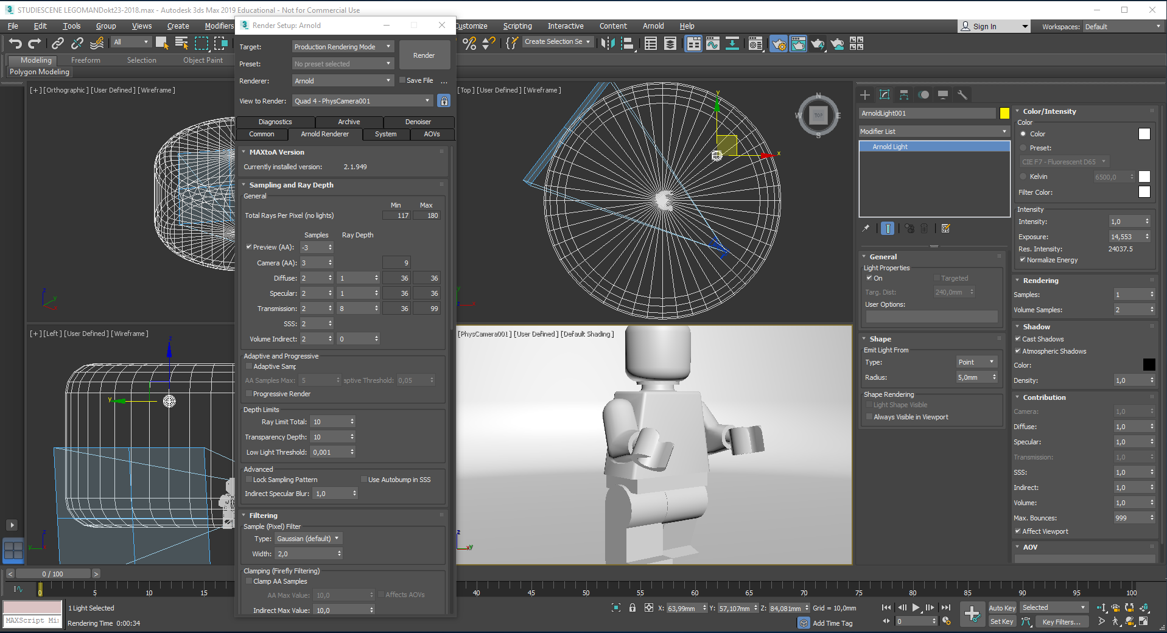
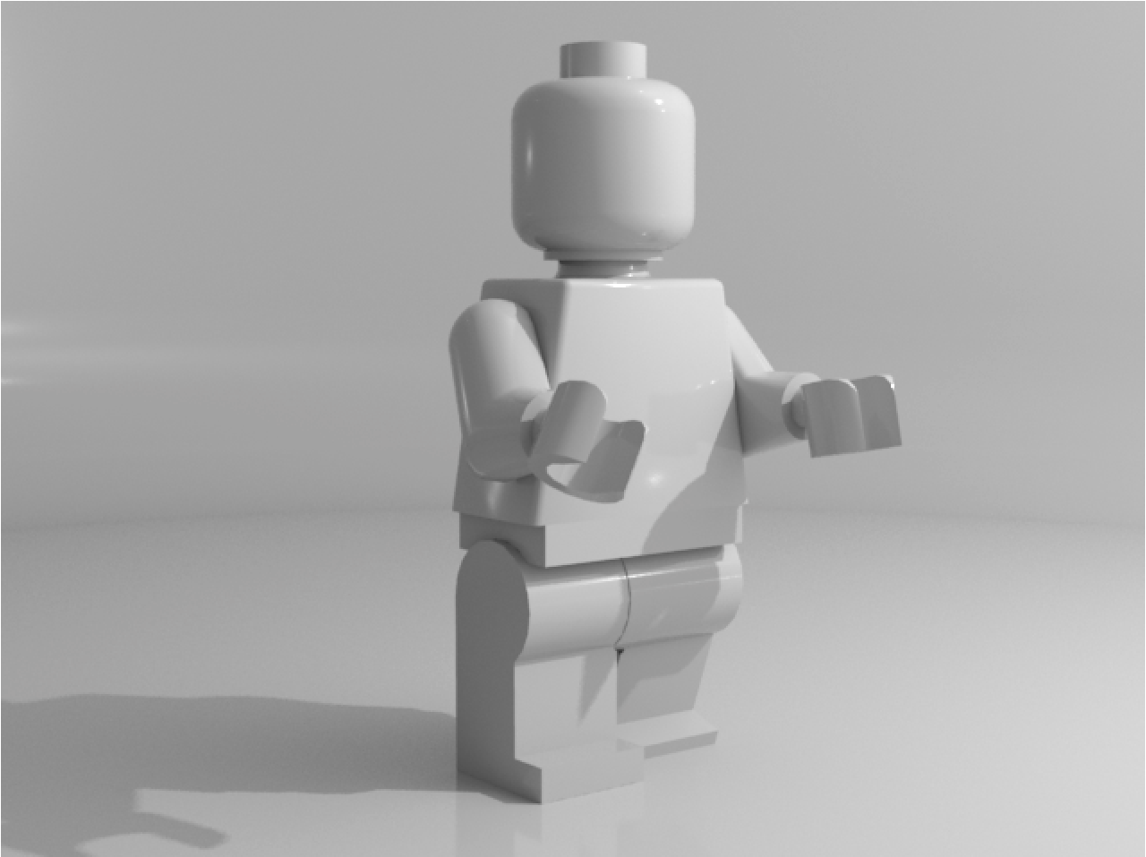
This tutorial is a continuation of Visualization of the LEGO man, describing how to place him in a virtual photo studio, arranging light and a camera, allowing you to render him, and save the pictures.
Here I will demonstrate how to put materials and textures on him, imitating the looks and appearances from real life, in order to create realistic looking images.
Before starting this tutorial you must copy the map Day-3 to your X-drive:
P:\Courses \41618-3ds Max Design\day-3.
That done, open your completed Visualization of the LEGO man 3ds Max file, containing Mr. Lego himself, a studio and a lamp.
This tutorial is a continuation of Visualization of the LEGO man, describing how to place him in a virtual photo studio, arranging light and a camera, allowing you to render him, and save the pictures.
Here I will demonstrate how to put materials and textures on him, imitating the looks and appearances from real life, in order to create realistic looking images.
Before starting this tutorial you must copy the map Bitmaps to your X-drive:
P:\Courses \41618-3ds Max Design\Bitmaps.
That done, open your completed Visualization of the LEGO man 3ds Max file, containing Mr. Lego himself, a studio and a lamp.

Slide 3
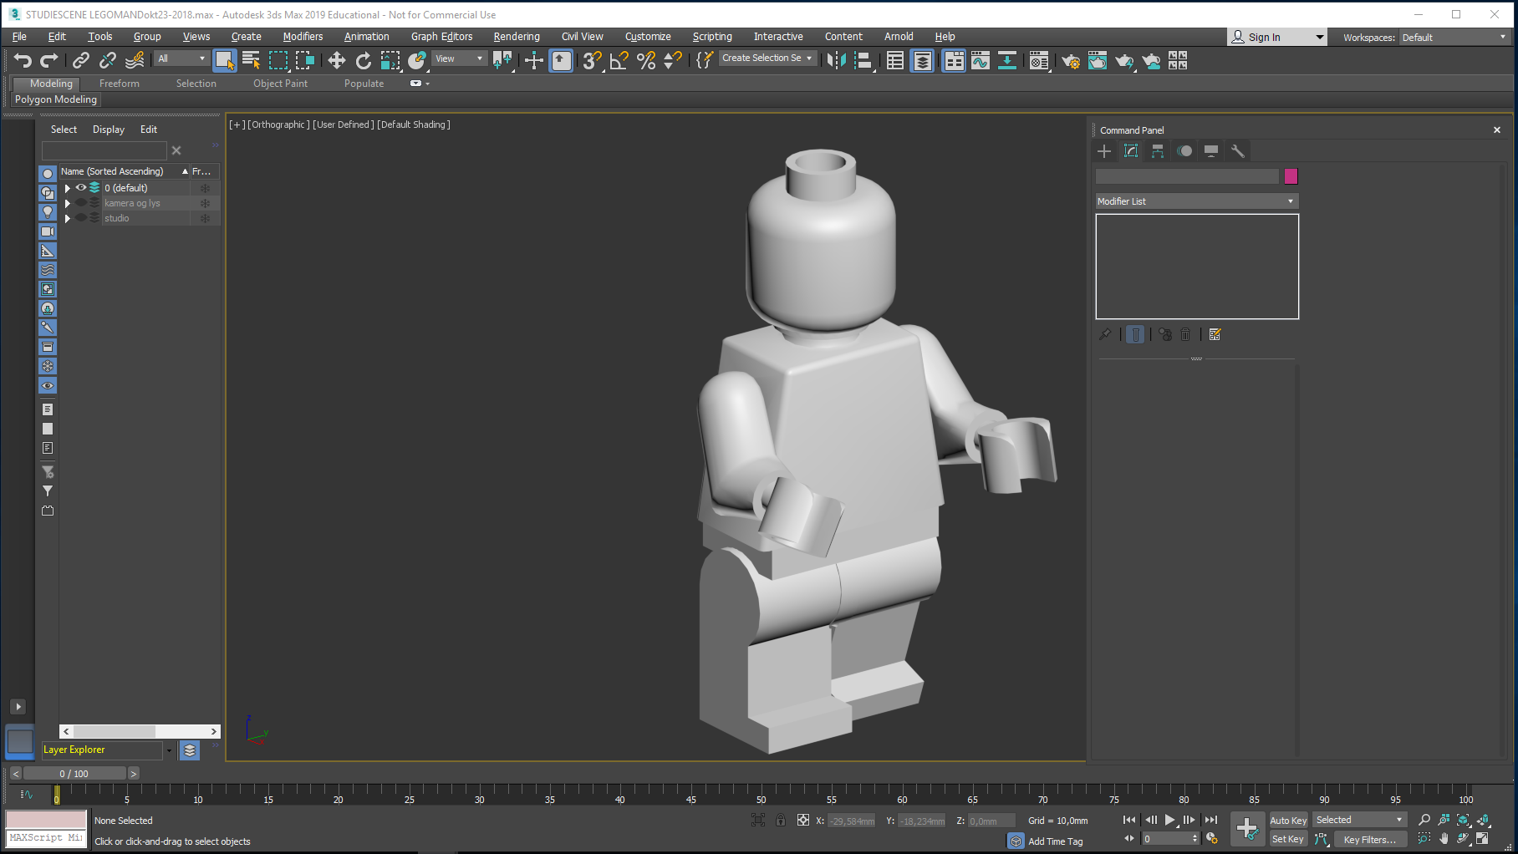
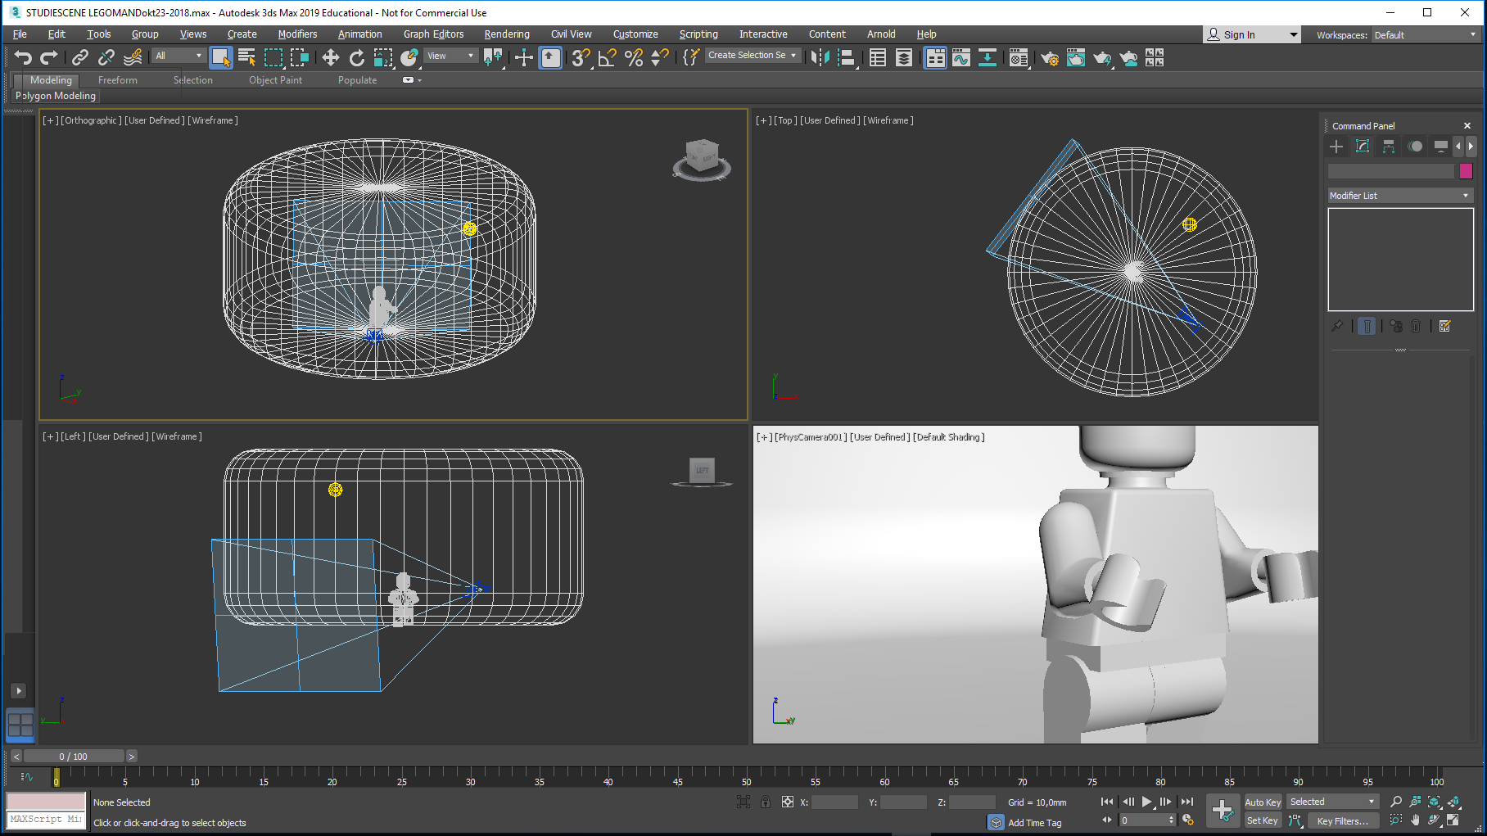
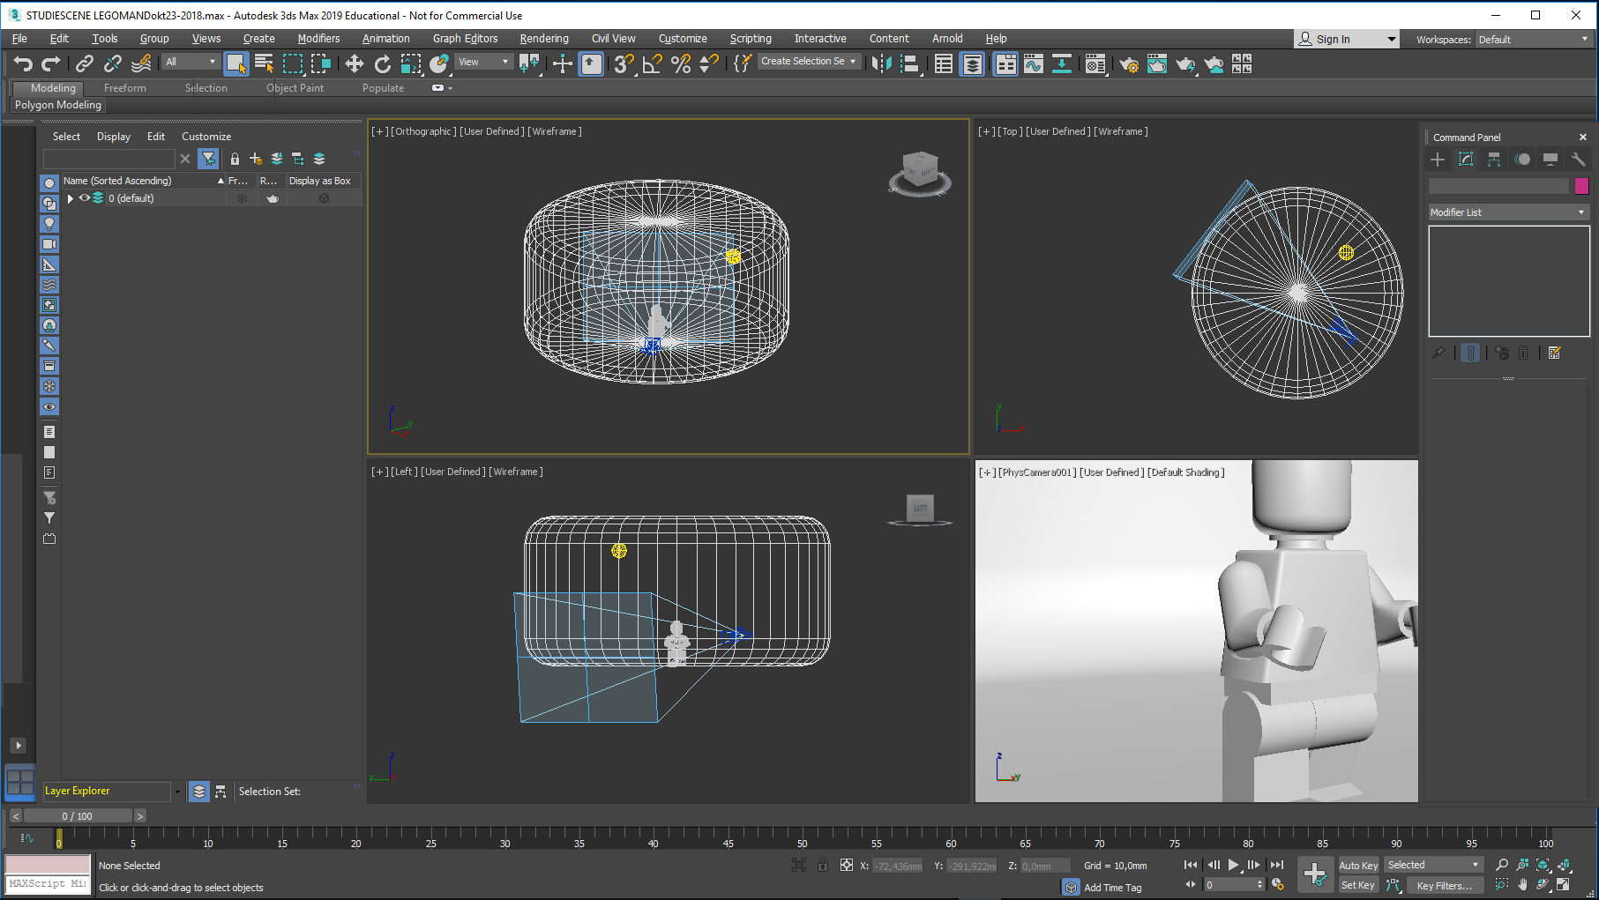
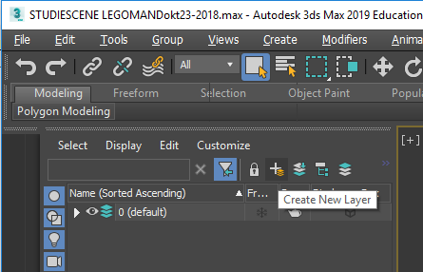
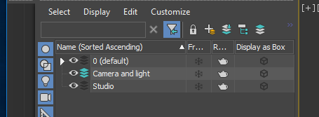
Layer dialogue
This scene is prepared by opening the layer dialogue
This tutorial is a continuation of Visualization of the LEGO man, describing how to place him in a virtual photo studio, arranging light and a camera, allowing you to render him, and save the pictures.
Here I will demonstrate how to put materials and textures on him, imitating the looks and appearances from real life, in order to create realistic looking images.
Before starting this tutorial you must copy the map Bitmaps to your X-drive:
P:\Courses \41618-3ds Max Design\Bitmaps.
That done, open your completed Visualization of the LEGO man 3ds Max file, containing Mr. Lego himself, a studio and a lamp.
Move the viewport edge to the right to reveal all layer commands
Create a new layer…”Studio”
And another…”Camera and Light” - watch out that this layer is not placed on the ”Studio” layer (and getting invisible, when layers are collapsed)

Slide 4
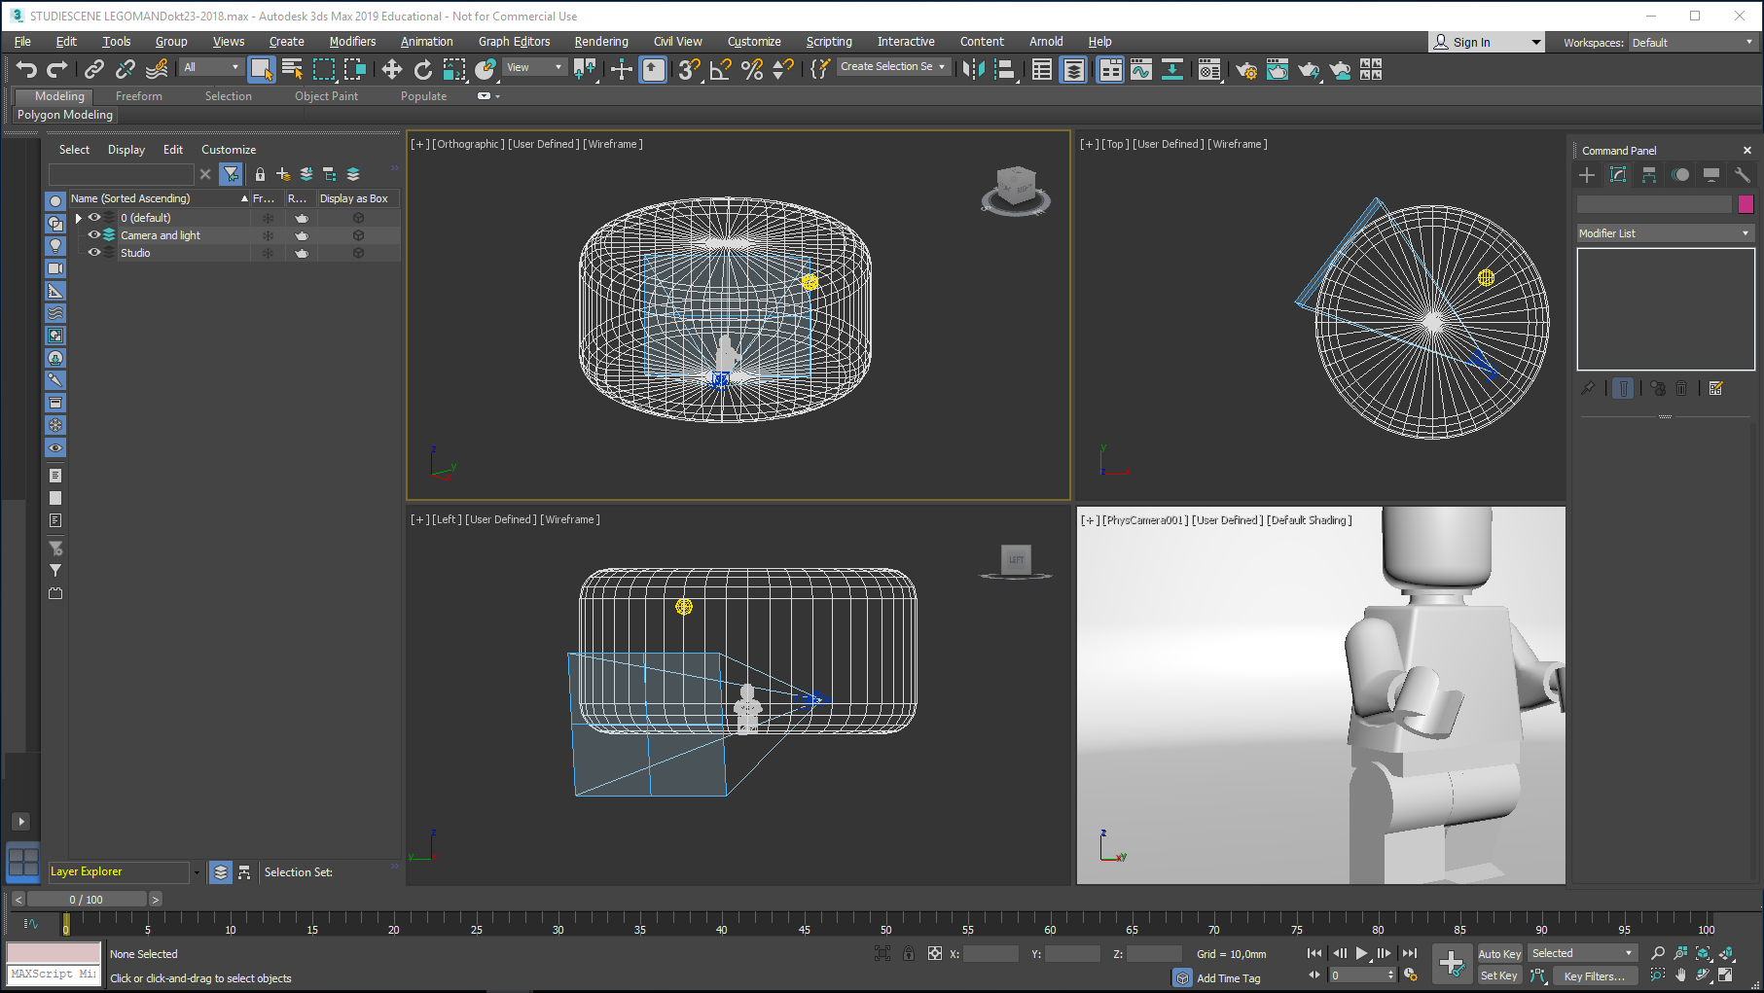
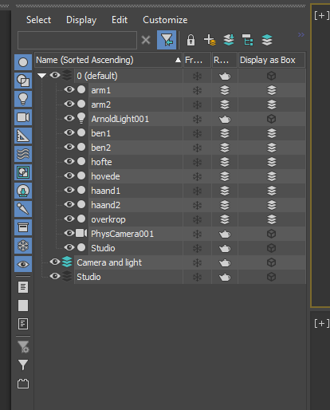
Click the small triangle at layer 0…
Layer 0 expands…now, pull the ArnoldLight001 to the Camera and Light layer…do likewise with PhysCamera001
Similarly, pull the Studio to the Studio layer

Slide 5
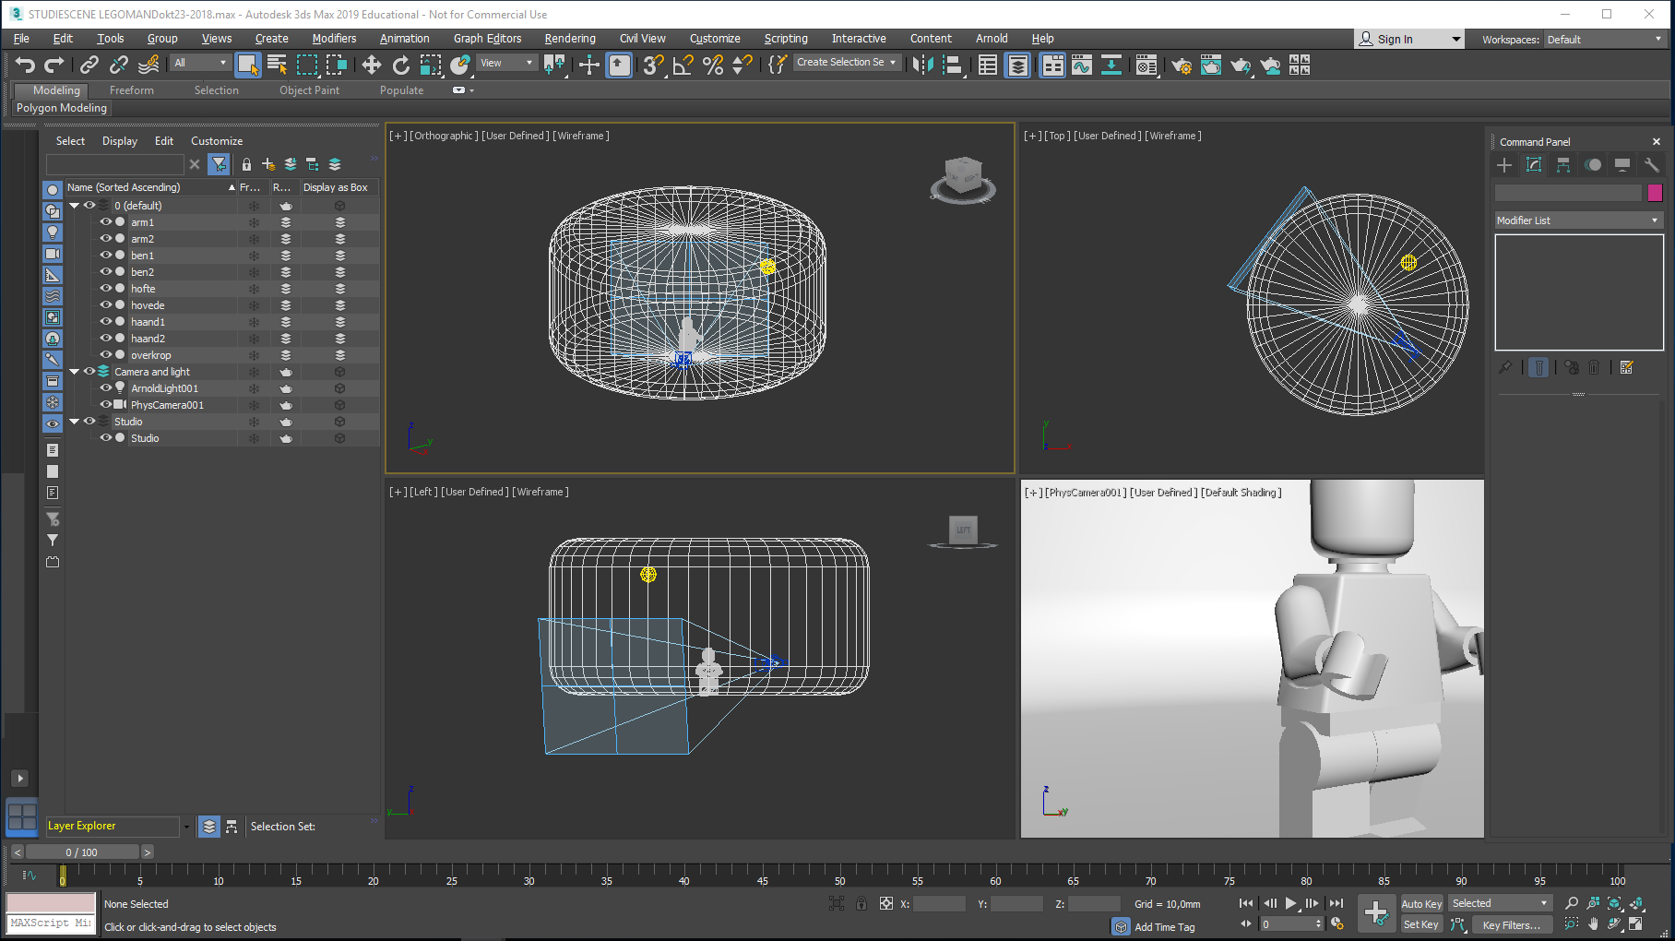
Turn off the Camera and Light layer and the Studio layer by clicking on their eyes…
Make layer 0 the active one by clicking on the right side of its eye – a green icon displays

Slide 6
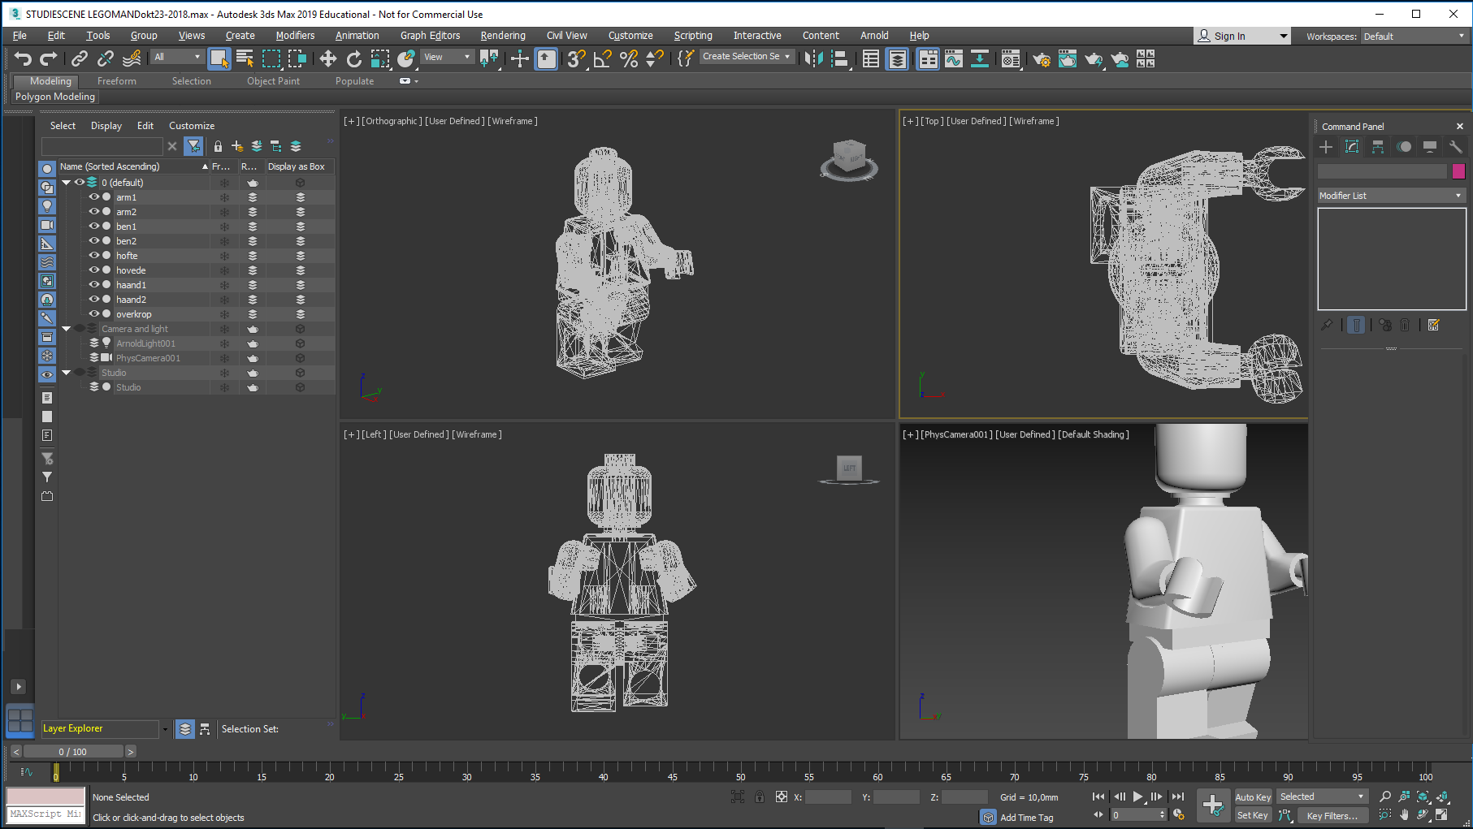
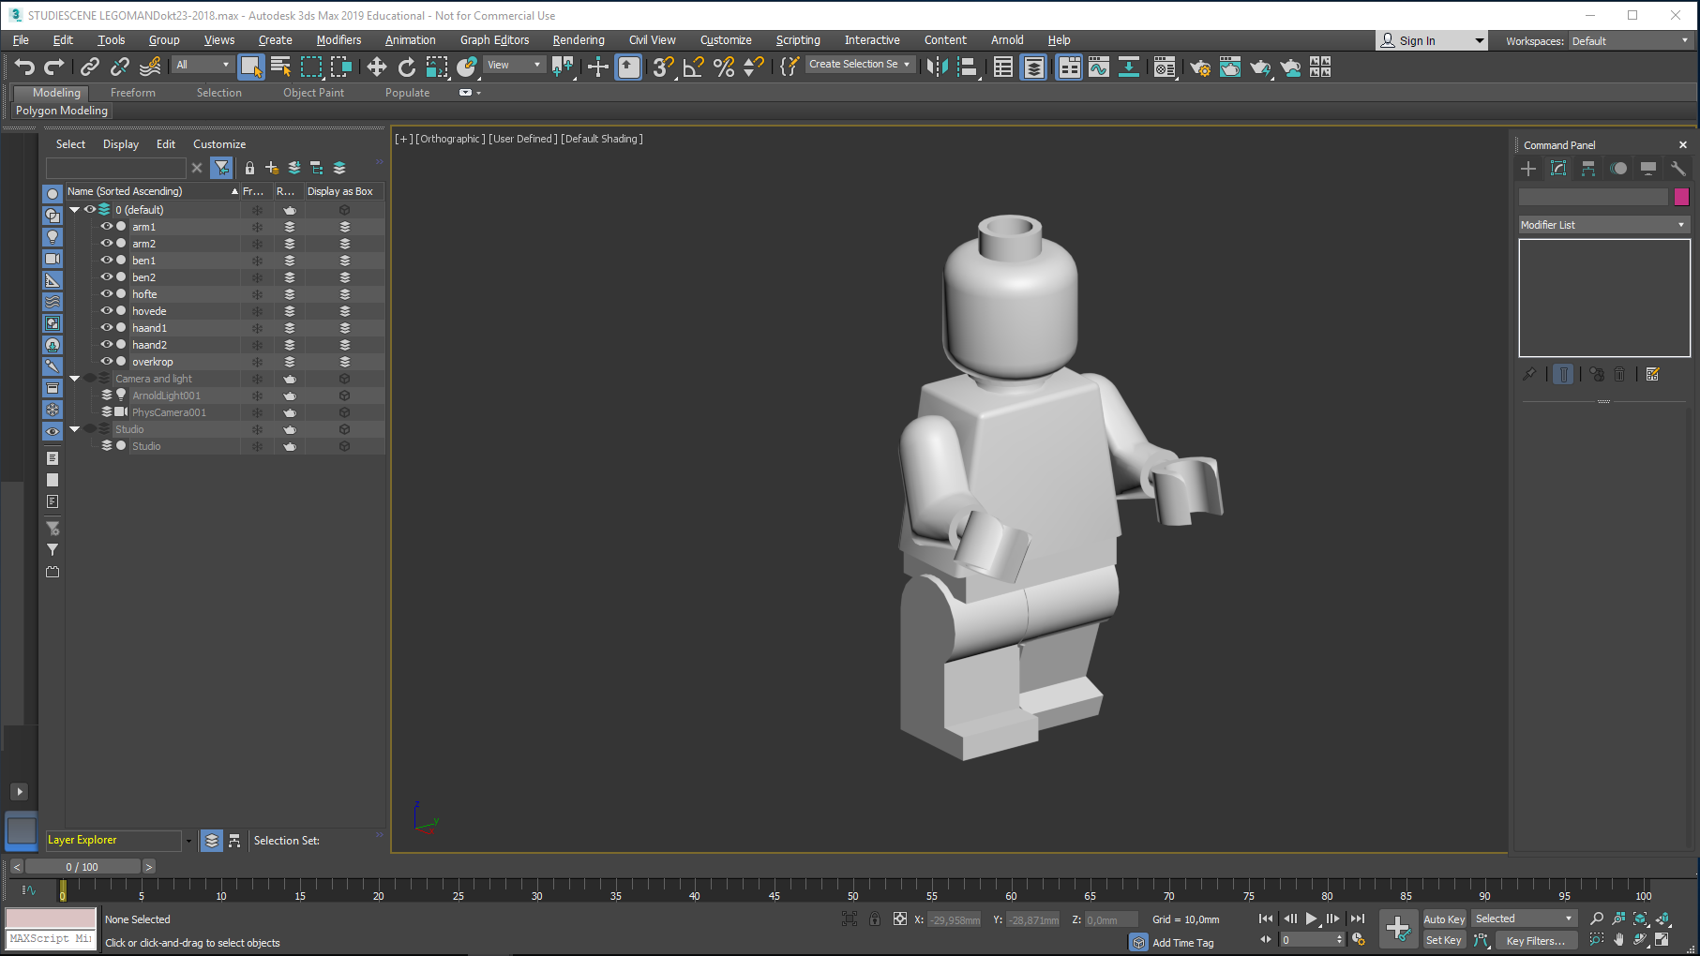
Mr. Lego should be the only visible object now…
I have maximized him using CTRL ALT Z in each viewport…
- Followed by ALT W in the top left viewport…and shaded him using F3

Slide 7
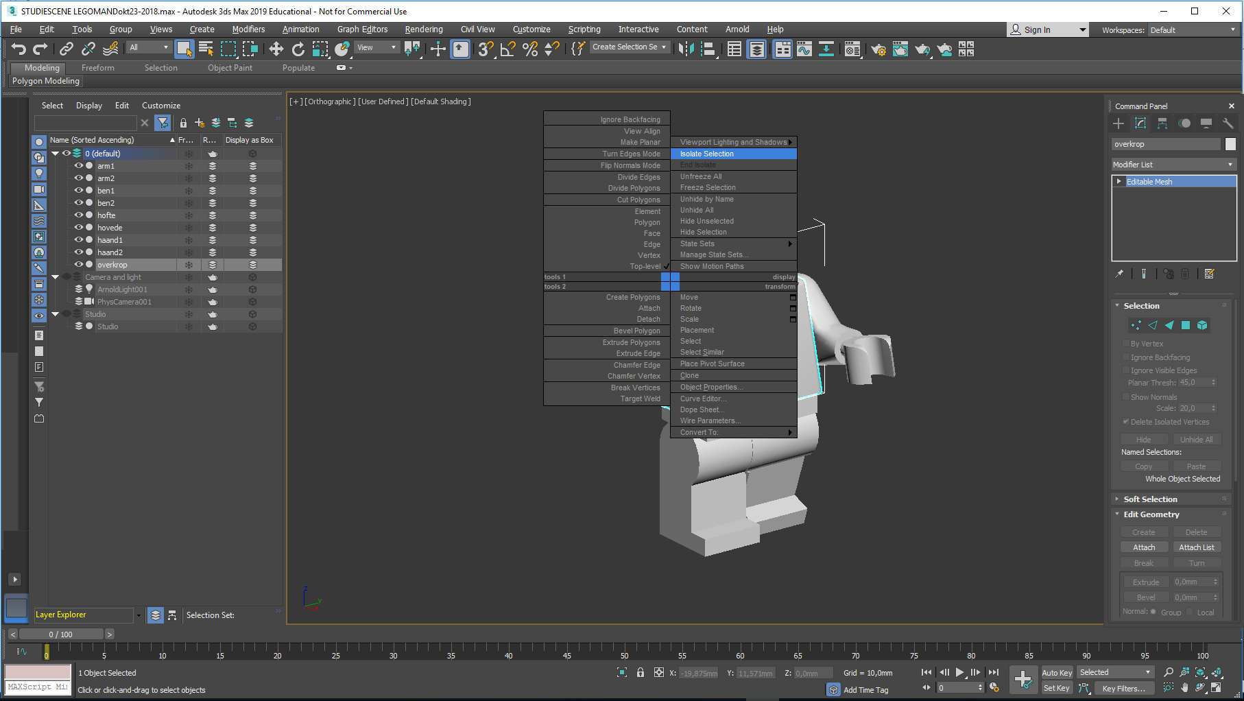
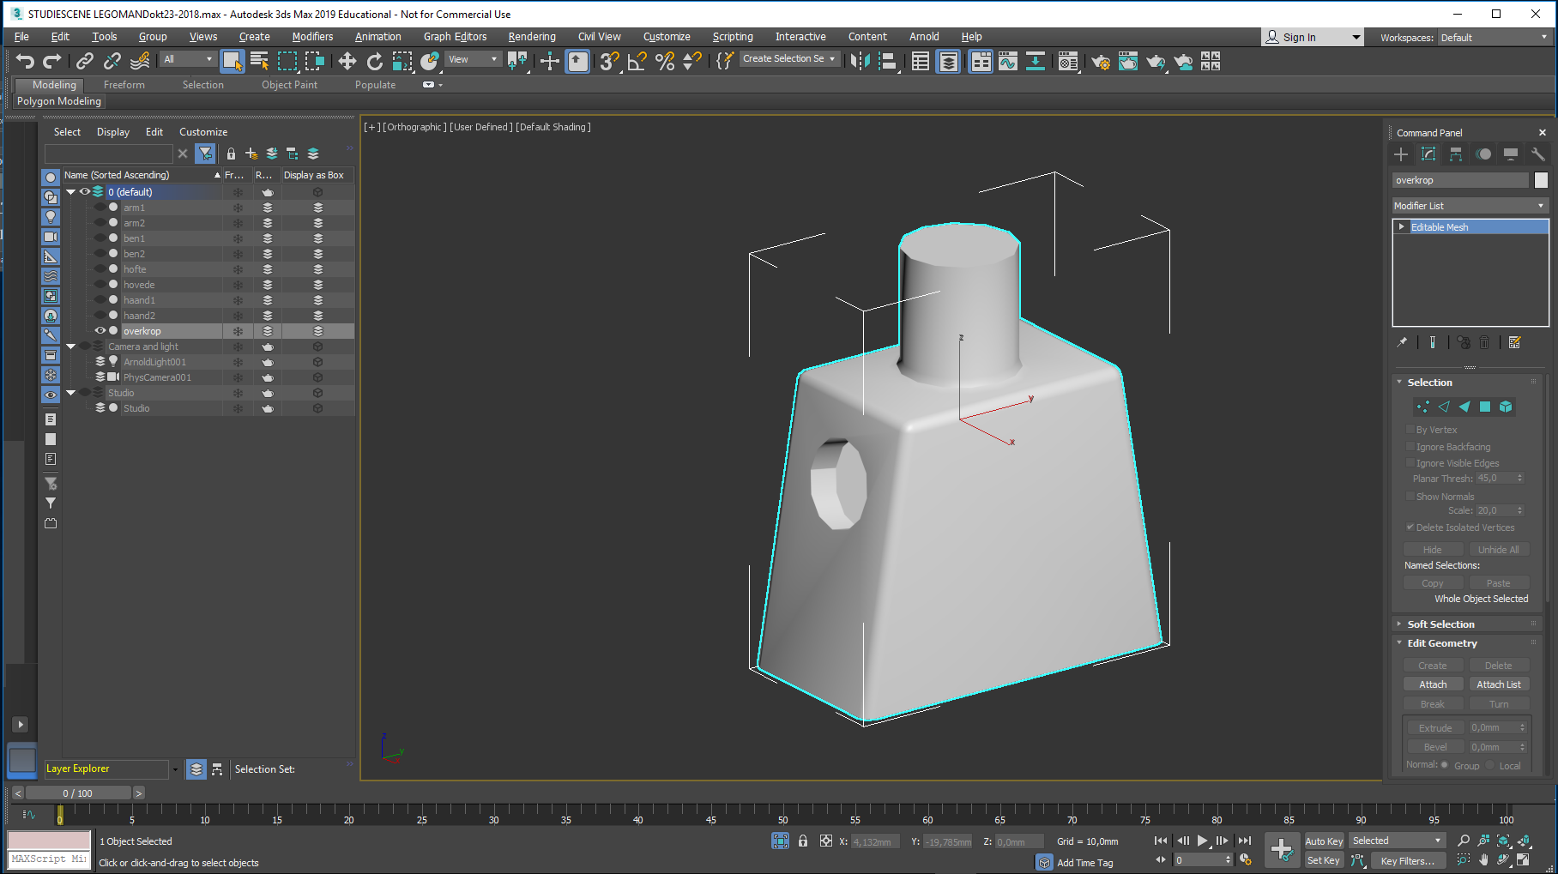
You should only see the torso now. Right-click it and choose convert to Editable poly. It may already be in this state Now it is time to define which polygons on the torso should be covered by a jacket (they get ID 1)… And which ones by a shirt. (they get ID 2) this ID 1 and 2 grouping is needed if you want to apply multiple materials on one object - The torso
Time for dressing him up…
My plan is to provide him with a jacket and a shirt…
Click on his torso, rightclick it…
… and select isolate Selection

Slide 8
Click the small triangle

Slide 9
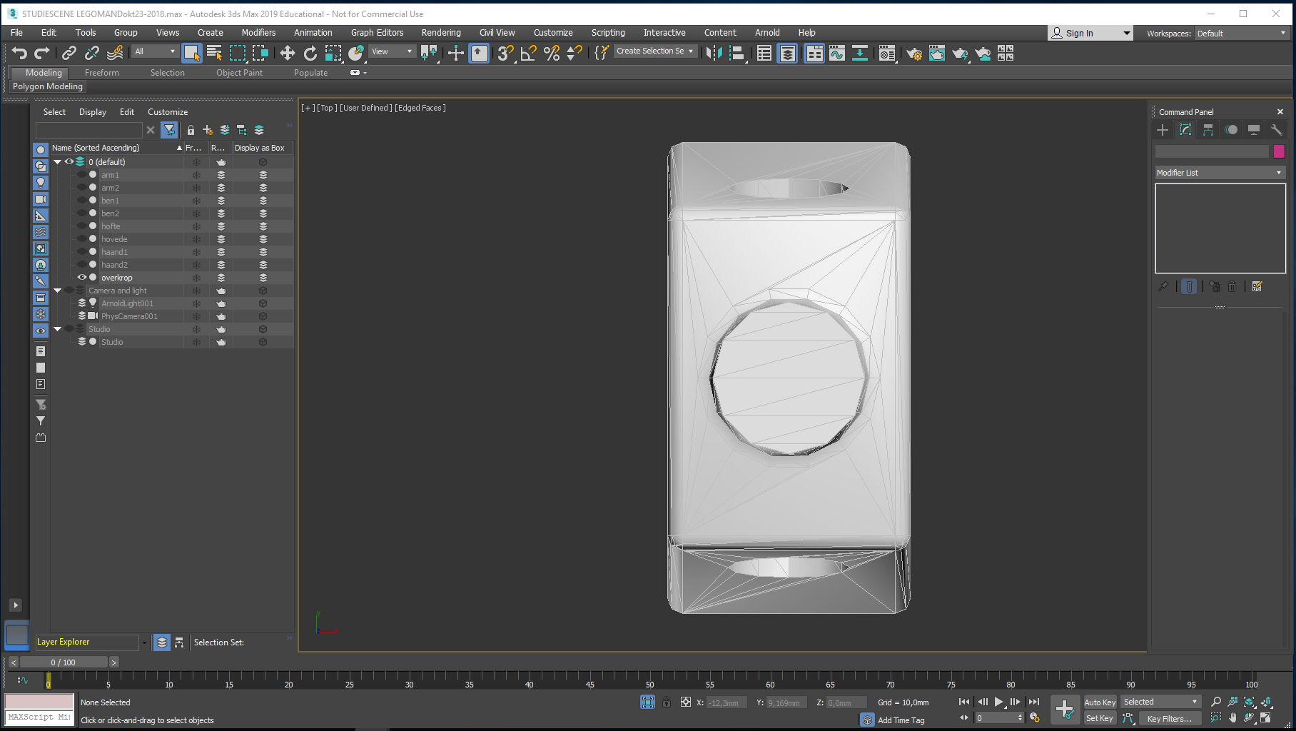
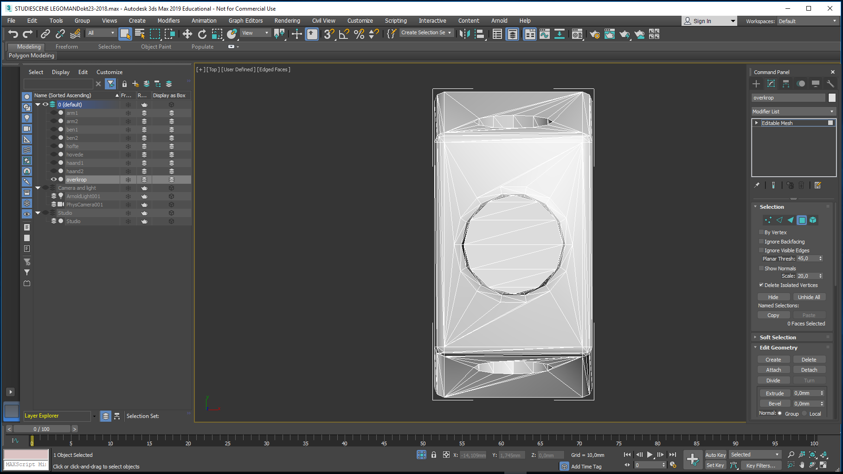
First we define the ID 1 polygons: Arrange a top view… Select the torso…
Click the Modify button… Enter Polygon level…

Slide 10
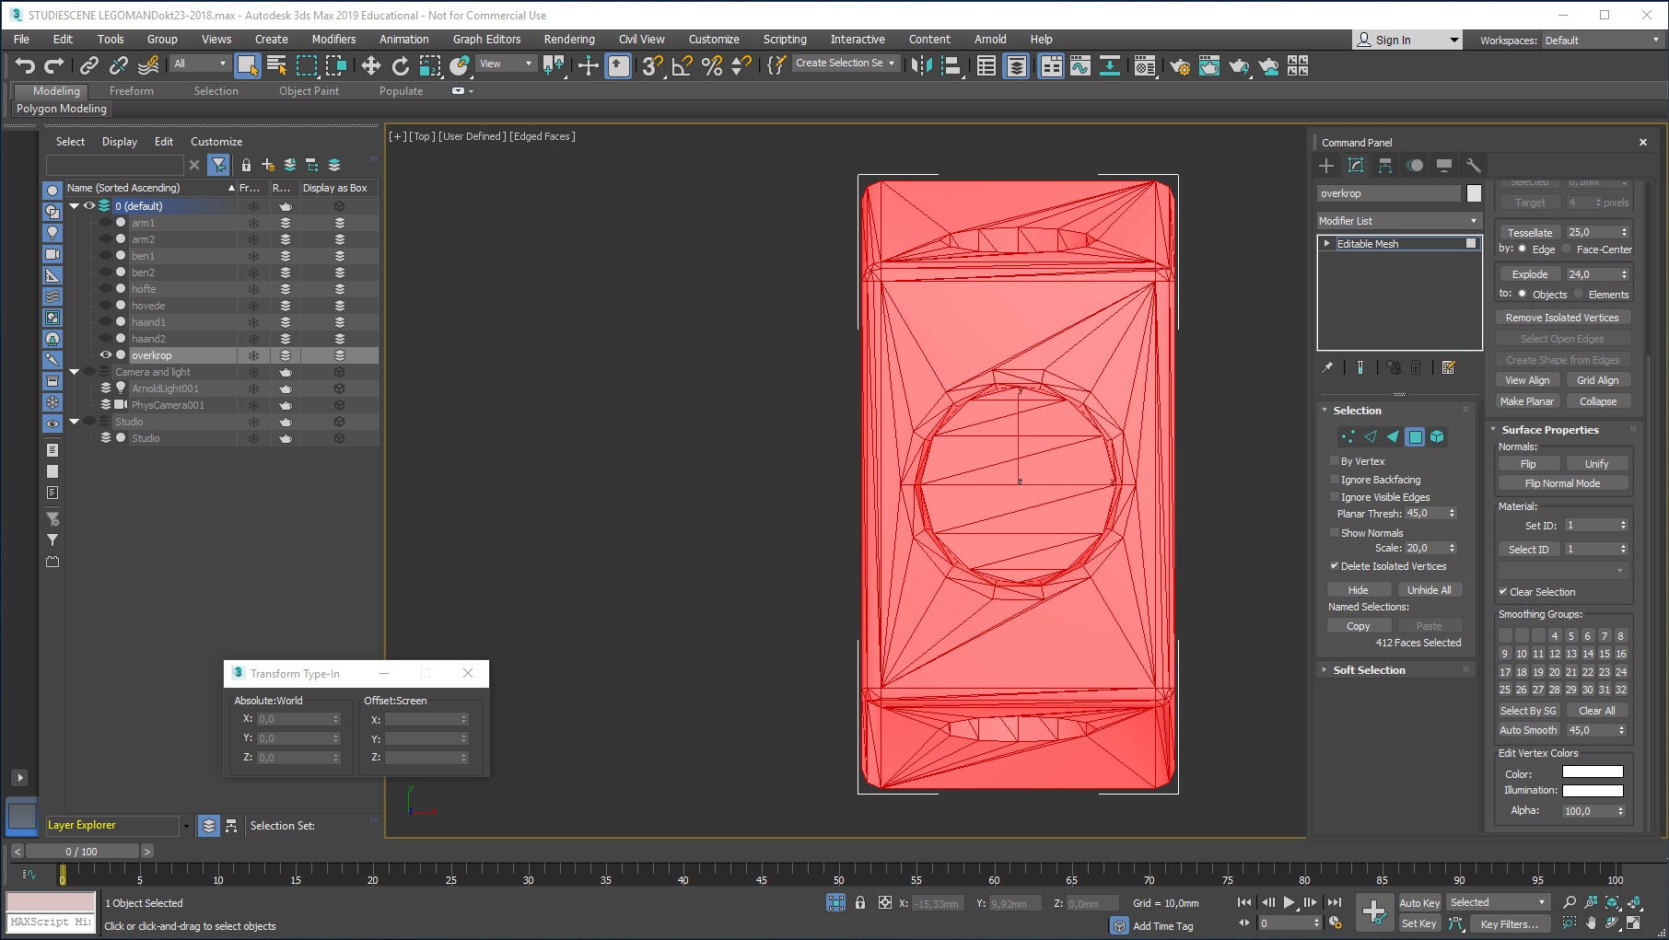
And choose all the polygons of the torso, using CTRL + A.
Set ID = 1…

Slide 11
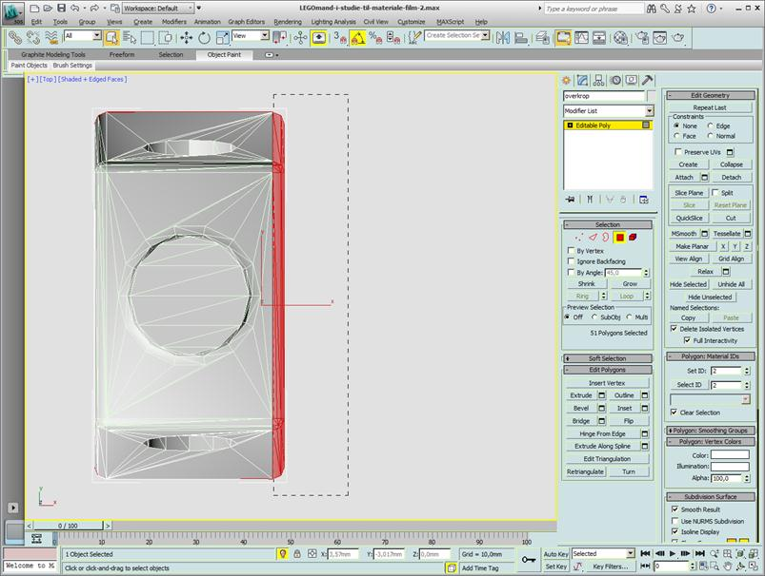
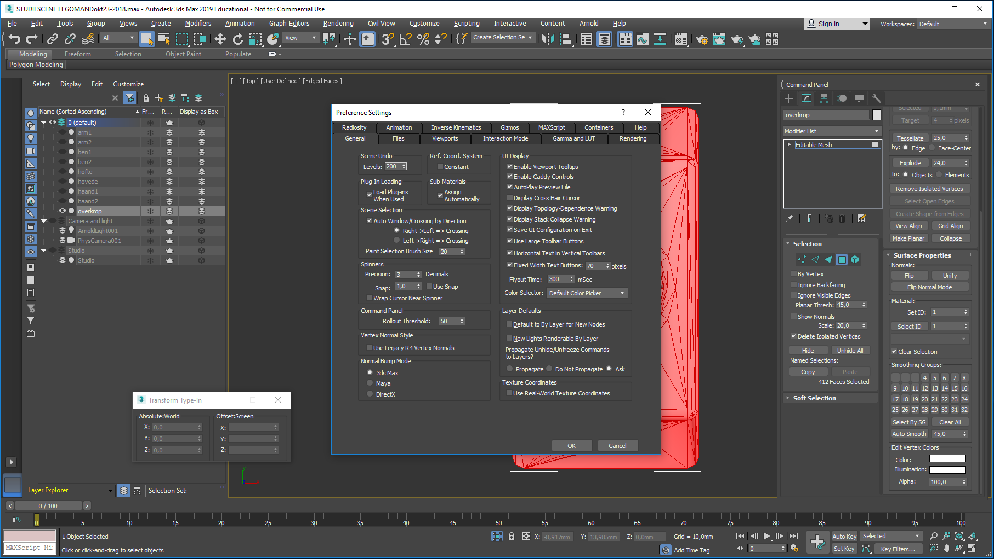
And now the ID 2 polygons: Still in top view, click in the background to deselect the polygons… Choose from right to left the polygons on his chest and set their ID = 2
We need to check a setting now:
Enter Customize
Verify that Scene Selection has Auto Window/Crossing = on, and Right to Left = on

Slide 12
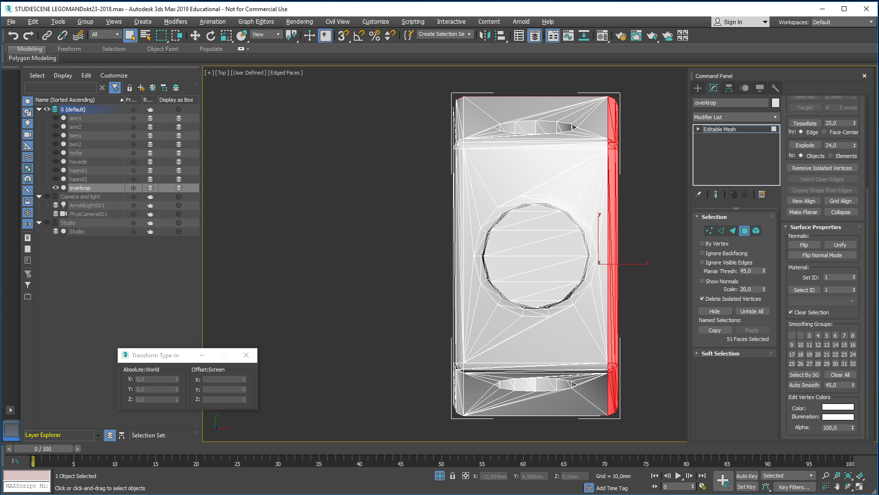
And now the ID 2 polygons: Still in top view, click in the background to deselect the polygons…
Choose from right to left the polygons on his chest and set their ID = 2

Slide 13
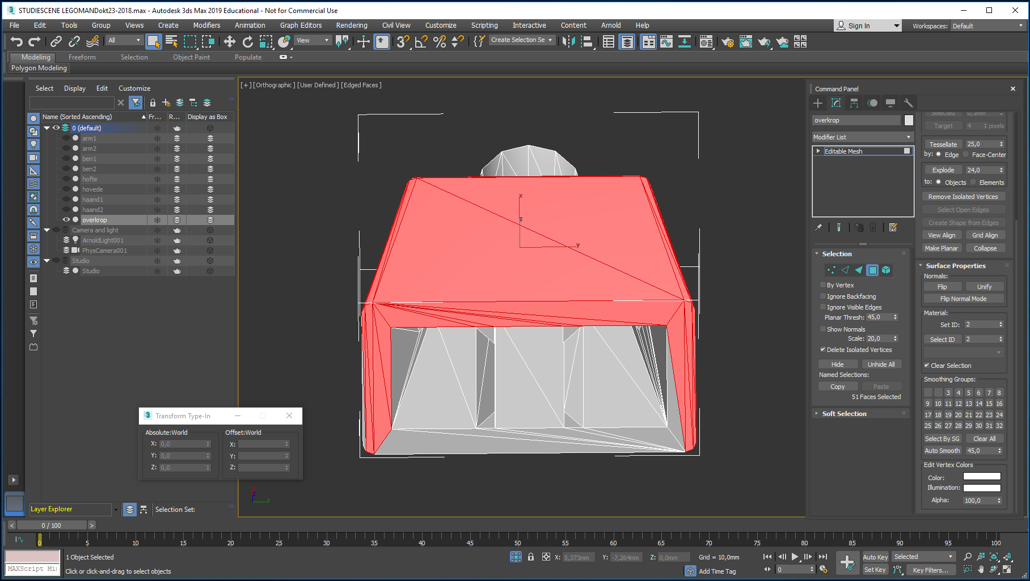
Rotate the view and use Select ID to check the polygon ID values. Here, it looks like most of the bottom polygons are ID’ed to 2. They should be converted to ID 1…
So: Jacket = ID 1
Shirt = ID 2
Remember this!
Fashion dictates that Mr. Lego dresses in a giraffe patterned jacket and a striped shirt.
To be able to control the size and the placement of these maps (images, really), we need to place 2 UVW Maps on his torso.

Slide 14
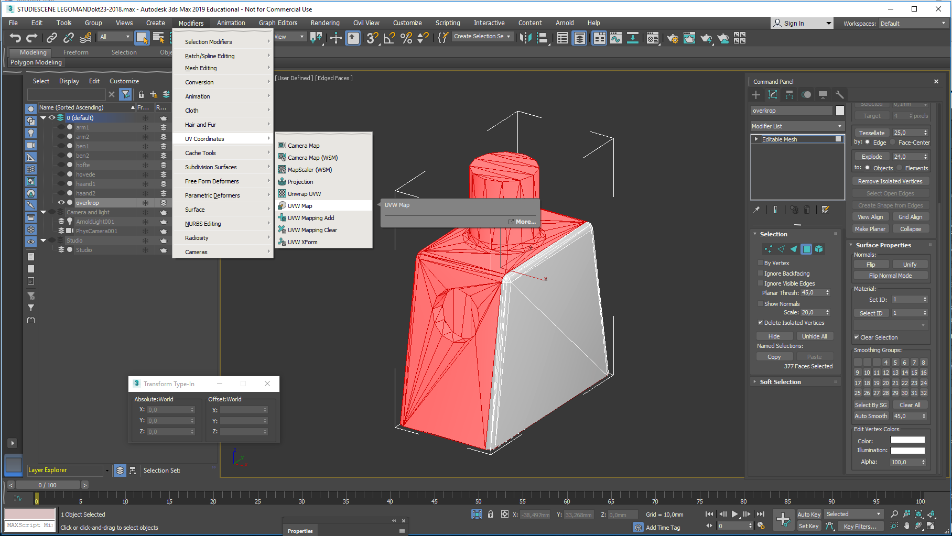
Select the ID 1 polygons and Choose UVW Map as shown.
This way the Map will be assigned to the ID 1 polygons.

Slide 15
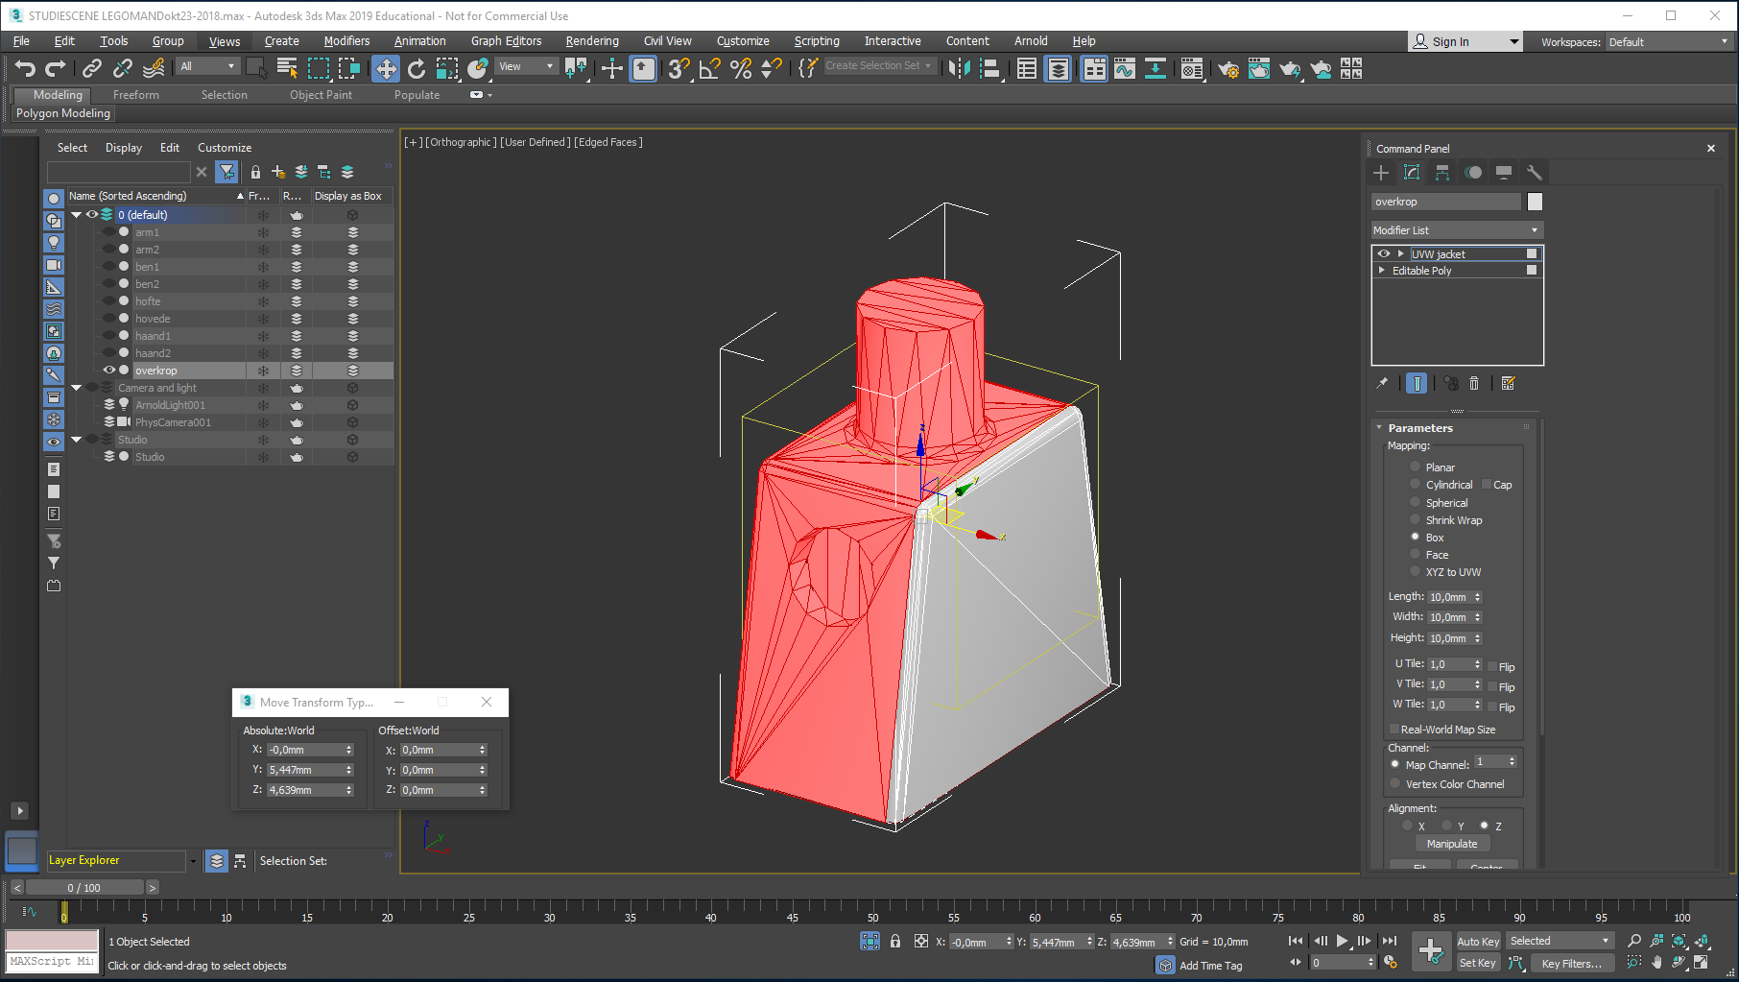
Name the UVW Map
UVW jacket,
choose Box Mapping,
with L W H = 10,10,10
Check that Real-World Map size is Off,
and notice Map Channel = 1

Slide 16
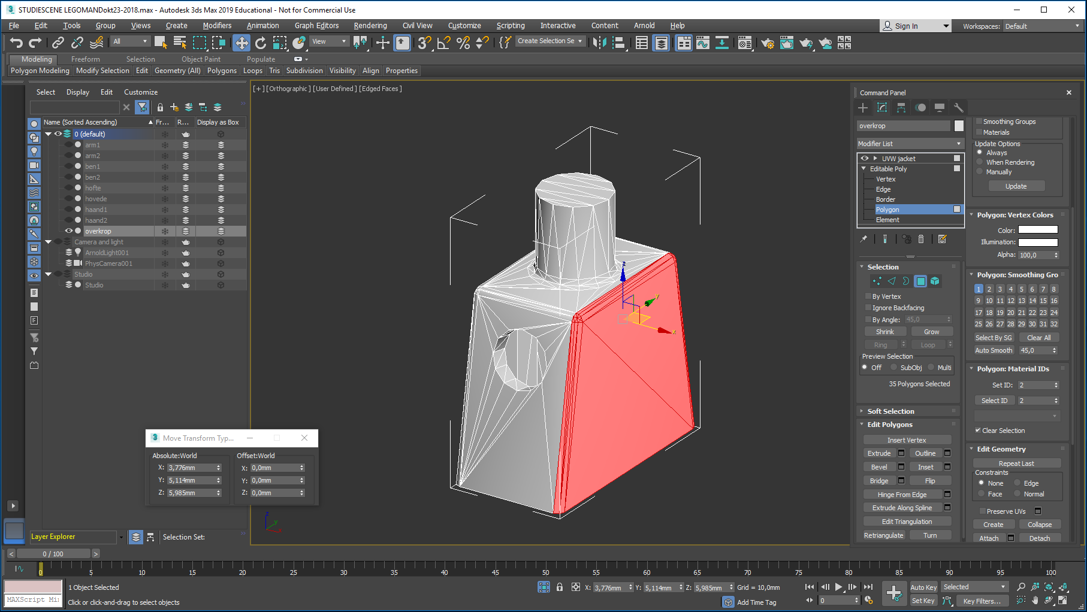
Click the Editable Poly entry, enter Polygon level and select the ID 2 polygons…
Repeat the previous UVW procedure, only with Box L W H = 12,12,12 (so you dont mix up the two UVW boxes) and set Map Channel = 2

Slide 17
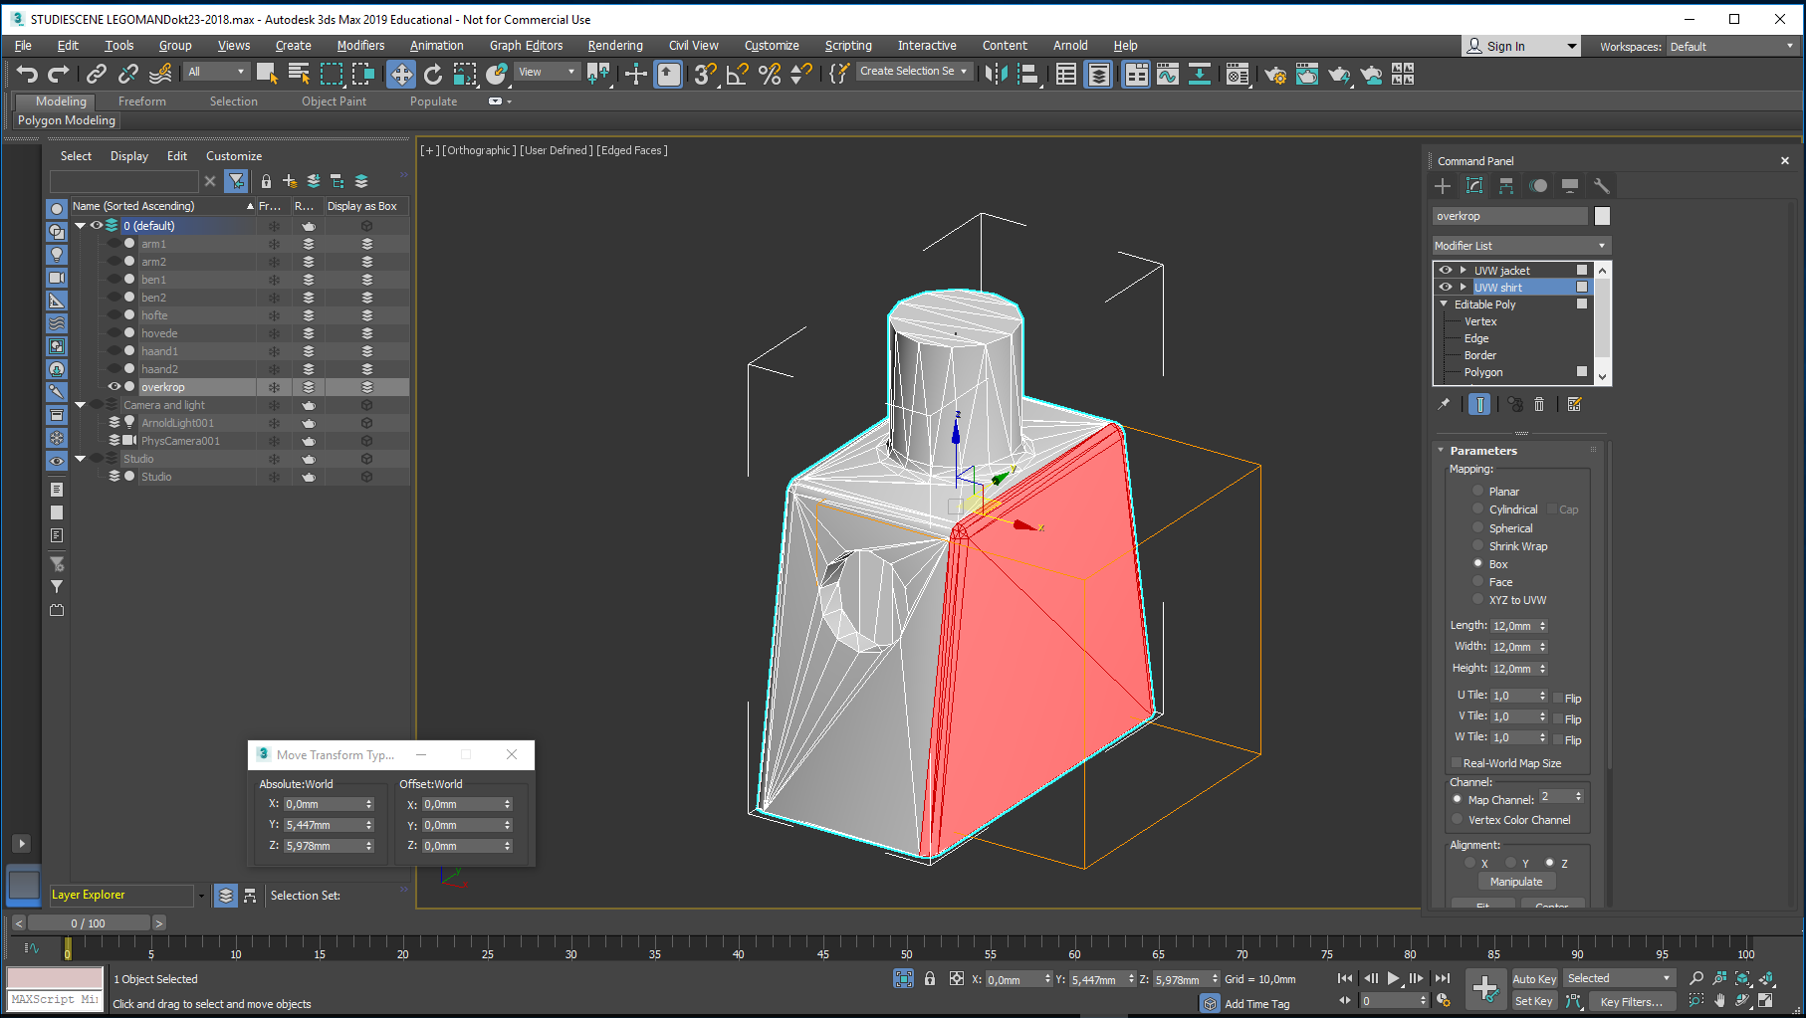
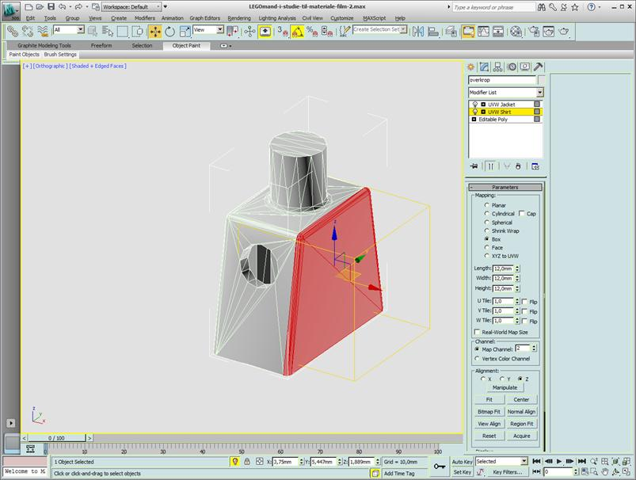
It should look like this… The torso is ready to get dressed.
Now it is time for the Jacket and Shirt material to be designed, using the Material Editor.
Press M to open it…

Slide 18
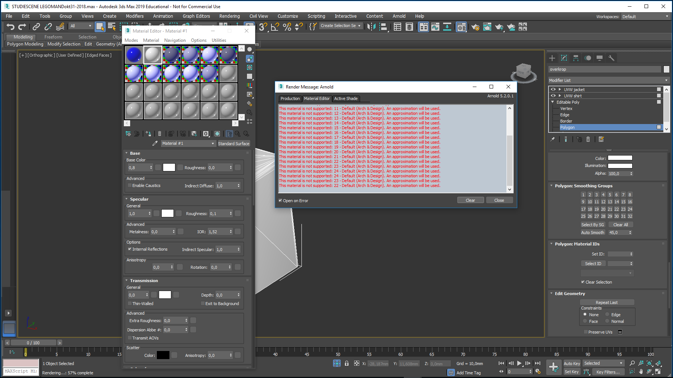
It may look like this…
And there may be an ugly Render Message Arnold warning…just close this…
And enter Modes … change this from Compact to Slate Material Editor

Slide 19
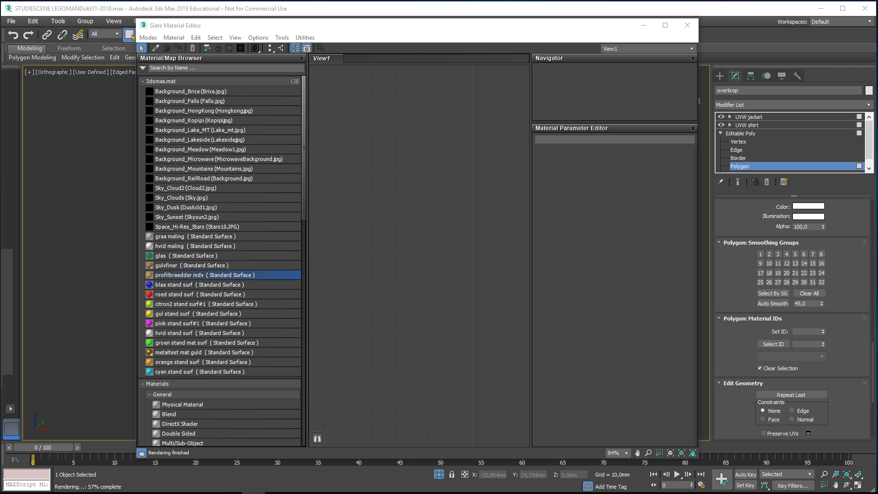
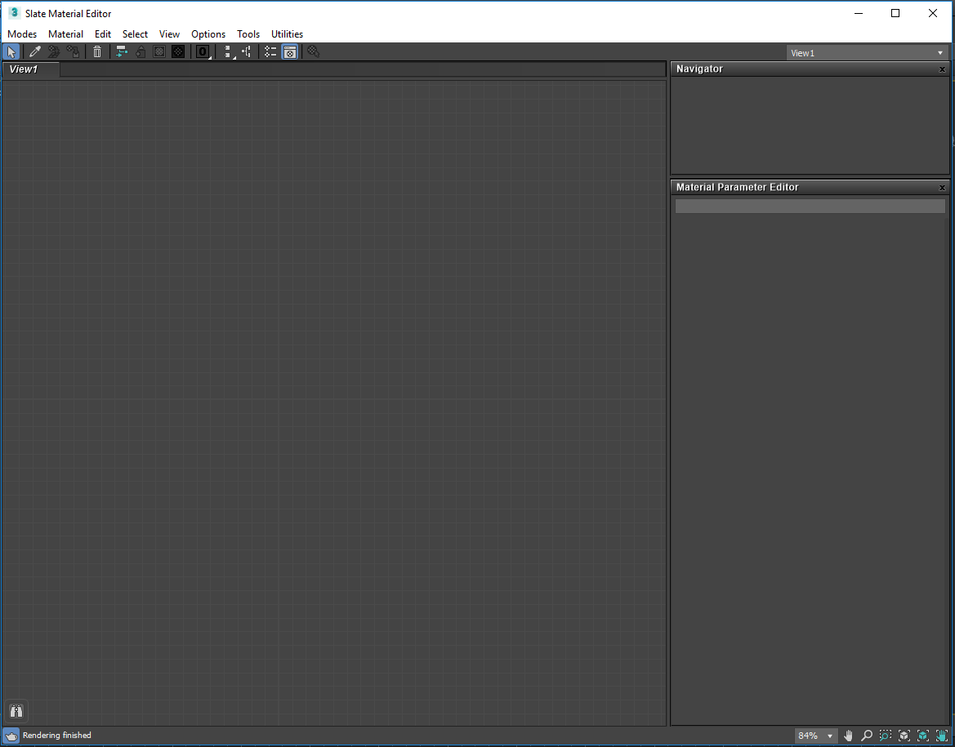
The Slate editor:
To the left is a Material/Map browser with a Material Library
In the middle is a working area
To the right a Navigator and the Material Parameter Editor
No use for the Material Library at this moment.
Close it to get some workspace…

Slide 20
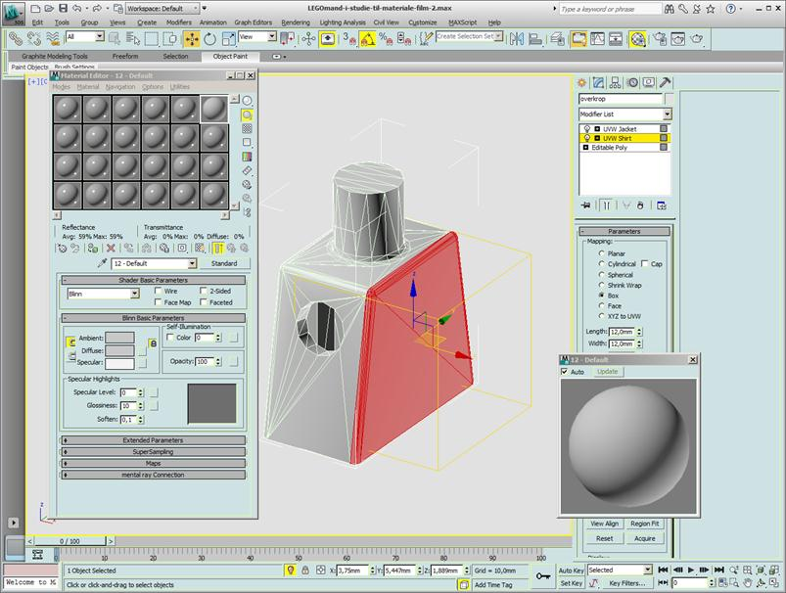
The Material Editor is opened. If it opens as Slate Material Editor, choose Modes and change from slate to compact A quick overview: Sample slot. This one is the active one, shown by the white edge Naming field Entry to the Material/Map browser. The text on this button could display as Arch & Design or Physical material instead of Standard… Close-up view: If you double-click the active Sample slot you will get this closer look. Check that Auto-update = On

Slide 21
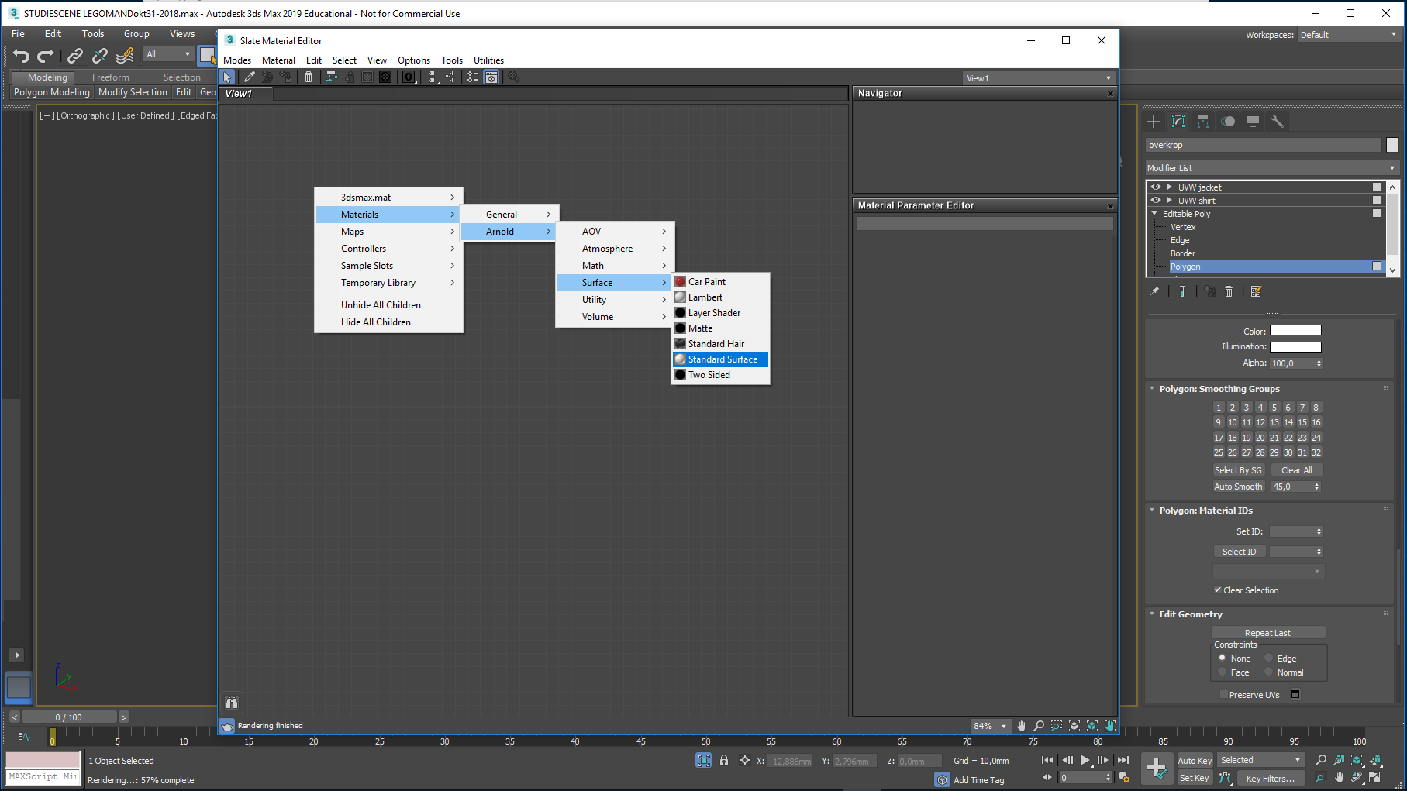
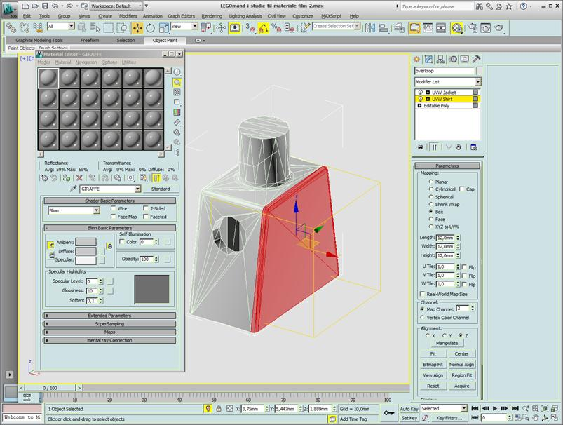
Now we will design two materials - Jacket and Shirt - and after some testing combine them in a new material: Torso-dress. Right-click somewhere in the work area
Select Materials, followed by
Arnold, followed by
Surface, followed by
Standard Surface

Slide 22
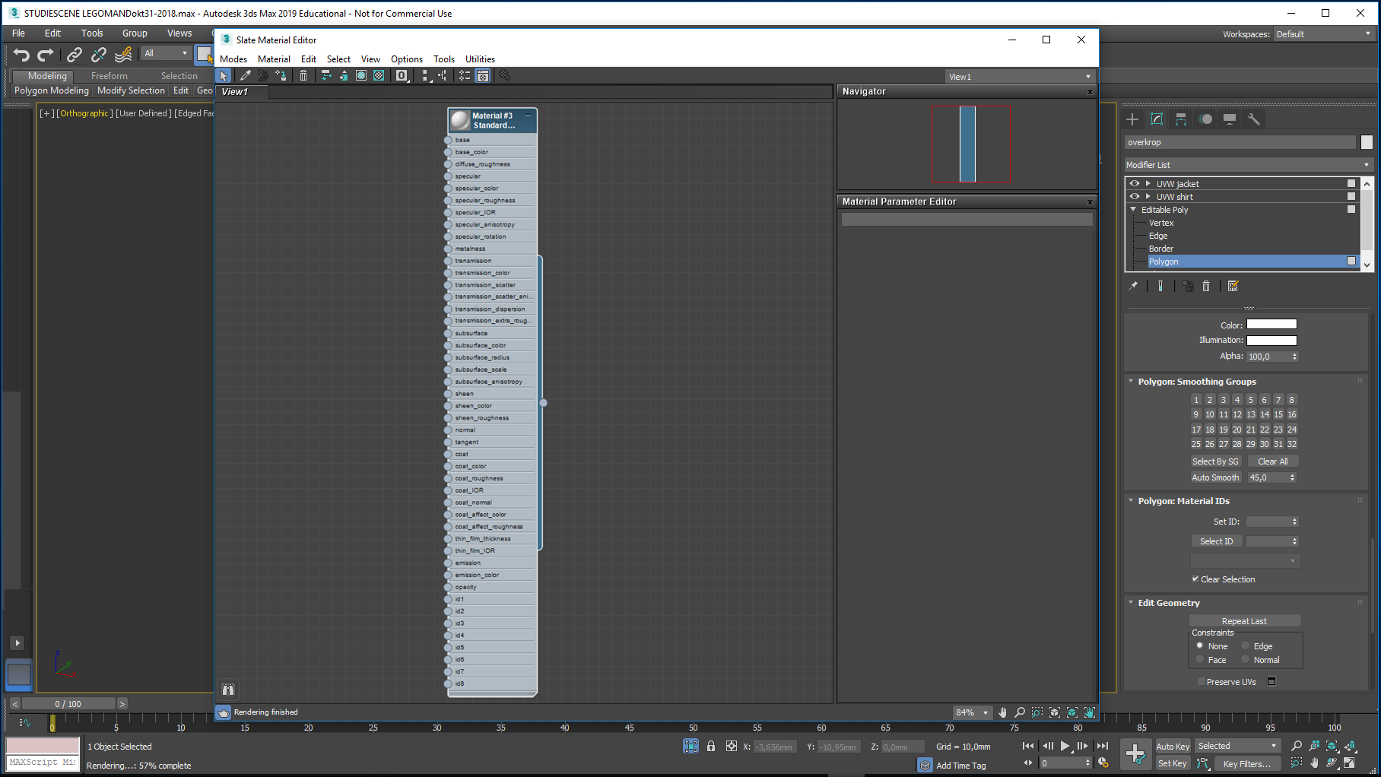
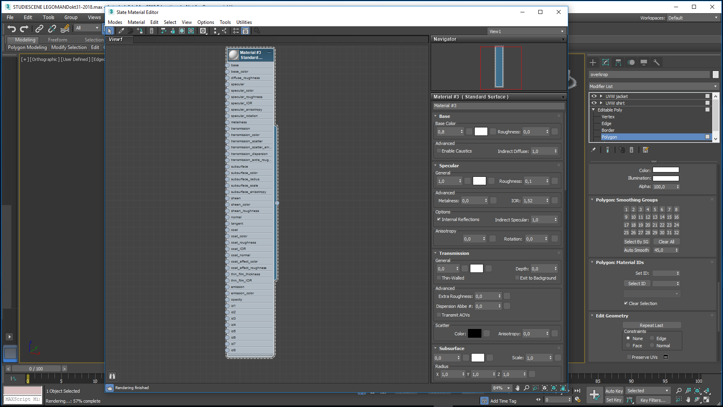
This was standard procedure for creation of a new Arnold material… Now to the editing of this…
Double-click the blue top area,
Giving access to the material Parameters…
There are plenty – we will just adjust a few of them,
But before doing so, we will jump out of the Material Editor to launch a special viewer allowing us to see what happens when we edit the material…

Slide 23
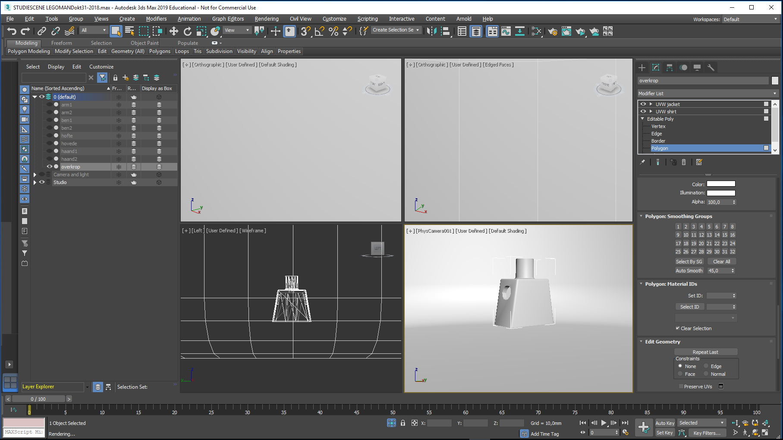
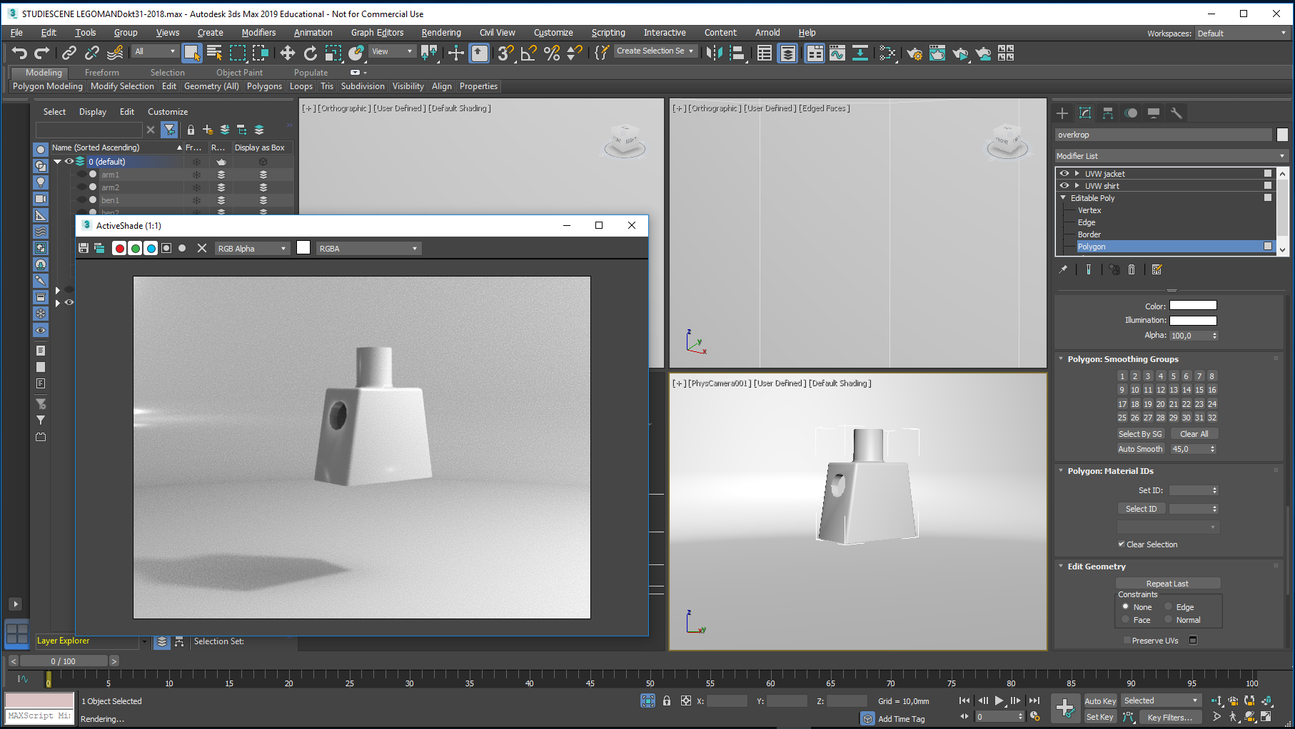
Close the Material Editor, and turn on the Studio layer…
Go in 4-view mode, and make the PhysCamera001 Viewport active
Click and hold this teapot here, and select the Active Shade… (the teapot icon with the small triangle)
Active Shade will automatically pre-render any content in the active viewport

Slide 24
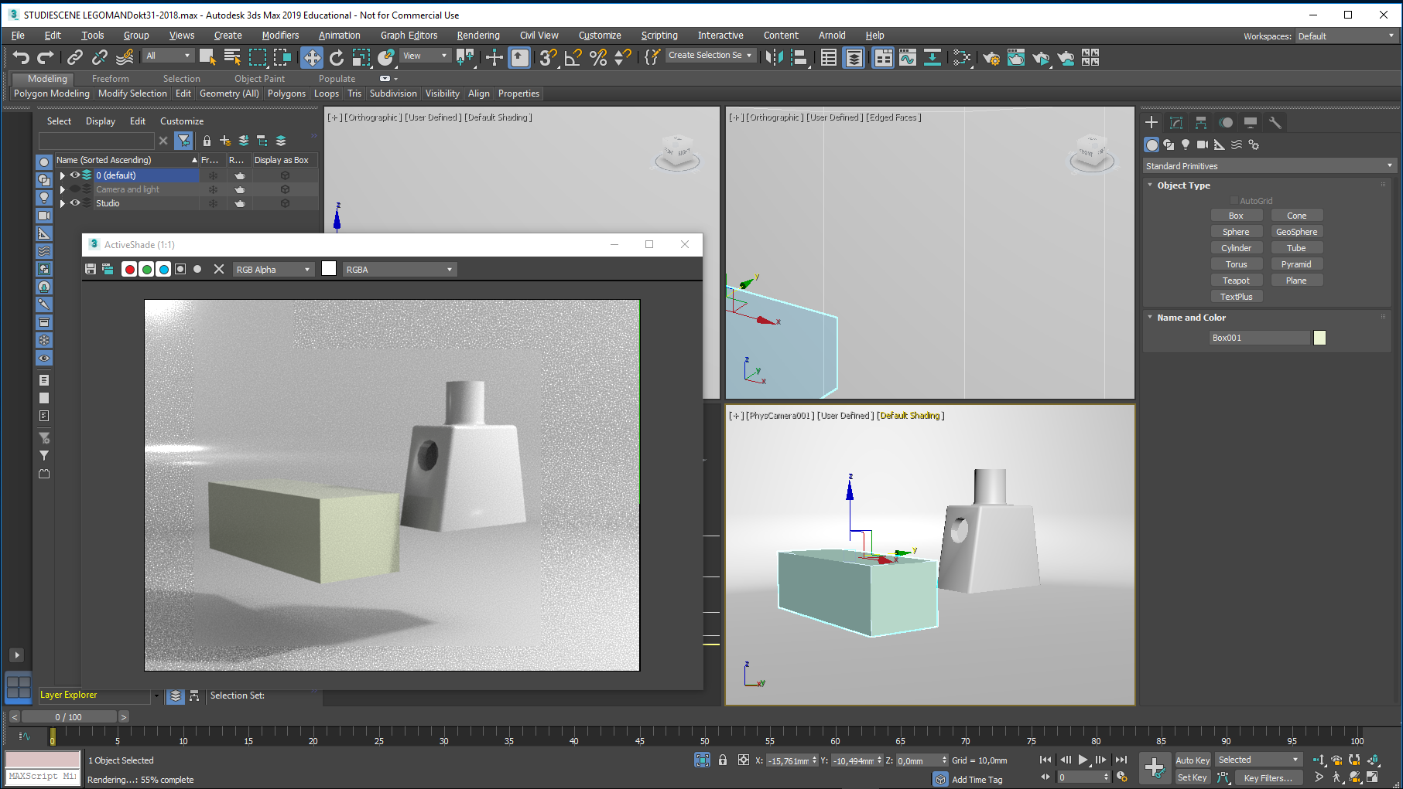
Create a small box, and leave it selected…
The Active Shade window will update accordingly…

Slide 25
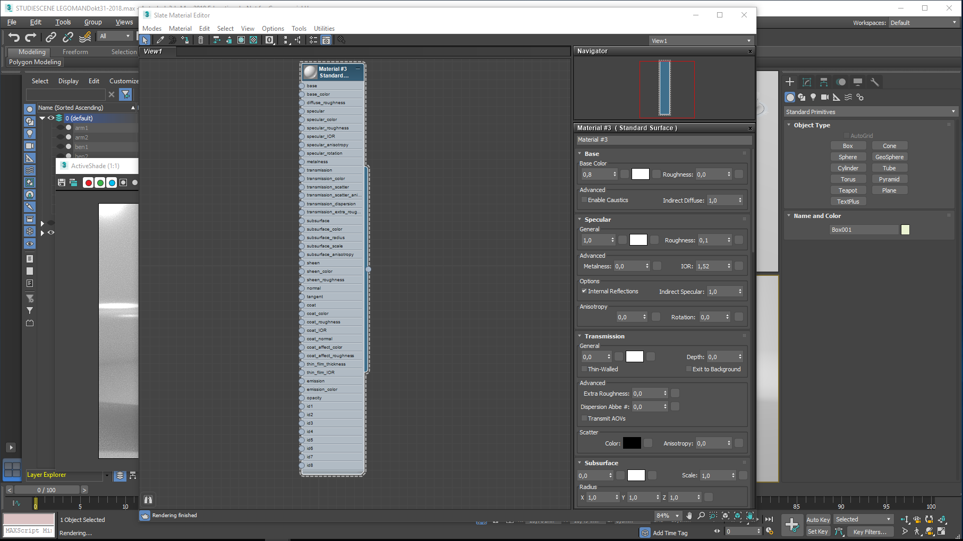
Open the Material Editor…
And right-click in the top blue area on your new material
Select 1) Assign Material to selection…
And select 2) Show shaded Material in Viewport…

Slide 26
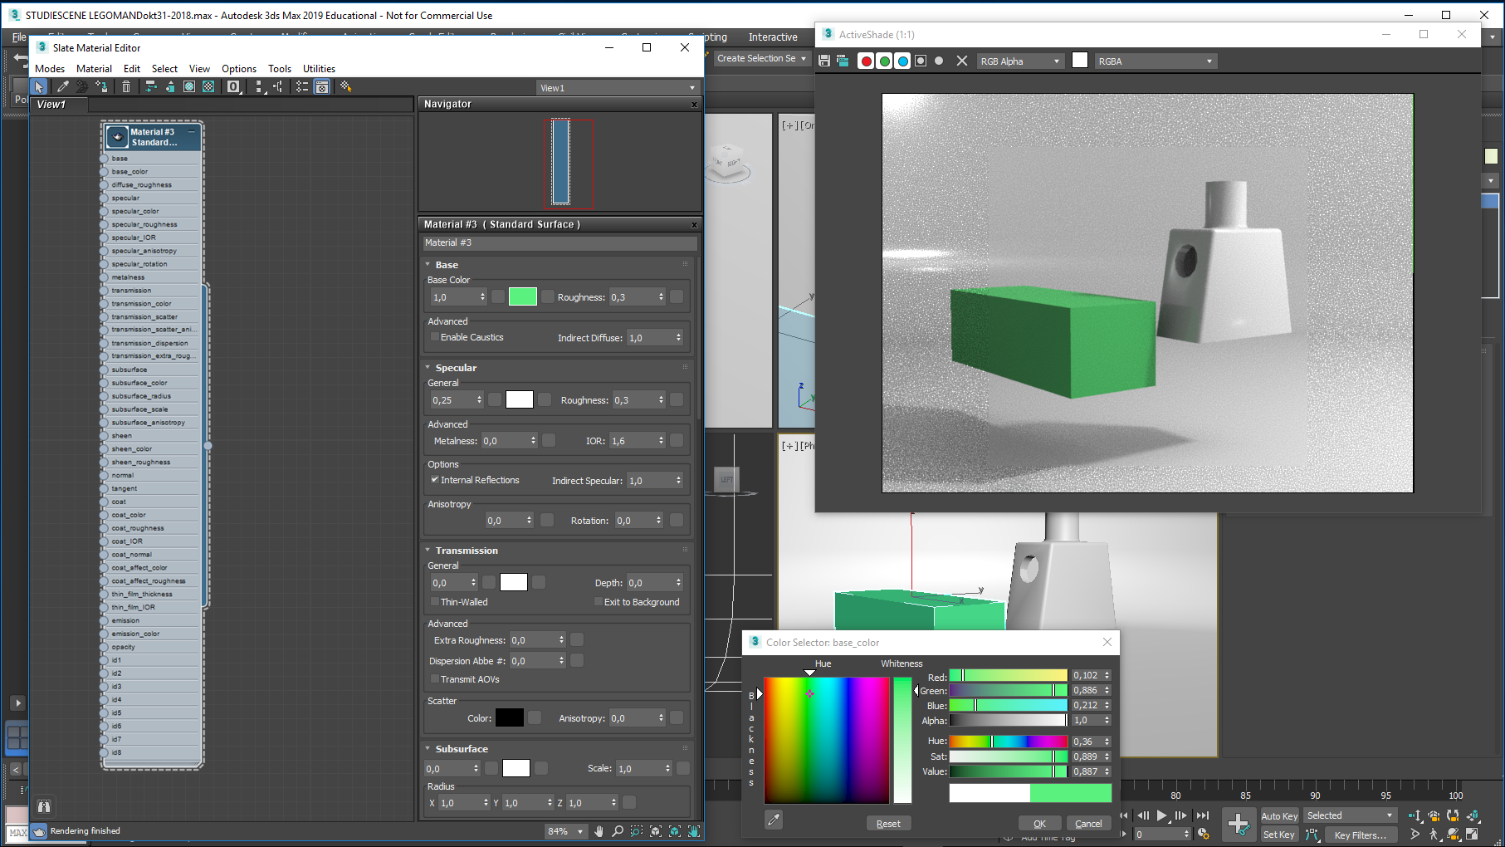
Next, I will create a plastic material with these settings:
Maximize the base Color value (to 1,0…a color intensity value) and enter the Base Color box, selecting a green color. Set Roughness to 0,3
These settings control how the diffuse light hits the box
Base first…
Set the Specular value = 0,25, and set Roughness to 0,3. Set IOR (Index of refraction) to 1,6 (typical plastic value)
These settings control how the Specular light (highlight) hits the box
Then Specular

Slide 27
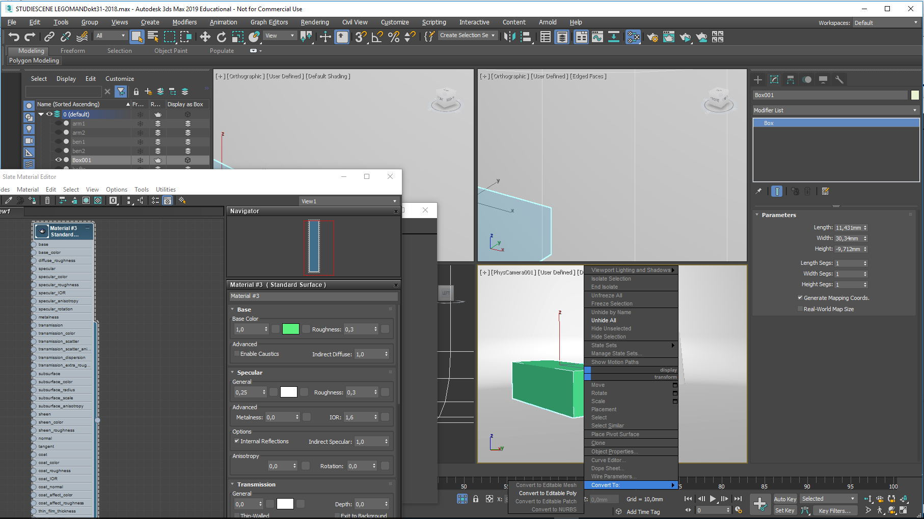
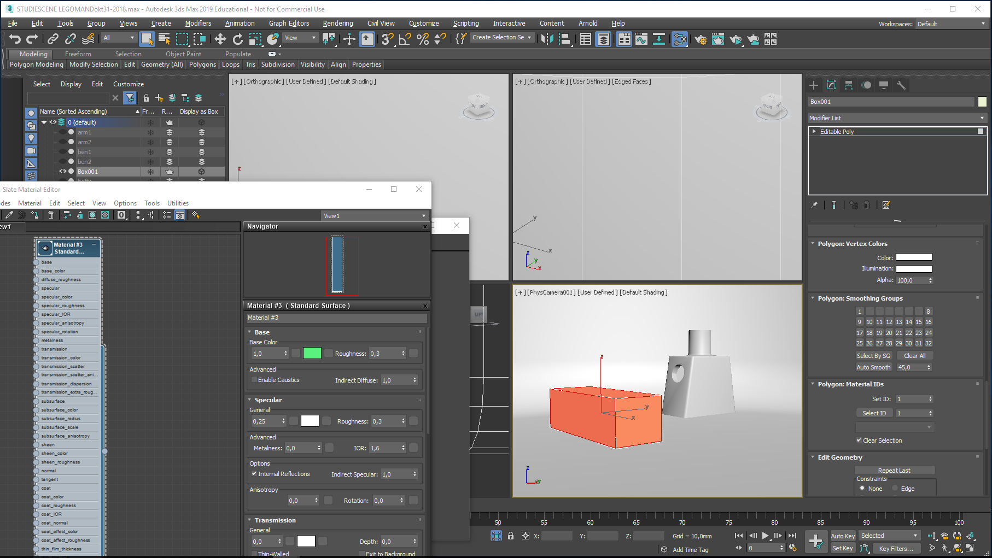
Now, right-click the box and convert it to an Editable Poly…
Enter Polygon level and select all its polygons…
Set the Polygons to an ID value of 1

Slide 28
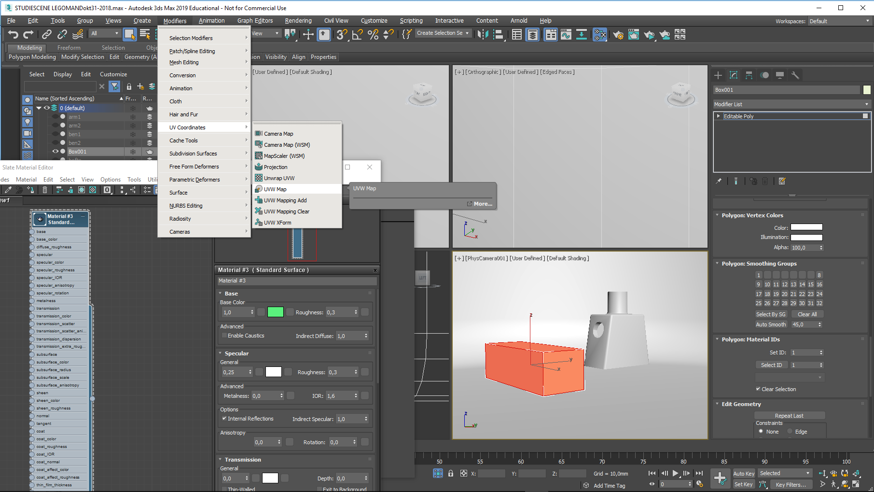
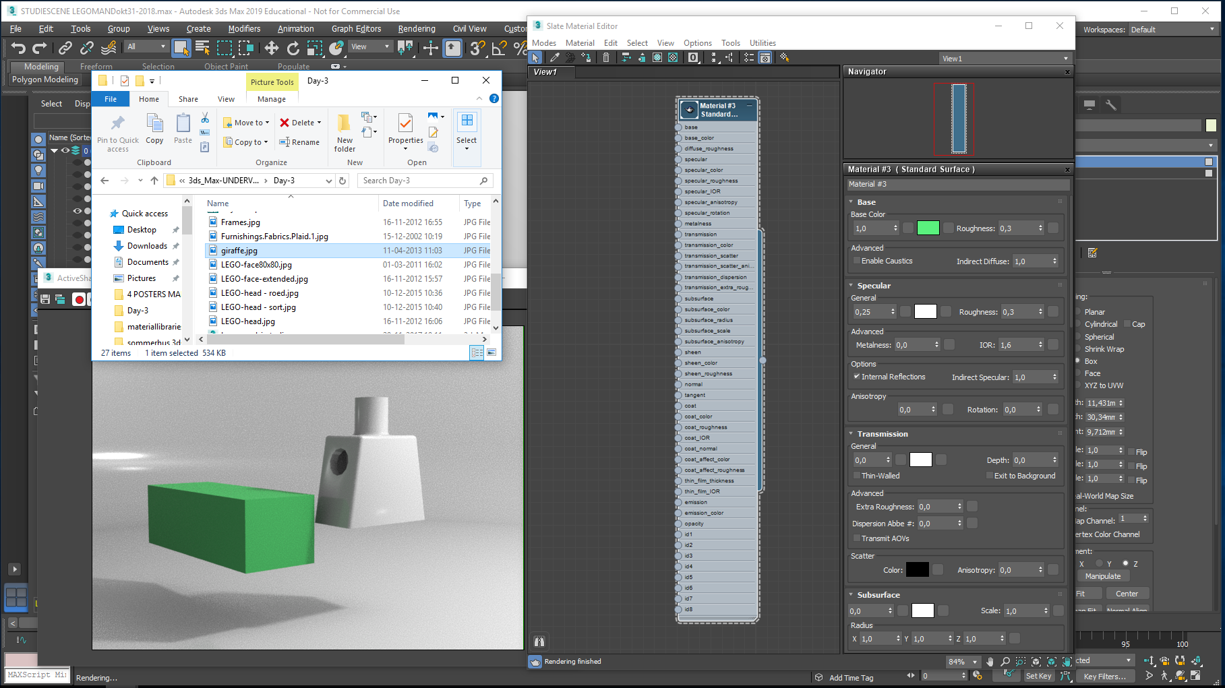
With all the faces still selected, create a UVW map… of a Box type. It will get the shape and size of the box. Default ID value is 1 – this is fine.
Now it is time to look up the image that will serve as a Map for the Jacket material:

Slide 29
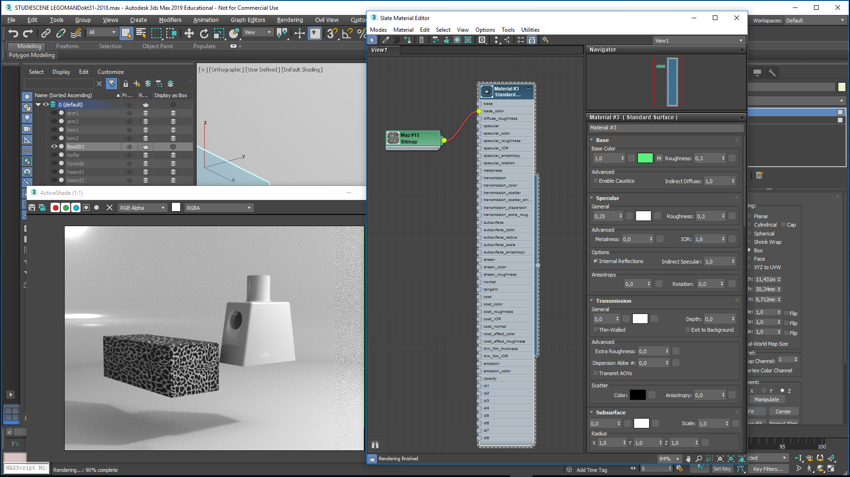
Rename it here: Jacket
Giraffe.jpg has been found…now, pull it from the folder to the working area in the Slate material Editor:
Connect the image(Map…) to the base color as shown
…and watch what happened in the Active Shade window
Jacket material looks OK

Slide 30
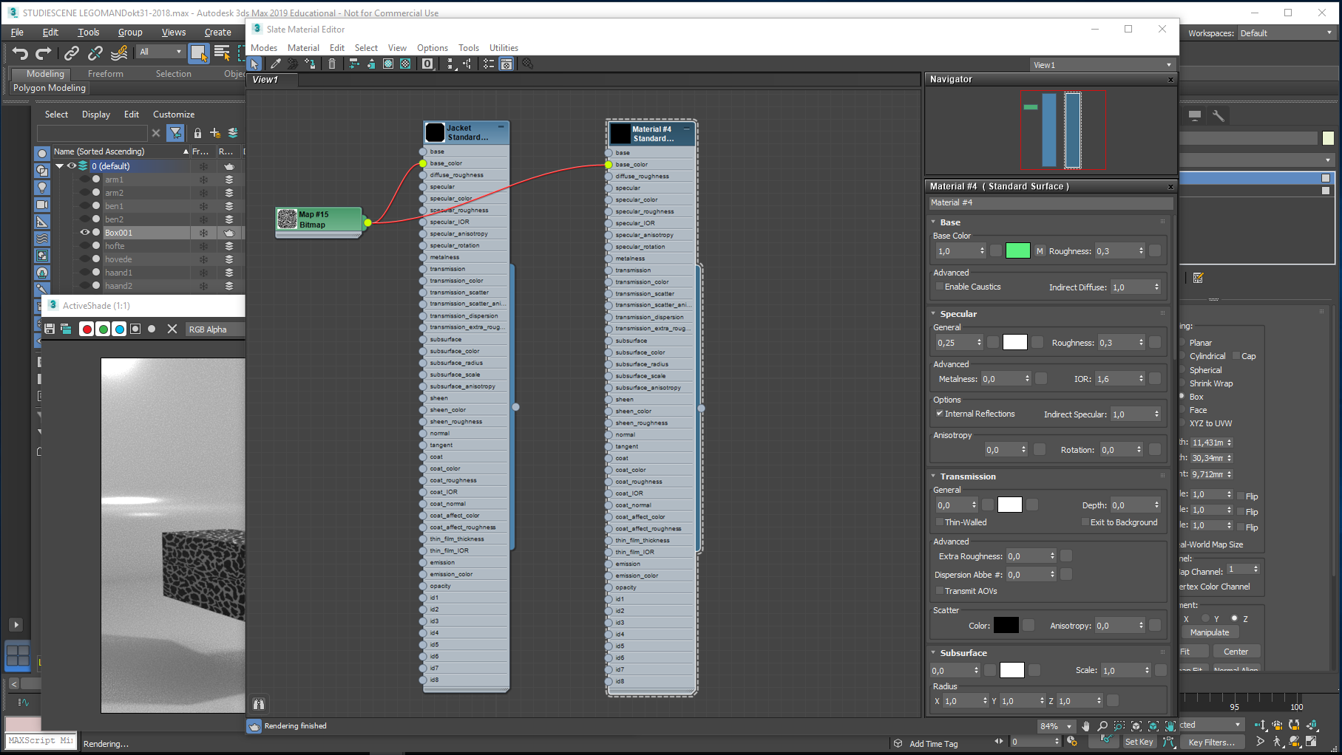
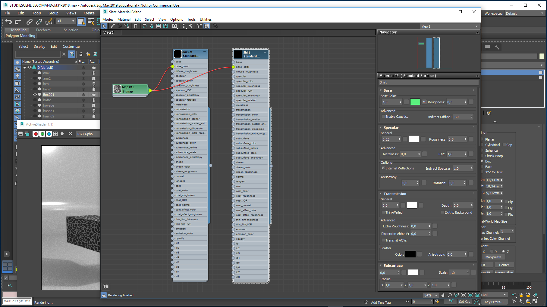
Rename it here: Shirt
The new Shirt material is still an exact copy of the Jacket material…this has to be changed…
Press SHIFT, and click and move in the top blue area on the Jacket material, effectively copying it…
Doubleclick in the new material to access its parameters

Slide 31
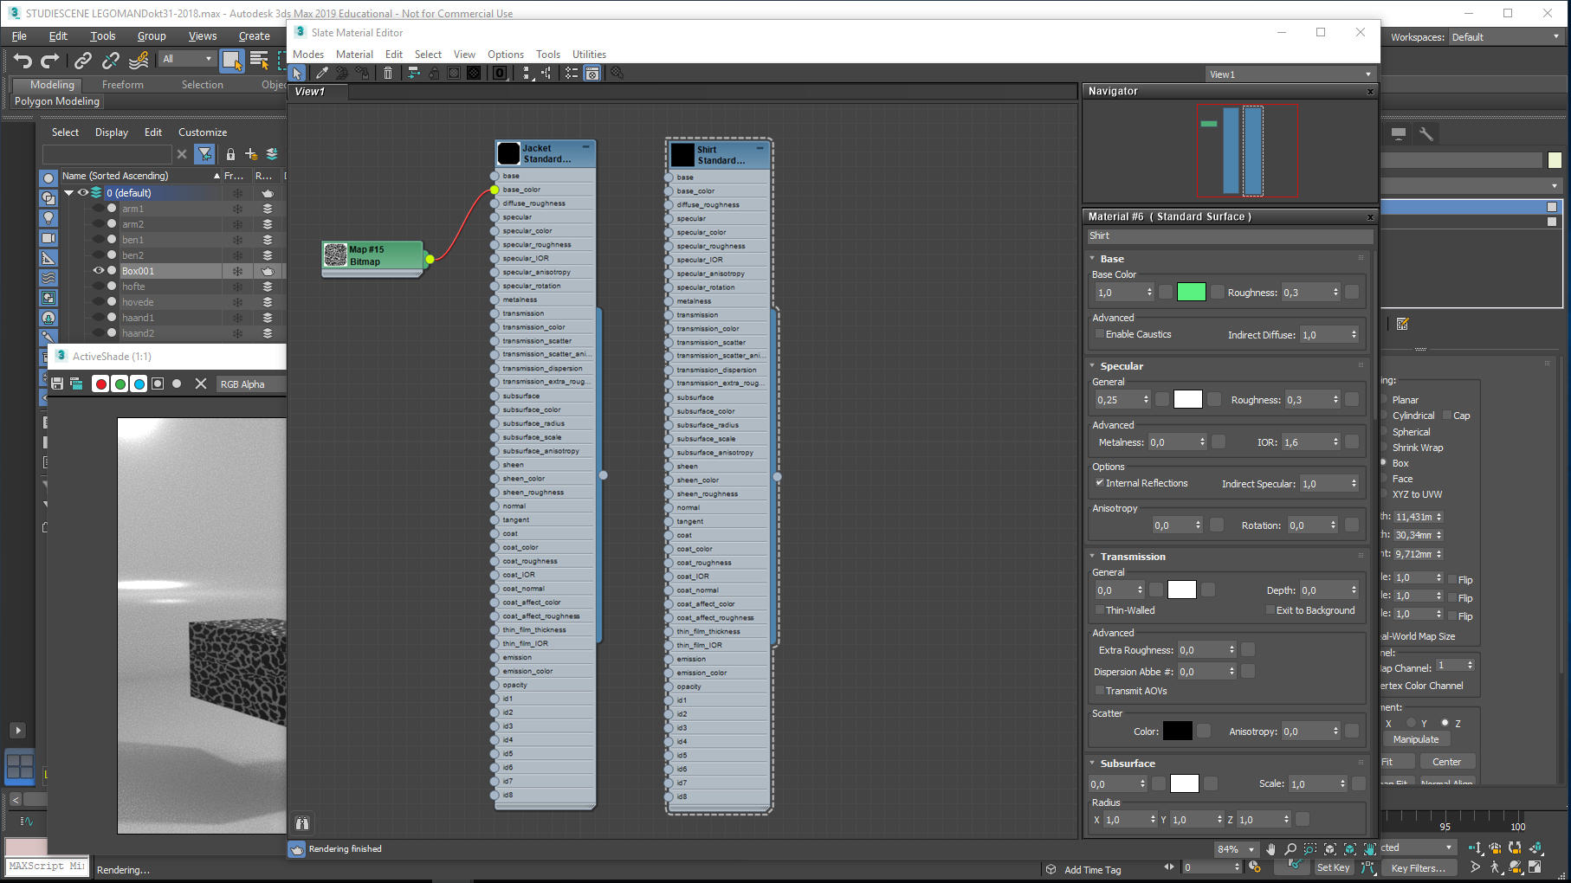
Unplug the Map#15 Bitmap connection to the base color of the Shirt material
Now, look for the Shirt-stribes.jpg image…
Repeat the pull procedure

Slide 32
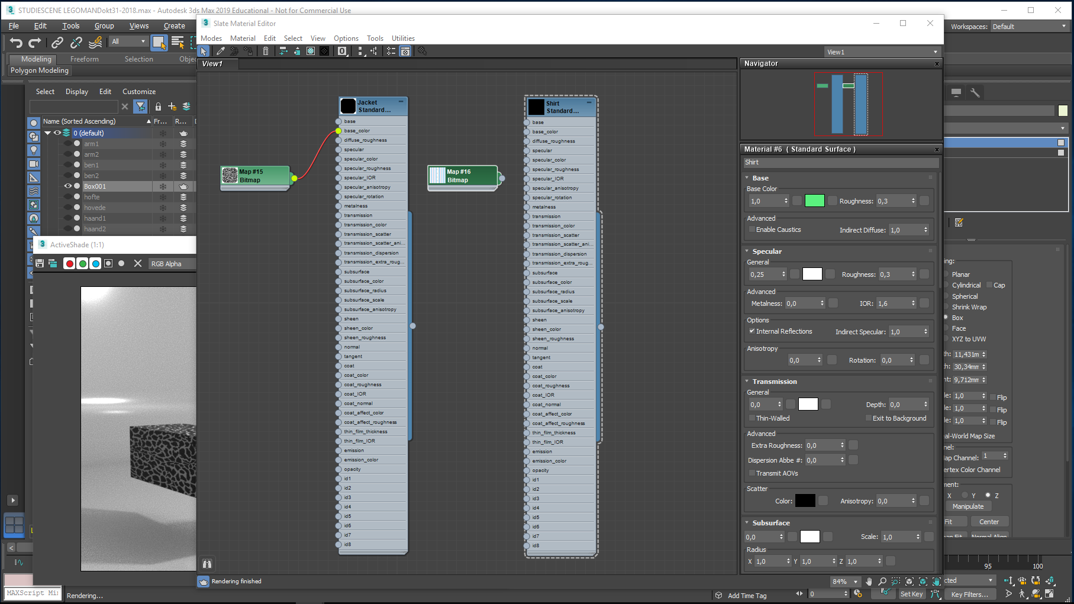
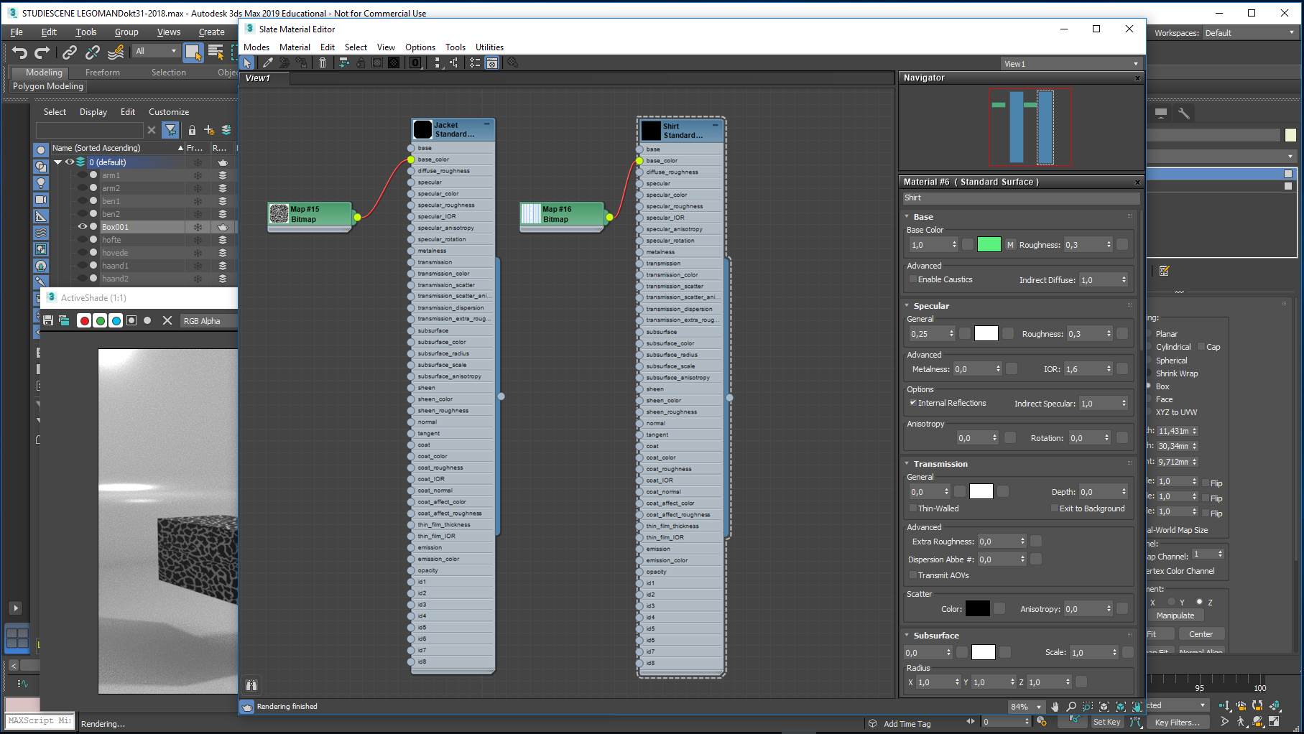
Followed by the connect procedure…
Repeat the pull procedure…

Slide 33
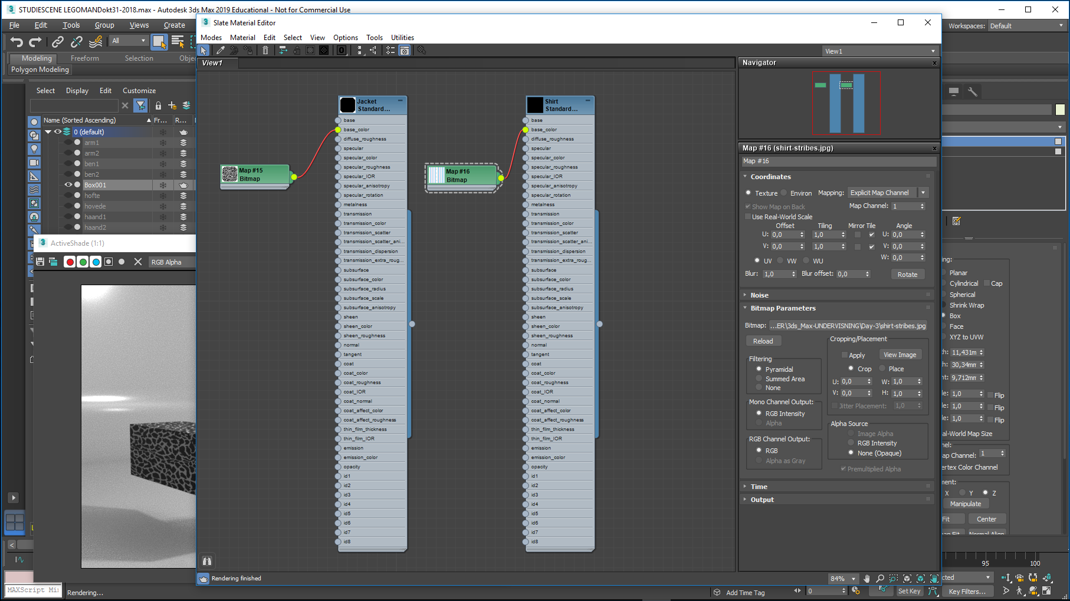
The Shirt material has to change Map Channel (from 1 to 2)
Double click the small map entry (M)
Increase to 2

Slide 34
The Material Editor has been minimized…
Press SHIFT, select the Giraffe patterned box and pull it upwards, effectively copying it…
In the Clone Options dialogue, answer OK to the Copy suggestion…

Slide 35
Make Box002’s UVW Map active
And change its Map Channel from 1 to 2…

Slide 36
Now, enter the Editable Poly entry, select Polygon level
Roll to the bottom of the dialogue and select all its polygons – they probably are selected already – and change their ID from 1 to 2…

Slide 37
Back in the Material Editor select the blue top of the Shirt Material, right-click and select Assign Material to Selection (=box002)

Slide 38
- And look what happened..! It seems we have two functional materials now…
Time to create a Multi-sub material…

Slide 39
Right-click in the work area and select Materials/General/Multi-Sub Object…a new Material appears…
Double-click it to access its parameters
Reduce the numbers from 10 to 2

Slide 40
Only two Sub-materials now…
Connect the Jacket material to entry 1
Do likewise with the Shirt material, only plug it to entry 2
Select the Lego torso,
Right-click the Multi-Sub material (Rename to Torso-dress) and select Assign Material to selection…

Slide 41
The Active Shade window will probably look like this…
For convenience, right-click each material and select Show Shaded material in Viewport…
As the materials are linked, the material on the torso will update too..
The red area indicates viewport visibility..
The Active Shade window will probably look like this…
The shirt is buttoned a bit unconventionally, this needs to be corrected:

Slide 42
The torso is still selected…
The Shirt doesn’t look right…
select the UVW Shirt entry…
Select Y Alignment instead of Z
Shirt looks right…

Slide 43
In the following I have created his right jacket sleeve. The procedure was: Select the arm, right click it and convert it to an Editable Poly… Enter Polygon level, select all the polygons and set their ID = 1… Assign a UVW Map, this time with a Cylindrical mapping as this shape best resembles the geometry of the arm. On the model you can see the UVW map is in need of some adjustment. The UVW cylinder can be adjusted by clicking on the small triangle sign to the left of the UVW name. Underneath is a Gizmo…

Slide 44
Using the UVW Gizmo to rotate and scale, the UVW map has been adjusted…

Slide 45
In the Material Editor right-click the Torso-Dress material and assign it to his arm…

Slide 46
The UVW Map Gizmo is used once more – here by rotation - to fine tune the pattern, so it matches his torso… Additionally you can try out the alignment X Y Z buttons…

Slide 47
His left arm now has got the same treatment… Notice that sometimes things just do not look right, even though you have done everything correctly. Remember to deselect everything when you want to check the looks of your work. If something looks strange even when deselected, you must look for errors in your setup. This calls for detective work and methodology, as the there are many spots where settings could be wrong. Try to apply your material on other items (the test boxes we did earlier) to filter out the error. Some times it works to save your file, close and reopen it. When working with 3ds Max you spend a lot of time tweaking and testing. Getting routine will speed up your work…

Slide 48
Now his head needs some treatment…
Select the head, and convert it to an Editable Poly…
Select all its polygons and assign them ID 1
Deselect the Polygon mode, and deselect the head

Slide 49
We will create a new material in order to improve his looks: Copy the Jacket material: Click the Jacket material to select it, press Shift and with lmb pressed down, drag the cursor to the right…a copy is made… This way we will reuse the Jacket material settings…
Rename the new material Head…

Slide 50
Click on the Map entry and select the Bitmap path in the Material/Map browser…
Unplug the connection to the Map#15 Bitmap

Slide 51
Look up the LEGO-head.jpg and select this…

Slide 52
Create a UVW map for his head, select a cylindrical one, and align this with his head shape

Slide 53
Click the Head Material, right-click it and select Assign Material to selection and Show Shaded Material in Viewport
Use the UVW Map’s Gizmo to rotate and move the map so it fits like this…

Slide 54
In the Material Editor, zoom out so all Materials are visible…
Select them all and delete them…
They still exist, being part of the scene
Create a new Material and doubleclick it…

Slide 55
In the Material Editor, click the Materials Sphere to enlarge it…
make the Camera viewport active…
unhide the studio if it was hidden…
And turn on Active Shade…
Time for the creation of a glass Material…
Select his right leg and apply the new Material to it…
No visual change yet…

Slide 56
Base Color and Roughness value to be 0,0. The color itself doesn’t matter here
Specular Color 1,0 value, color white, Roughness 0,0
IOR 1,52
Transmission Color 1,0 value, color itself: HSV 0,45 – 0,05 – 0,99

Slide 57
Finally, Mr LEGO gets some fancy gold gloves…
Base Color value 1…
Color: HSV 0,12 – 0,6 – 0,95…
Roughness value to be 0,0.
Specular Color value 1…
Color: HSV 0,16 – 0,24 – 0,99…
Metalness 1,0…
IOR 1,52
Transmission Color 0,0 value…
Time for a snapshot…

Slide 58
Production Render…
Image size 800 x 600 – Size is defined in the Common pane
Diffuse Value 10…
Render time 6 min. 10 sec…
The render settings used were identical to those in the VISUALIZATION OF THE LEGO MAN tutorial…
I have so far only touched a few of the many parameters in the Material Editor … You will learn a lot by doing your own experiments and use the Help (F1) in 3ds Max…

